Slide 1
Third Class
Real Time System Design
Programmable Interface Devices
8155/8156
Asst. Lec. Lubna A. Alnabi

Slide 2
Programmable Interface Devices 8155/8156
Programmable Interface Devices
Used to interface an I/O device to the microprocessor.
Can be programmed/configured to perform various I/O functions by writing software instructions.

Slide 3
Programmable Interface Devices 8155/8156
8155/8156 – A Multipurpose Programmable Interface
Its programmable interface device used to interface I/O device to μP, its multifunction device, contain RAM, I/O ports, and timer.
Designed to be compatible with 8085.
It includes:
• 256 bytes of Read/Write memory.
• Three I/O ports (programmable I/O):
o Port A (8-bit).
o Port B (8-bit).
o Port C (6-bit).
• A 14-bit timer.

Slide 4
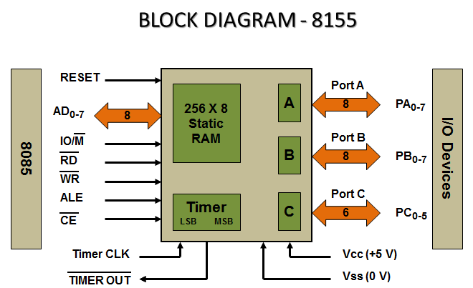
Programmable Interface Devices 8155/8156

Slide 5
Programmable Interface Devices 8155/8156
8155 block diagram shows 5 control signals, all except (CE) are input signal directly generated by the processor; the (CE) is input from decoder.
o CE: chip enable, connected to the decoder.
o IO/M: specify whether the memory section is selected, or I/O section (include timer) is selected.
o ALE: address latch enable.
o RD and WR
o RESET: connect to the RESET out of processor used to reset the chip and initializes I/O ports as input.
• In 8155 we have control register, 3 I/O ports, and 2 register for timer, so we need 3 address lines to decode there register.

Slide 6
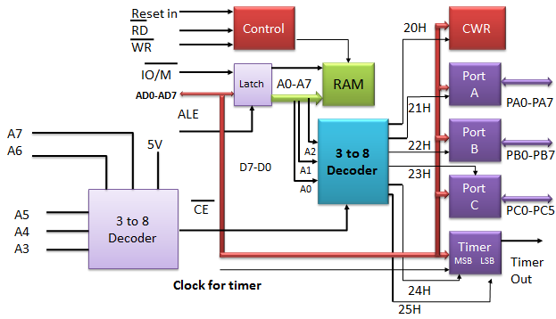
Ex: design (draw) and determine the address of the control/status, I/O ports and timer register of the 8155 if the output of decoder O2?

Slide 7
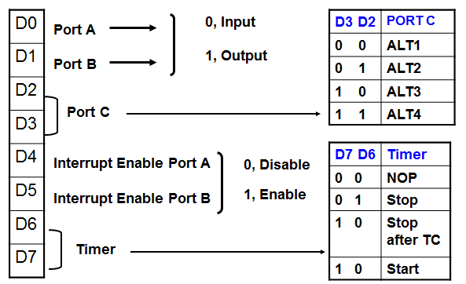
Control word (command reg) format

Slide 9
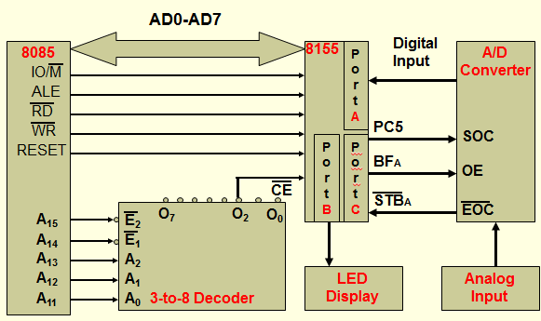
Ex: Design an interfacing circuit to read data from an A/D converter using the 8155A in the peripheral mapped I/O.

Slide 10
