Slide 1
Third Class
Real Time System Design
8259 Programmable Interrupt
Controller (PIC)
Asst. Lec. Lubna A. Alnabi

Slide 2
8259 Programmable Interrupt Controller (PIC)
The interrupt driven data transfer mode is the best method of data transfer for effectively utilizing the processor time. In this mode, the processor first initiates the I/O device for data transfer. After initiating the device, the processor will continue the execution of instructions in the program.

Slide 3
8259 Programmable Interrupt Controller (PIC)
Also at the end of an instruction the processor will check for a valid interrupt signal. If there is no interrupt then the processor will continue the execution. When the I/O device is ready, it will interrupt the processor. On receiving an interrupt signal, the processor will complete the current instruction execution and saves the processor status in stack. Then the processor calls an interrupt service routine (ISR) to service the interrupted device.

Slide 4
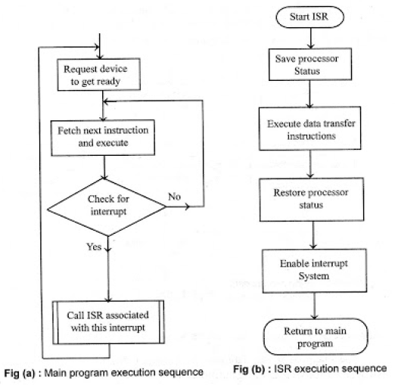

Slide 5
8259 Programmable Interrupt Controller (PIC)
• Able to handle a number of interrupts at a time.
• Takes care of a number of simultaneously appearing interrupt requests along with their types and priorities.
• Compatible with 8-bit as well as 16-bit processors (The 8259A is a programmable interrupt controller designed to work with Intel microprocessor 8080 A, 8085, 8086, 8088).
• One 8259 can accept 8 interrupt requests and allow one by one to processor INTR pin.
• The Programmable Interrupt Controller (PlC) functions as an overall manager in an Interrupt-Driven system.

Slide 6
8259 Programmable Interrupt Controller (PIC)
Features of 8259
• Programmed to work with 8085 & 8086 (Compatible with 8-bit as well as 16-bit processors).
• It manages 8 interrupts according to the instructions written into its control registers.
• The priorities of interrupts are programmable.
• 8259 can be programmed to accept either level triggered or edge triggered
• The interrupts can be masked or unmasked individually.
• The 8259s can be cascaded to accept a maximum of 64 interrupts.

Slide 7
8259 Programmable Interrupt Controller (PIC)
Functional block diagram of 8259:-
It has eight functional blocks. They are
•Control logic
•Read Write logic
•Data bus buffer
•Interrupt Request Register (IRR)
•In-Service Register (ISR)
•Interrupt Mask Register (IMR)
•Priority Resolver (PR)
•Cascade buffer.

Slide 8
