Slide 1
Third Class
Real Time System Design
Input and Output Interfacing
Asst. Lec. Lubna A. Alnabi

Slide 2
Input and Output Interfacing
Input interface:-
The sources of binary information (0, 1) are usually the output of logic gates. It could also be provided by some other circuits such as switches. One of the input interface devices is the three states gate which is usually used to input data from devices to
controlling system.

Slide 3
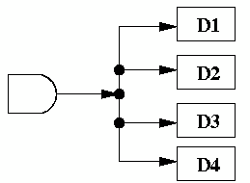
Tri-state buffer
logic gates process 0's and 1's. 0's and 1's are really electric current at certain voltages. If there isn't enough current, it's hard to measure the voltage.
The current can decrease if the fan out is large. Here's an example
The "fan out" is the number of devices that an output is attached to. Thus, the AND gate above is attached to the inputs of four other devices. It has a fan out of 4. If the current coming out of the AND gate is I, then assuming each of the four devices gets equal current, then each device gets I / 4 of the current.

Slide 4
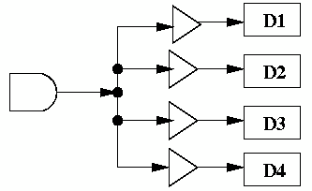
Tri-state buffer
if we put in a buffer:
Then the current can be "boosted" back to the original strength. Thus, a buffer (like all logic gates) is an active device. It requires additional inputs to power the gate, and provide it voltage and current.

Slide 5
Tri-state buffer
A tri-state buffer has two inputs: a data input x and a control input c. The control input acts like a valve. When the control input is active, the output is the input. That is, it behaves just like a normal buffer. The "valve" is open.

Slide 6
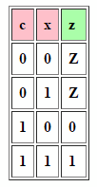
Tri-state buffer
an active-high tri-state buffer

Slide 7
Tri-state buffer
an active-low tri-state buffer

Slide 8
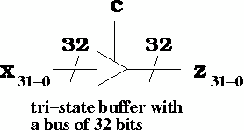
Multi-bit Tri-State Buffers
In this case, we have 32 wires coming into the tri-state buffer. We have 32 wires coming out of the tri-state buffer. There's still only 1 control bit.
This can easily be implemented using 32 tri-state buffers taking one bit as input and one bit as output.

