Slide 1
2018-2019
رهاط ةزمحلا .م : ةداملا سردم
Digital Communications
CTE Department -3rd stage
Reference: Digital Communications Fundamentals and Applications,
2nd Addition, by FernardSklar
Dr. Hussam Dheaa Kamel
Al-Mustafa University Collage CTE Department 2018-2019

Slide 2
Digital Communications
CTE Department -3rd stage
Chapter Four Band pass waveform
Introduction:
When a digital is to be transmitted over a long distance, it needs Continue Wave (CW) modulation. A high frequency carrier of 𝑓₀ is modulated, then 𝑓₀has some deviation called bandpass transmission which is not start from 0 Hz.
When it is required to transmit digital signals on banpass channel, the amplitude, frequency or phase of sinusoidal carrier is varied in accordance with the incoming digital data, then it is called Amplitude Shift Keying (ASK), Frequency Shift Keying (FSK) and Phase Shift Keying (PSK) respectively. Instead of transmitting one bit, it can be transmit two or more bits simultaneously. This called M-ary transmission, which result in reduce channel bandwidth.
Any digital modulation scheme should satisfy the following requirements:
Maximum data rate.
Maximum resistance to interfering signals.
Minimum probability of symbol error.
Minimum channel bandwidth.
Minimum transmitted power.
Minimum circuit complexity.

Slide 3
Digital Communications CTE Department -3rd stage
1- Binary Phase Shift Keying(BPSK):
In BPSK, binary "1" and "0" modulate the phase of the carrier. Let the carrier be,
𝑠(𝑡) = 𝐴𝑐𝑜𝑠(2𝜋𝑓₀𝑡)
If the load resistance is standard 1Ω, the power dissipated will be
1
2
𝑃 = ₂ 𝐴 → 𝐴 = √2𝑃
If the symbol is 1
𝑠₁(𝑡) = √2𝑃𝑐𝑜𝑠(2𝜋𝑓₀𝑡)
If next symbol is 0
𝑠₂(𝑡) = √2𝑃𝑐𝑜𝑠(2𝜋𝑓₀𝑡 + 𝜋) = −√2𝑃𝑐𝑜𝑠(2𝜋𝑓₀𝑡)
Thus we can define BPSK as:
𝑠(𝑡) = 𝑏(𝑡)√2𝑃𝑐𝑜𝑠(2𝜋𝑓₀𝑡)
𝑤ℎ𝑒𝑟𝑒 𝑏(𝑡) = +1 𝑓𝑜𝑟 𝑏𝑖𝑛𝑎𝑟𝑦 1 𝑎𝑛𝑑 − 1 𝑓𝑜𝑟 𝑏𝑖𝑛𝑎𝑟𝑦 0 𝑎𝑠 𝑠ℎ𝑜𝑤𝑛 𝑖𝑛 𝐹𝑖𝑔. 1

Slide 4
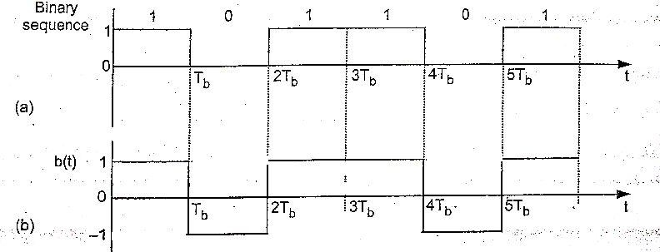
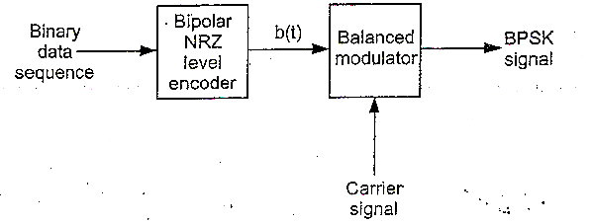
Digital Communications
CTE Department -3rd stage
Figure 1
1-1 BPSK generation:
The BPSK signal can be generated by applying carrier signal to the balanced modulator. The baseband signal 𝑏(𝑡) is applied as modulating signal to the balanced modulator as shown in Fig. 2.
Figure 2

Slide 5
Digital Communications
CTE Department -3rd stage
Fig. 3 shows the waveform of BPSK
1-2 The spectrum and bandwidth of BPSK:
The Fourier transform of modulating signal which is consider here as NRZ bipolar, its amplitude is ±𝑉_{𝑏} and each
pulse is ± ^{𝑇𝑏} :
2
sin(𝜋𝑓𝑇 )
𝑋(𝑓) = 𝑉 𝑇
𝑏
(𝜋𝑓𝑇_{𝑏})
𝑏 𝑏
The power spectral density 𝑆(𝑓)is:
_{𝑆(𝑓) = |}⃑⃑_{𝑋}⃑⃑⃑⃑₍⃑⃑_{𝑓}⃑⃑⃑₎⃑ |2_{/𝑇𝑠}
So that
[𝑉 𝑇
sin(𝜋𝑓𝑇_{𝑏})]²
𝑆(𝑓) =
𝑏 𝑏
(𝜋𝑓𝑇_{𝑏})
𝑇_{𝑠}
For BPSK 𝑇_{𝑏} = 𝑇_{𝑠} and;

Slide 6
Digital Communications
CTE Department -3rd stage
𝑆(𝑓) = 𝑉²𝑇_{𝑏} [
sin(𝜋𝑓𝑇_{𝑏}) ²
𝑏
(𝜋𝑓𝑇_{𝑏})
]
The shape of psd for NRZ is shown in Fig. 4
Figure 4
After modulation the spectrum of BPSK is centered around the carrier frequency 𝑓₀. If 𝑓_{𝑏} = 1/𝑇_{𝑏} then the maximum frequency in the baseband signal will be 𝑓_{𝑏}, from Fig. 5 the bandwidth of BPSK can be calculated as:
𝐵𝑊 = 𝑓₀ + 𝑓_{𝑏} − (𝑓₀ − 𝑓_{𝑏}) = 2𝑓_{𝑏}
Thus the minimum bandwidth of BPSK signal is equal to twice of the highest frequency contained in baseband signal.

Slide 7
Digital Communications
CTE Department -3rd stage
Figure 5
1-3 Detection of BPSK (Coherent Detection):
Fig. 6 shows the bock diagram of the scheme to recover baseband signal from BPSK signal. The transmitted signal is:
𝑠(𝑡) = 𝑏(𝑡)√2𝑃𝑐𝑜𝑠(2𝜋𝑓₀𝑡)

Slide 8
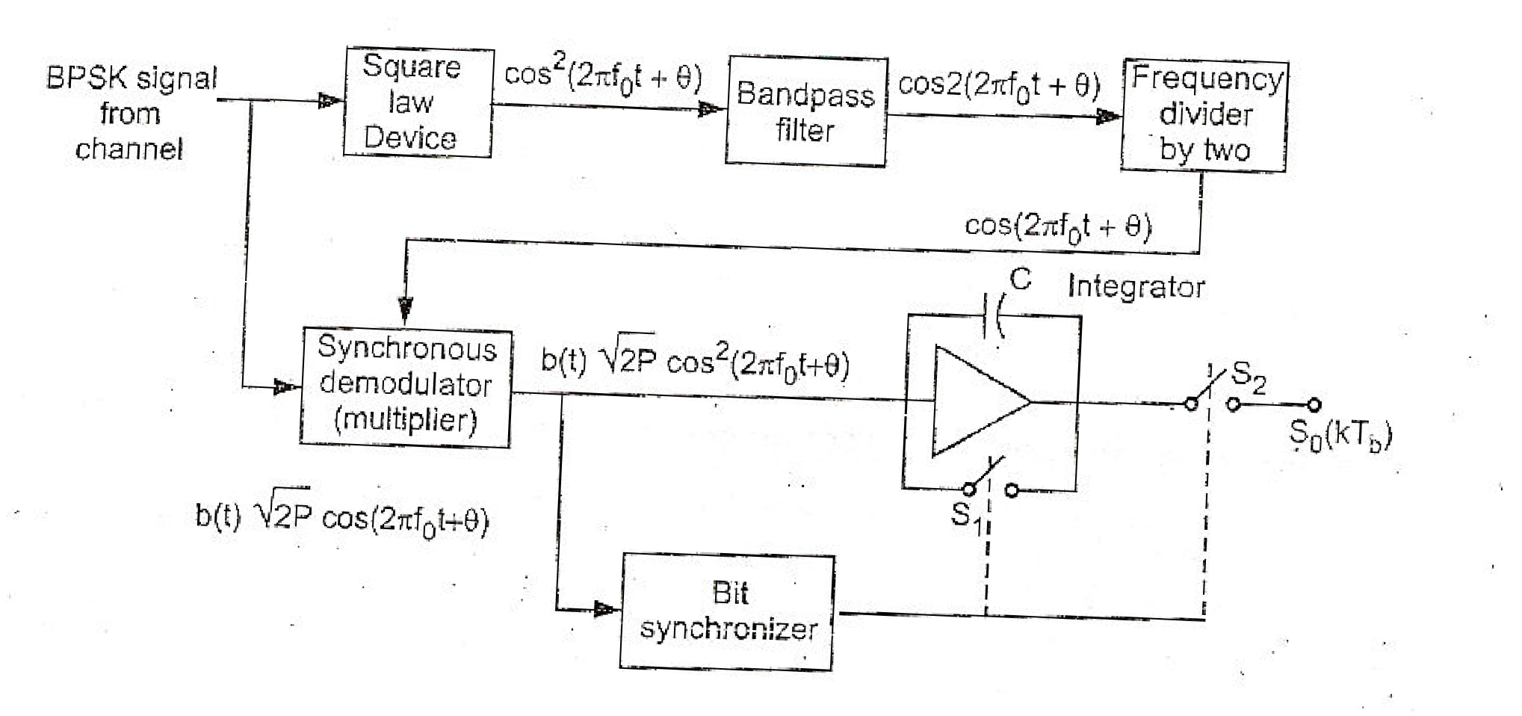
Digital Communications
CTE Department -3rd stage
Figure 6
The received signal is:
𝑠(𝑡) = 𝑏(𝑡)√2𝑃𝑐𝑜𝑠(2𝜋𝑓₀𝑡 + 𝜃)
Since it is coherent detection the signal is separated and then multiplied with its self in the synchronous demodulator. The part of received signal that pass through square low device is:
2₍
1 1
𝑐𝑜𝑠 2𝜋𝑓₀𝑡 + 𝜃) = ₂ + ₂ 𝑐𝑜𝑠2(2𝜋𝑓₀𝑡 + 𝜃)
The band pass filter will remove the DC component (1/2), so we get 𝑐𝑜𝑠2(2𝜋𝑓₀𝑡 + 𝜃), and pass through frequency divider to get 𝑐𝑜𝑠(2𝜋𝑓₀𝑡 + 𝜃) as second input to the multiplier. At the output of multiplier we get:

Slide 9
Digital Communications
CTE Department -3rd stage
𝑏(𝑡)√2𝑃𝑐𝑜𝑠(2𝜋𝑓₀𝑡 + 𝜃) × 𝑐𝑜𝑠(2𝜋𝑓₀𝑡 + 𝜃) = 𝑏(𝑡)√2𝑃𝑐𝑜𝑠²(2𝜋𝑓₀𝑡 + 𝜃)
= 𝑏(𝑡)√2𝑃 × ¹ × [1 + 𝑐𝑜𝑠2(2𝜋𝑓 𝑡 + 𝜃)]
2
0
= 𝑏(𝑡)√𝑃/2 × [1 + 𝑐𝑜𝑠2(2𝜋𝑓₀𝑡 + 𝜃)]
The integrator integrate the signal over one bit period. The bit synchronizer take care of starting and ending times of a bit. At the end of bit duration 𝑇_{𝑏}, the synchronizer closes switch 𝑆₂ temporarily which is same to sampling to output of integrator. The synchronizer then opens switch 𝑆₂ and switch 𝑆₁ is closed temporarily. This reset integrator voltage to zero to integrate next bit and so on. In the 𝑘^{𝑡ℎ} bit interval we can write output signal as,
𝑘𝑇_{𝑏}
𝑃
∫ [1 + 𝑐𝑜𝑠2(2𝜋𝑓₀𝑡 + 𝜃)]𝑑𝑡
(𝑘−1)𝑇_{𝑏}
𝑘𝑇_{𝑏}
𝑆₀(𝑘𝑇_{𝑏}) = 𝑏(𝑘𝑇_{𝑏})√₂
𝑘𝑇_{𝑏}
𝑃
∫ 1𝑑𝑡 +
(𝑘−1)𝑇_{𝑏}
∫ [𝑐𝑜𝑠2(2𝜋𝑓₀𝑡 + 𝜃)]𝑑𝑡]
(𝑘−1)𝑇_{𝑏}
= 𝑏(𝑘𝑇_{𝑏})√₂ [
Here ∫^{𝑘𝑇𝑏} [𝑐𝑜𝑠2(2𝜋𝑓₀𝑡 + 𝜃)]𝑑𝑡 = 0, because the average value of sinusoidal waveform is zero if integration performed
(𝑘−1)𝑇_{𝑏}
over full cycles, so that above equation becomes:

Slide 10
Digital Communications
CTE Department -3rd stage
𝑘𝑇_{𝑏}
∫
(𝑘−1)𝑇_{𝑏}
𝑃
𝑆₀(𝑘𝑇_{𝑏}) = 𝑏(𝑘𝑇_{𝑏})√₂
1𝑑𝑡
√
𝑃
𝑘𝑇_{𝑏} (𝑘−1)𝑇
√
𝑃
= 𝑏(𝑘𝑇 ) [𝑡]
= 𝑏(𝑘𝑇 )
{𝑘𝑇_{𝑏} − (𝑘 − 1)𝑇_{𝑏}}
𝑏
2
𝑏
𝑏
2
𝑃
𝑆₀(𝑘𝑇_{𝑏}) = 𝑏(𝑘𝑇_{𝑏})√₂ 𝑇_{𝑏}
This equation shows that the output of the receiver depending upon the value of 𝑏(𝑘𝑇_{𝑏}) to generate the output of 𝑆₀(𝑘𝑇_{𝑏})
2- Binary Frequency Shift Keying (BFSK):
In BFSK the frequency of the carrier is shifted according to the binary symbol. Let there be a frequency shift by Ω. Then
we can write following equations:
𝑖𝑓 𝑏(𝑡) = 1;
𝑖𝑓 𝑏(𝑡) = 0;
𝑠_{𝐻}(𝑡) = √2𝑃_{𝑠} cos(2𝜋𝑓₀ + Ω) 𝑡
𝑠_{𝐿}(𝑡) = √2𝑃_{𝑠} cos(2𝜋𝑓₀ − Ω) 𝑡
We can combine above equations as:
𝑠(𝑡) = √2𝑃_{𝑠} cos(2𝜋𝑓₀ + 𝑑(𝑡)Ω) 𝑡

Slide 11
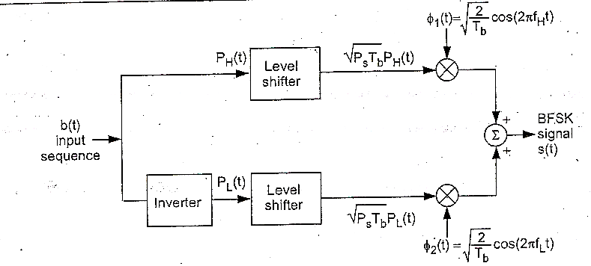
Digital Communications CTE Department -3rd stage
Thus when symbol "1" is to be transmitted, the carrier frequency will be 𝑓₀ + (Ω/2𝜋), and 𝑓₀ − (Ω/2𝜋) for symbol "0".
2-1 BFSK generation:
Fig. 7 shows the block diagram of BFSK generator, the input sequence 𝑏(𝑡) is the same as 𝑃_{𝐻}(𝑡), but an inverter is added to get 𝑃_{𝐿}(𝑡).
Figure 7
Each of 𝑃_{𝐻}(𝑡) and 𝑃_{𝐿}(𝑡) are unipolar signals. If the input to level shifter is "1" then its output is √𝑃_{𝑠}𝑇_{𝑏}, and zero if the input is "0".

Slide 12
Digital Communications CTE Department -3rd stage
After level shifter there are product modulators with two carriers ∅₁(𝑡) and ∅₂(𝑡) orthogonal with each other. In one bit period of input signal 𝑇_{𝑏}, ∅₁(𝑡) or ∅₂(𝑡) have integral number of cycles. Not that the output of both multiplier is not possible because ∅₁(𝑡) and ∅₂(𝑡) are complementary to each other as shown in Fog. 8.
Figure 8
2-2 The spectrum and bandwidth of BFSK:
The output of BFSK generator can be write as:
𝑠(𝑡) = √2𝑃_{𝑠}𝑃_{𝐻}(𝑡) cos(2𝜋𝑓_{𝐻}𝑡) + √2𝑃_{𝑠}𝑃_{𝐿} (𝑡) cos(2𝜋𝑓_{𝐿} 𝑡)
The above equation is the BFSK signal equation:
𝑠_{𝐵𝑃𝑆𝐾}(𝑡) = √2𝑃𝑏(𝑡) cos(2𝜋𝑓₀𝑡)

Slide 13
Digital Communications CTE Department -3rd stage
The equation of BPSK is similar to BFSK but 𝑏(𝑡) is a bipolar signal while the coefficient 𝑃_{𝐻}(𝑡) and 𝑃_{𝐿}(𝑡) are unipolar. Therefore let convert those coefficients in bipolar form as follows:
1 1
′
𝑃_{𝐻}(𝑡) = + 𝑃 (𝑡)
2 2
𝐻
And
1 1
′
𝑃_{𝐿}(𝑡) = + 𝑃 (𝑡)
2 2
𝐿
Here 𝑃′ (𝑡) and 𝑃′(𝑡) will be bipolar (i.e. +1 𝑜𝑟 − 1). Substitute those value in BFSK equation, we get:
𝐻 𝐿
1 1
′
1 1
′
𝑠(𝑡) = √2𝑃 [
+ 𝑃
(𝑡)] cos(2𝜋𝑓 𝑡) + √2𝑃 [
+ 𝑃
(𝑡)] cos(2𝜋𝑓 𝑡)
𝑠
2 2
𝐻
𝐻 𝑠
2 2
𝐿
𝐿
√𝑃_{𝑠}
𝑃_{𝑠}
𝑃_{𝑠}
𝑃_{𝑠}
√ √
′
√
′
= cos(2𝜋𝑓 𝑡) + cos(2𝜋𝑓 𝑡) +
𝑃 (𝑡)cos(2𝜋𝑓 𝑡) +
𝑃 (𝑡)cos(2𝜋𝑓 𝑡)
𝐻 𝐿 𝐻 𝐻
𝐿 𝐿
2 2 2 2
In the above equation the first two terms represent two frequencies 𝑓_{𝐻} and 𝑓_{𝐿} with constant amplitude while the last two terms are similar to BPSK.
𝑃_{𝑠} 𝑃_{𝑠}𝑇_{𝑏} sin(𝜋𝑓_{𝐻} 𝑇_{𝑏}) ² 𝑃_{𝑠}𝑇_{𝑏} sin(𝜋𝑓_{𝐿} 𝑇_{𝑏}) ²
𝑆(𝑓) = √ ₂ {𝛿(𝑓 − 𝑓_{𝐻} ) + 𝛿(𝑓 − 𝑓_{𝐿})} +
2 [ (𝜋𝑓_{𝐻}𝑇_{𝑏}) ^{] +} 2 [ (𝜋𝑓_{𝐿}𝑇_{𝑏}) ]

Slide 14
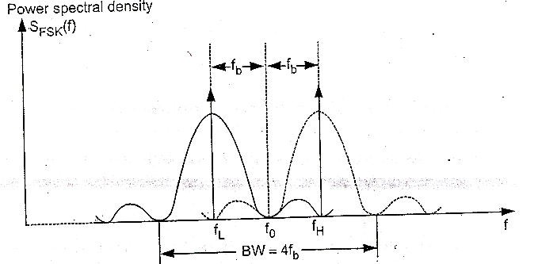
Digital Communications CTE Department -3rd stage
Fig.9 shows the power spectral density of BFSK signal given by above equation:
Figure 9
It is clear that the width of one lobe is 2𝑓_{𝑏} so that the total bandwidth:
𝐵𝑊 = 2𝑓_{𝑏} + 2𝑓_{𝑏}
or
𝐵𝑊 = 4𝑓_{𝑏}
𝐵𝑊(𝐵𝐹𝑆𝐾) = 2 × 𝐵𝑊(𝐵𝑃𝑆𝐾)
so that

Slide 15
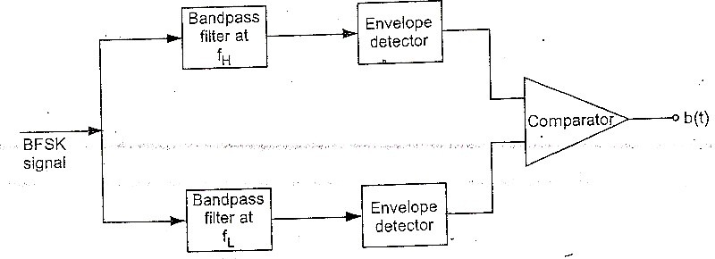
Digital Communications
CTE Department -3rd stage
2-3 BFSK detection:
The block diagram of BFSK receiver is consist of two bandpass filters one with center frequency 𝑓_{𝐻} and other with 𝑓_{𝐿} , since
𝑓_{𝐻} − 𝑓_{𝐿} = 2𝑓_{𝑏}, the output do not overlap. The output of filters are applied to envelop detectors. The outputs of detectors are compared by the comparator, which introduced bit sequence 𝑏(𝑡).
Figure 9

Slide 16
Digital Communications
CTE Department -3rd stage
2-4 Advantages and disadvantages of BFSK:
Even though the generation of BFSK is easier, it has many disadvantages compared with BPSK: a- The bandwidth is almost double bandwidth of BPSK.
b- If we expand the equation of BFSK:
𝑠(𝑡) = √2𝑃_{𝑠} cos(2𝜋𝑓₀ + 𝑑(𝑡)Ω) 𝑡
𝑠(𝑡) = √2𝑃_{𝑠}𝑐𝑜𝑠{𝑑(𝑡)Ω} cos(2𝜋𝑓₀𝑡) − √2𝑃_{𝑠}𝑠𝑖𝑛{𝑑(𝑡)Ω} sin(2𝜋𝑓₀𝑡)
Since 𝑑(𝑡) = ±1 ∴ 𝑐𝑜𝑠{±Ω𝑡} = cos(Ω𝑡)
And 𝑠𝑖𝑛{±Ω𝑡} = ±𝑠𝑖𝑛(Ω𝑡) = 𝑑(𝑡)sin(Ω𝑡)
𝑠(𝑡) = √2𝑃_{𝑠}cos(Ω𝑡) cos(2𝜋𝑓₀𝑡) − √2𝑃_{𝑠}𝑑(𝑡)sin(Ω𝑡) sin(2𝜋𝑓₀𝑡)
Form above equation it is clear that only second term carry information, thus half the transmitted energy carries information signal.

