Slide 1
Third Class
Real Time System Design
8255A Programmable
Peripheral Interface PPI
Asst. Lec. Lubna A. Alnabi

Slide 2
8255A Programmable Peripheral Interface PPI
The 8255A is a general purpose programmable I/O device designed for use with microprocessors. It can be programmed to transfer data under various conditions. It consists of three 8-bit bidirectional I/O ports (24 I/O lines) that can be configured to meet different system I/O needs.

Slide 3
8255A Programmable Peripheral Interface PPI
The 8255A contains three 8-bit ports (A, B and C). These ports are used to control the external devices and it can be configured as I/O ports. The 8 bits of port C can be used as individual bits or be grouped in two 4-bit ports: C upper (CU) and C lower (CL). The three ports are divided in two groups Group A (Port A and upper Port C) Group B (Port B and lower Port C).

Slide 4
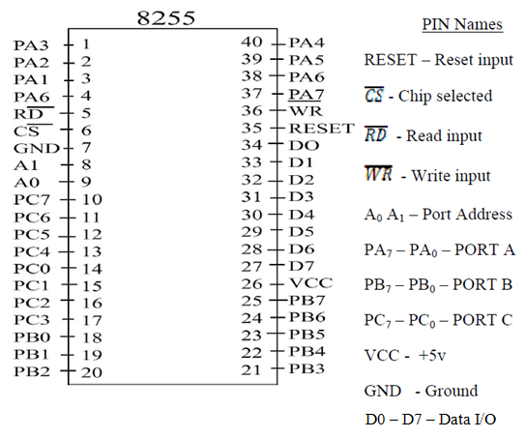

Slide 5
Function of Pins:
• Data bus (D0-D7): These are 8-bit bi-directional buses, connected to μP data bus for transferring data.
• VCC and GND: +5V power supply and 0V.
• (CS) Chip Select: A “low’ on this input pin enables the communication between the 8255A, and the CPU.
• (RD) Read: A “low” on this Input pin enables the 8255A to send the data or status information to the CPU, it allows the CPU to “read from the 8255A.
• (WR) Write: A. “ low” on the input pin enables the CPU to write data or control words into the 8255A.

Slide 6
Function of Pins:
• RESET: This is used to reset the device. That means clear control registers and all the ports are set to the input mode.
• PA0-PA7: It is the 8-bit bi-directional I/O pins used to send the data to peripheral or to receive the data from peripheral.
• PB0-PB7: Similar to PA
• PC0-PC7: This is also 8-bit bidirectional I/O pins. These lines are divided into two groups: PC0 to PC3 (Lower Groups), PC4 to PC7 (Higher groups), these two groups working in separately use 4 data’s.
• (A0 and A1): The selection of input port and control word register is done by using A0 and A1.

Slide 7
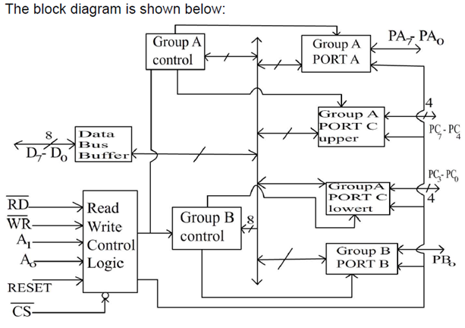

Slide 8
8255A Programmable Peripheral Interface PPI
It has 4 groups:-
1. Data bus buffer.
2. Read Write control logic.
3. Group A and Group B controls.
4. Port A, B and C.

Slide 9
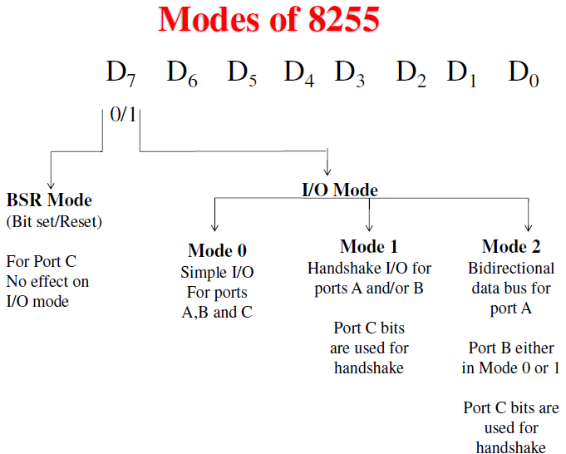

Slide 10
