Slide 1
2018-2019
رهاط ةزمحلا .م : ةداملا سردم
2-
Digital Communications
CTE Department -3rd stage
Reference: Digital Communications Fundamentals and Applications,
2nd Addition, by FernardSklar
Dr. Hussam Dheaa Kamel
Al-Mustafa University Collage CTE Department 2018-2019

Slide 2
Digital Communications CTE Department -3rd stage
3- Intersymbol Interference (ISI):
ISI arises because dispersive nature of the communication channel, thus the errors are introduced in the detected data at the receiver. The binary data can be transmitted in baseband or passband. One of the baseband system of digital data is PAM which is have only two amplitude level corresponding to binary "1" and "0". Successive binary digits can combined into symbol. Line codes generate discrete PAM signals which transmitted in baseband form (without any modulation) over the channel. Fig. 5 shows the block diagram of such baseband transmission system.
Figure 15
The binary data (b_{k}) is applied to the data encoder which generate the pulse waveform x(t) represented mathematically by:
∞
𝑥(𝑡) = ∑ 𝐴_{𝑘} 𝑔(𝑡 − 𝑘𝑇_{𝑏})
𝑘=−∞
𝑇_{𝑏} is the duration of each input binary bit.
𝑔(𝑡) is the shaping pulse.

Slide 3
Digital Communications
CTE Department -3rd stage
And
+𝑎
𝐴_{𝑘} = {
𝑖𝑓 𝑏_{𝑘} = 1
−𝑎 𝑖𝑓 𝑏_{𝑘} = 0
The signal x(t) is then passed through the transmitting filter which combine all the necessary transmitting circuits and systems with transfer function of H_{T}(f). The signal is then passed through the channel having transfer function H_{C}(f). The channel delivers the signal to the receiving filter which combine all the necessary receiving circuits and systems with transfer function of H_{R}(f). The output of the receiving filter is y(t) is a noisy replica of the transmitted signal x(t). The signal y(t) is then sampled synchronously with clock pulse at the transmitter having sampling instants 𝑡 = 𝑖𝑇_{𝑏}. The sampled signal y(t_{i}) is then given to decision device which compare the input signal with threshold "𝜆":
If y(t_{i}) ˃ 𝜆 select symbol '1' If y(t_{i}) ≤ 𝜆 select symbol '0'
ISI Problem: Consider the output y(t) of the receiving filter represented by:
∞
𝑦(𝑡) = µ ∑ 𝐴_{𝑘} 𝑝(𝑡 − 𝑘𝑇_{𝑏})
𝑘=−∞
Here µ is scaling factor and P(t) is the different from that of g(t)
We have 𝑡 = 𝑖𝑇_{𝑏} then:
∞
𝑦(𝑡) = µ ∑ 𝐴_{𝑘} 𝑝(𝑖𝑇_{𝑏} − 𝑘𝑇_{𝑏})
𝑘=−∞

Slide 4
Digital Communications
CTE Department -3rd stage
∞
𝑦(𝑡) = µ ∑ 𝐴_{𝑘} 𝑝(𝑖 − 𝑘)𝑇_{𝑏}
𝑘=−∞
Let us rearrange above equation:
∞
𝑦(𝑡) = µ 𝐴_{𝑖} 𝑝(0) + µ ∑ 𝐴_{𝑘} 𝑝(𝑖 − 𝑘)𝑇_{𝑏}
𝑘=−∞
𝑘≠𝑖
𝑎𝑛𝑑 𝑖 = 0, ∓1, ∓2, ∓3, … … ….
If ISI is absent then the second term of above equation will not be present, and p(t) is normalized such that 𝑝(0) = 0 yelds:
𝑦(𝑡) = µ 𝐴_{𝑖} . At 𝑡 = 𝑖𝑇_{𝑏}, the correct bit is 𝐴_{𝑖}. Observe that it is decoded correctly in absence of ISI, but it is not possible to eliminate the second term totally. The ISI can be reduced by proper design of transmitted filter H_{T}(f), receive filter H_{R}(f), and channel filter H_{C}(f).

Slide 5
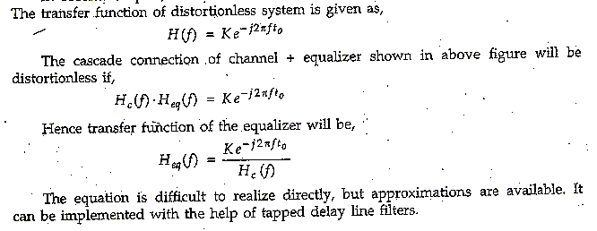
Digital Communications
CTE Department -3rd stage
Equalization:
Figure 4
Fig. 5 shows tapped delay line filter. The output of such filter is given as:
𝑀−1
𝑦(𝑛𝑇) = ∑ 𝑤_{𝑖}𝑥 (𝑛𝑇 − 𝑖𝑇)
𝑖=0
Here w_{i} is the weight of i^{th} tap, M is the total number of taps and T is the symbol duration of the signal.

Slide 6
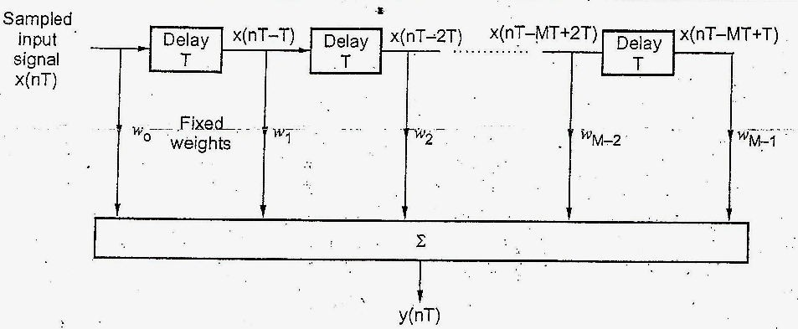
Digital Communications
CTE Department -3rd stage
Figure 5
The weights are basically filter coefficients. This filter approximates the equalizer transfer function of above equation. The approximation will be more accurate if we use more tape in filter.
Adaptive Equalizer:
The transmission characteristic of the channel keep in changing. Hence adaptive equalization is used. In adaptive equalization, the filters adapt themselves to the dispersive effects of the channel. That is the coefficients of the filters are changed continuously according to the received data.
The adaptive equalizer is a tapped delay-line filter. It consist of set of delay elements and variable multipliers. The sequence
𝑥(𝑛𝑇) is applied to the input of adaptive filter. The output 𝑦(𝑛𝑇) of the adaptive filter will be,

Slide 7
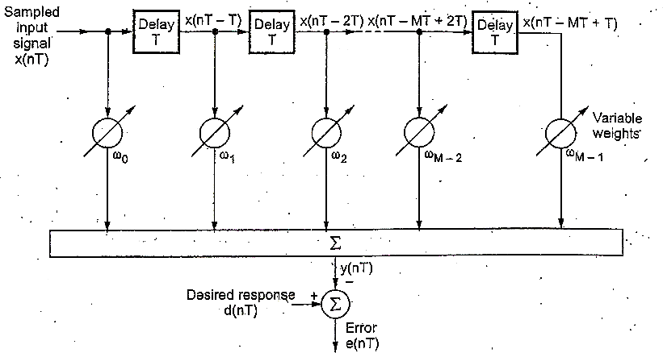
Digital Communications CTE Department -3rd stage
𝑀
𝑦(𝑛𝑇) = ∑ 𝑤_{𝑖}𝑥 (𝑛𝑇 − 𝑖𝑇)
𝑖=0
The weights 𝑤_{𝑖} on the taps are basically adaptive filter coefficients. A known sequence {𝑑(𝑛𝑇)} is transmitted first. This sequence is known to the receiver. The error between two sequences is calculated:
𝑒(𝑛𝑇) = 𝑑(𝑛𝑇) − 𝑦(𝑛𝑇), 𝑛 = 0, 1, 2, … . . 𝑁 − 1

Slide 8
Digital Communications CTE Department -3rd stage
The weights of the filter are changed recursively such that error 𝑒(𝑛𝑇) is minimized. There are standard algorithms to change weights of filter recursively. One of important algorithm is Least Mean Square (LMS) Algorithm.
The tap weights are adapted by this algorithm as follows:
𝑤́ _{𝑖}(𝑛𝑇 + 𝑇) = 𝑤́ _{𝑖}(𝑛𝑇) + 𝜇𝑒(𝑛𝑇)𝑥(𝑛𝑇 − 𝑖𝑇)
𝑤́ _{𝑖}(𝑛𝑇) is the present estimate for tap 𝑖 at time nT,
𝑤́ _{𝑖}(𝑛𝑇 + 𝑇) is the updated estimate for tap 𝑖 at time nT,
𝜇 is the adaption constant, 𝑥(𝑛𝑇 − 𝑖𝑇) is the filter input and 𝑒(𝑛𝑇) is the error signal.
In this algorithm initial tap weights are assumed zero.
𝑖 = 0, 1, … … 𝑀 − 1
The Matched Filter:
A matched filter is a linear filter designed to provide the maximum signal to noise ratio at its output for a given transmitted symbol waveform. Consider that a known signal s(t) plus AWGN n(t) is the input to a linear time- invariant (receiving filter followed by a
sampler. The ratio of instantaneous signal power to average noise power, (_{𝑁})_{𝑇}, at time 𝑡 = 𝑇, out of sampler is
𝑆
𝑆
𝑁
_{𝑎}2
(
_{)𝑇 =} 𝑖
_{𝜎}2
0
We can express the signal 𝑎_{𝑖}(𝑡) at the filter output in terms of filter transfer function:
∞
𝑎_{𝑖}(𝑡) = ∫ 𝐻(𝑓)𝑆(𝑓)𝑒^{𝑗2𝜋𝑓𝑡}𝑑𝑓
−∞

Slide 9
Digital Communications
CTE Department -3rd stage
Where 𝑆(𝑓) is the Fourier transform of input signal, 𝑠(𝑡). If the two sided power spectral density of the input is ^{𝑁0} watts/hertz, then we can
express the output noise power as:
2
2
𝑁₀
∞
|
|2
𝜎 = ∫ 𝐻(𝑓) 𝑑𝑓
0
2
−∞
Substitute in the first equation:
𝑆
|∫∞ 𝐻(𝑓)𝑆(𝑓)𝑒^{𝑗2𝜋𝑓𝑡}𝑑𝑓|²
( )_{𝑇} =
−∞
𝑁 _{0 ∫}∞
𝑁
|𝐻(𝑓)|²𝑑𝑓
2 −∞
Using Schwarz's inequality:
2
|∫∞ 𝐻(𝑓)𝑆(𝑓)𝑒^{𝑗2𝜋𝑓𝑡}𝑑𝑓| ≤ ∫∞ |𝐻(𝑓)|²𝑑𝑓 ∫∞ |𝑆(𝑓)|²𝑑𝑓
−∞ −∞ −∞
yields
𝑆 2
∞
|
|2
( )
𝑇
= ∫ 𝑆(𝑓) 𝑑𝑓
𝑁
𝑁
0
−∞
𝑜𝑟
𝑚𝑎𝑥 ( ^{𝑆} ) = ^{2𝐸}
𝑁 ^{𝑇} 𝑁₀
Where the energy E of the input signal s(t)is
∞
𝐸 = ∫ |𝑆(𝑓)|²𝑑𝑓
−∞
Thus the maximum output (_{𝑁})_{𝑇} depends on the input signal energy and the and the power spectral density of the noise, not on the particular shape of the waveform that used.
𝑆
𝑚𝑎𝑥 (^{𝑆} )_{𝑇} holds only if the optimum filter transfer function 𝐻₀(𝑓) is employed:
𝑁

Slide 10
Digital Communications
CTE Department -3rd stage
𝐻(𝑓) = 𝐻₀(𝑓) = 𝑘𝑆∗(𝑓)𝑒^{𝑗2𝜋𝑓𝑡}
ℎ(𝑡) = 𝐼𝐹𝑇{ 𝑘𝑆∗(𝑓)𝑒^{−𝑗2𝜋𝑓𝑡}}
Or
Since s(t) is a real valued signal,
_{ℎ(𝑡) = {}𝑘𝑠(𝑇 − 𝑡)
0 ≤ 𝑡 ≤ 𝑇
𝑒𝑙𝑠𝑒𝑤ℎ𝑒𝑟𝑒
0
Thus, the impulse response of a filter that produces the maximum output signal to noise ratio is the mirror image of the message signal s(t)
delayed by the symbol time duration T.

