Slide 1


2018-2019
رهاط ةزمحلا .م : ةداملا سردم
Digital Communications
CTE Department -3rd stage
Reference: Digital Communications Fundamentals and Applications,
2nd Addition, by FernardSklar
Dr. Hussam Dheaa Kamel
Al-Mustafa University Collage CTE Department 2018-2019

Slide 2
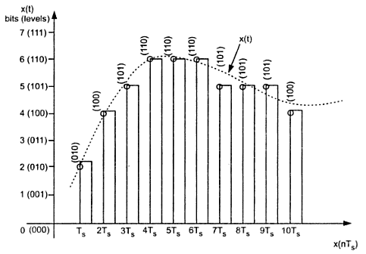
Digital Communications
CTE Department -3rd stage
2-7 Differential Pulse Code Modulation (DPCM):
Any signal does not change fast, so that the value from present sample to next sample does not differ by large amount. The adjacent samples of the signal carry the same information with little difference as shown if figure 2-11.
Figure 2-6 Redundant information of PCM
It can be seen from figure 2-11 the samples 4𝑇_{𝑠}, 5𝑇_{𝑠}, 𝑎𝑛𝑑 6𝑇_{𝑠} are encoded to the same value of (110). If this redundancy is reduced, the overall bit rate will decrease and the number of bits required for one sample will also be reduced. This is called Differential Pulse Code Modulation (DPCM).
DPCM works on the principle of prediction. The value of the present sample is predicted from the past samples as shown in figure 2-7.

Slide 3
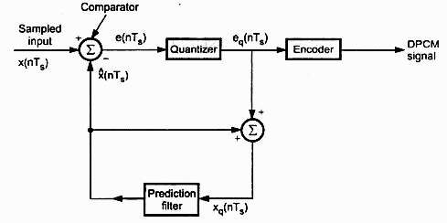
Digital Communications
CTE Department -3rd stage
Figure 2-7 DPCM transmitter
The comparator fined the difference between the actual sample value 𝑥(𝑛𝑇_{𝑠}) and predicted signal 𝑥̂(𝑛𝑇_{𝑠}) this is called error
𝑒(𝑛𝑇_{𝑠}):
𝑒(𝑛𝑇_{𝑠}) = 𝑥(𝑛𝑇_{𝑠}) − 𝑥̂(𝑛𝑇_{𝑠})
This error will be quantized and encoded by small number of bits. Thus number of bits per sample are reduced in DPCM. The quantization error can be written as:
𝑒_{𝑞}(𝑛𝑇_{𝑠}) = 𝑒(𝑛𝑇_{𝑠}) + 𝑞(𝑛𝑇_{𝑠})
The prediction filter input is:
𝑥_{𝑞}(𝑛𝑇_{𝑠}) = 𝑥̂(𝑛𝑇_{𝑠}) + 𝑒_{𝑞}(𝑛𝑇_{𝑠})

Slide 4
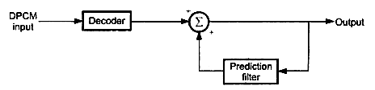
Digital Communications
CTE Department -3rd stage
Substituting by 𝑒_{𝑞}(𝑛𝑇_{𝑠}) yields
𝑥_{𝑞}(𝑛𝑇_{𝑠})=𝑥̂(𝑛𝑇_{𝑠}) + 𝑒(𝑛𝑇_{𝑠}) + 𝑞(𝑛𝑇_{𝑠})
We have
𝑥(𝑛𝑇_{𝑠}) = 𝑒(𝑛𝑇_{𝑠}) + 𝑥̂(𝑛𝑇_{𝑠})
From the last equations;
𝑥_{𝑞}(𝑛𝑇_{𝑠})=𝑥(𝑛𝑇_{𝑠}) + 𝑞(𝑛𝑇_{𝑠})
To reconstruct the original signal at the receiver, the decoder first reconstructs the quantized error signal as shown in figure 2-8.
Figure 2-8 Reconstruction of DPCM
The quantized error signals are summed up with prediction filter output to give the quantized version of the original signal. The signal at the receiver differs from actual signal by quantization error 𝑞(𝑛𝑇_{𝑠}).

Slide 5
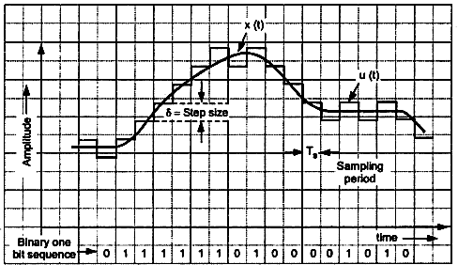
Digital Communications
CTE Department -3rd stage
2.8 Delta Modulation (DM):
DM transmit only one bit per sample. That is the present sample value is compared with the previous sample of approximated signal which confined to two levels (−𝛿 𝑎𝑛𝑑 + 𝛿). If the difference is negative ‘0’ bit is transmitted and ‘1’ bit is transmitted for positive difference, as shown in 2-9.
Figure 2.9 Delta modulation waveform

Slide 6
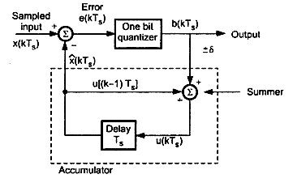
Digital Communications CTE Department -3rd stage
- DM transmitter:
The block diagram of DM transmitter is shown in figure 2-10
Figure 2.10 DM transmitter
The error between sampled value of 𝑥(𝑡) and last approximated sample is given by:
𝑒(𝑘𝑇_{𝑠}) = 𝑥(𝑘𝑇_{𝑠}) − 𝑥̂(𝑘𝑇_{𝑠})
From the waveform figure 𝑢(𝑘𝑇_{𝑠}) is the present sample approximation of staircase output and 𝑢[(𝑘 − 1)𝑇_{𝑠}] =
𝑥̂(𝑘𝑇_{𝑠}) is the last sample approximation of staircase output. Let the quantity of 𝑏(𝑘𝑇_{𝑠}) be define as,
𝑏(𝑘𝑇_{𝑠}) = 𝛿𝑠𝑖𝑔𝑛[𝑒(𝑘𝑇_{𝑠})]
So that
𝑏(𝑘𝑇_{𝑠}) = +𝛿
𝑏(𝑘𝑇_{𝑠}) = +𝛿
𝑖𝑓 𝑥(𝑘𝑇_{𝑠}) ≥ 𝑥̂(𝑘𝑇_{𝑠}), 𝑏𝑖𝑛𝑎𝑟𝑦 ′1′𝑖𝑠 𝑡𝑟𝑎𝑛𝑠𝑚𝑖𝑡𝑡𝑒𝑑
𝑖𝑓 𝑥(𝑘𝑇_{𝑠}) < 𝑥̂(𝑘𝑇_{𝑠}), 𝑏𝑖𝑛𝑎𝑟𝑦 ′0′𝑖𝑠 𝑡𝑟𝑎𝑛𝑠𝑚𝑖𝑡𝑡𝑒𝑑

Slide 7
Digital Communications CTE Department -3rd stage
Where 𝑇_{𝑠} is sampling interval.
The summer of figure 2-7adds quantizer output (∓𝛿) with previous sample approximation. This gives present sample approximation:
𝑢(𝑘𝑇_{𝑠}) = 𝑢(𝑘𝑇_{𝑠} − 𝑇_{𝑠}) + [∓𝛿] 𝑜𝑟
= 𝑢[(𝑘 − 1)𝑇_{𝑠}] + 𝑏(𝑘𝑇_{𝑠})
The previous sample approximation 𝑢[(𝑘 − 1)𝑇_{𝑠}] is restored by delayed one sample period 𝑇_{𝑠}. The sampled input signal 𝑥(𝑘𝑇_{𝑠}) and staircase approximated signal 𝑥̂(𝑘𝑇_{𝑠}) are subtracted to get error signal 𝑒(𝑘𝑇_{𝑠}). Then the one bit
quantizer produces +𝛿 or – 𝛿 step size depending on the sign of 𝑒(𝑘𝑇_{𝑠}), ‘1’ bit is transmitted for positive values and
‘0’ bit for negative values.

Slide 8
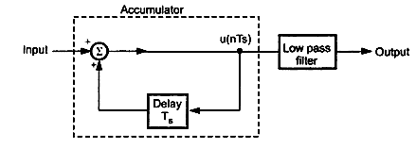
Digital Communications CTE Department -3rd stage
- DM receiver:
At the receiver shown in figure 2-11, the accumulator generates the staircase approximated signal and is delayed by one sample period 𝑇_{𝑠}. It adds +𝛿 step to the previous sample if the input bit is ‘1’ and subtract −𝛿 for ‘0’ input bit.
The low pass filter with cutoff frequency of highest frequency in 𝑥(𝑡).
Figure 2.11 DM receiver
- Advantageous of DM:
DM transmit only one bit for one sample. Thus the signaling rate and transmission channel bandwidth is quite small for DM.
ii- The DM transceiver system is very much simple.
i-

Slide 9
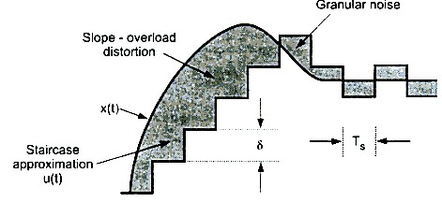
Digital Communications
CTE Department -3rd stage
- Disadvantageous of DM:
Figure 12 distortion of DM
Slop overload distortion: This distortion arises because of large dynamic range of input signal. In this case the step
size 𝛿 is too small for staircase signal 𝑢(𝑡) to follow the steep segment of 𝑥(𝑡). Thus there is large error between those signals. This error called slop overload distortion. To reduce this error the step size should be increased when slop of signal 𝑥(𝑡) is high. But since the step size is fixed it is called Linear Delta Modulation (LDM).
ii- Granular Noise (Hunting): It is occur when the step size is too large compared to small variation in the input signal
𝑥(𝑡) which can be considered flat, while the staircase signal is oscillated by ±𝛿 around it. The error in this case is called granular noise, so that step size should be small to reduce this error.
i-

Slide 10
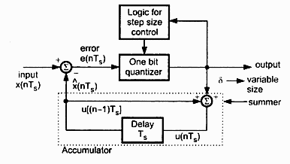
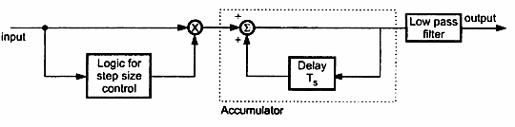
Digital Communications
CTE Department -3rd stage
3.9 Adaptive DM:
The large step size is required to reduce slope overload while small steps are required to reduce granular noise. Adaptive DM shown in figure 2-9 is a modification of LDM to overcome these errors.
Figure 2.13 Transmitter of adaptive DM
The step size increases with steep segment of input signal and reduces with small variation. This called Adaptive Delta Modulation (ADM).
At the receiver the logic for step size control is added is added as shown in figure 2-9.

Slide 11
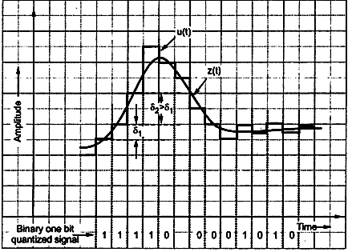
Digital Communications
CTE Department -3rd stage
Figure 2.14 ADM receiver
If one bit quantizer output is high ‘1’ the step size may be doubled for next sample and vice versa as shown in figure 2-10.
Figure 2.15 Waveform of ADM The previous input and the present input decided the step size.

