Slide 1
2018-2019
رهاط ةزمحلا .م : ةداملا سردم
Digital Communications
CTE Department -3rd stage
Reference: Digital Communications Fundamentals and Applications,
2nd Addition, by FernardSklar
Dr. Hussam Dheaa Kamel
Al-Mustafa University Collage CTE Department 2018-2019

Slide 2
Digital Communications
CTE Department -3rd stage
Chapter Three
Source Coding Techniques
Introduction:
Analog waveform or signals are sampled into pulses. In digital pulses modulation methods, the analog amplitude
pulses are converted to digital form. Thus each sample of the message signal is represented in binary (1, 0) format.
Pulse Code Modulation:
The PCM technique samples the input signal x(t) at frequency 𝑓_{𝑠} ≥ 2𝑊. This sampled pulse is then digitized by the analog to digital converter as shown in Fig. 2-1.
Figure 2-1 the block diagram of PCM

Slide 3
Digital Communications CTE Department -3rd stage
The x(t) is bandlimited to W by LPF. The sample and hold circuit then samples this signal at the rate above of Nyquist rate
𝑓_{𝑠} ≥ 𝑊. The sampled signal 𝑥(𝑛𝑇_{𝑠})is discrete in time and continuous in amplitude. The quantizer is convert it to q discrete level by rounding each sample to fixed digital level with minimum error (quantization error). The input to the quantizer
𝑥(𝑛𝑇_{𝑠}) (for example) can take any values between (−4𝛿 𝑡𝑜 + 4𝛿), the output of quantizer (𝑥_{𝑞}(𝑛𝑇_{𝑠}) are available at
𝛿 3𝛿 5𝛿 7𝛿 𝛿
± , ± , ± 𝑎𝑛𝑑 ± as shown in Fig. 2-2. Thus the maximum quantization error is ± .
2 2 2 2 2
The quantized signal (𝑥_{𝑞}(𝑛𝑇_{𝑠}) is converted by encoder to v digits binary word, and then converted to serial bit stream to generate single baseband signal as shown in Fig. 2-3.
2.1 Transmission bandwidth in PCM:
Each quantized sample can be represent by v digits: 𝑞 = 2^{𝑣}, where q is the total number of digital levels. The number of sample is 𝑓_{𝑠}, and each sample represent by v bits then:
Signaling rate of PCM: 𝑟 = 𝑣 × 𝑓_{𝑠}
And we have 𝑓_{𝑠} ≥ 2𝑊.
1
The bandwidth of PCM given half signaling rate: 𝐵_{𝑟} ≥ ₂ 𝑟
1
𝐵_{𝑟} ≥ ₂ 𝑣𝑓_{𝑠}
Figure 2-2:(a) Transfer characteristic of a quantizer
(b) Variation of quantizer error

Slide 4
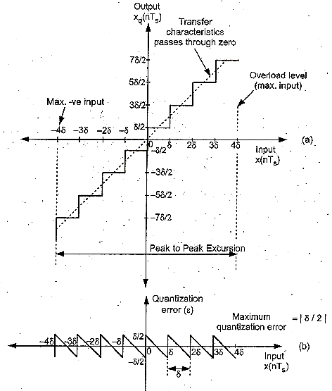
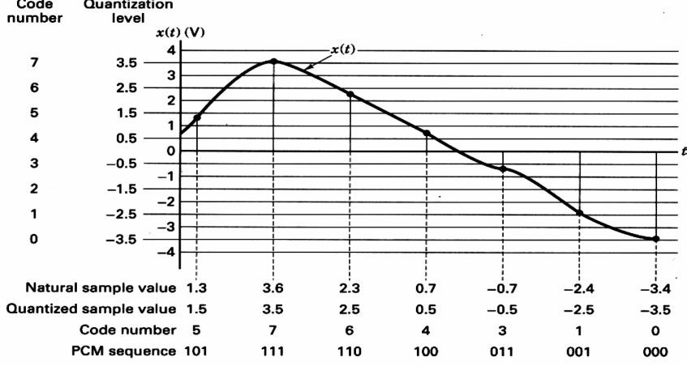
Digital Communications
CTE Department -3rd stage
Since 𝑓_{𝑠} ≥ 2𝑊
∴ 𝐵_{𝑟} ≥ 𝑣𝑊
Figure 2-3: quantizing of sample value

Slide 5
Digital Communications
CTE Department -3rd stage
2-2 PCM Receiver:
Figure 2-4 shows the block diagram of PCM receiver. The regenerator is to reshapes the pulse and removes the noise. The signal is then converted into parallel digital words for each sample.
Figure 2-4 PCM receiver
The digital word is converted to its analog value 𝑥_{𝑞}(𝑡) along with sample and hold (S/H), then passed through lowpass reconstruction filter to get 𝑦_{𝐷}(𝑡). There is quantization error between reconstructed signal 𝑥(𝑘𝑇_{𝑠}) and original signal 𝑥(𝑡) as shown in figure 2-5. This can reduced by increasing bits ‘v’, but this increases the bandwidth.

Slide 6
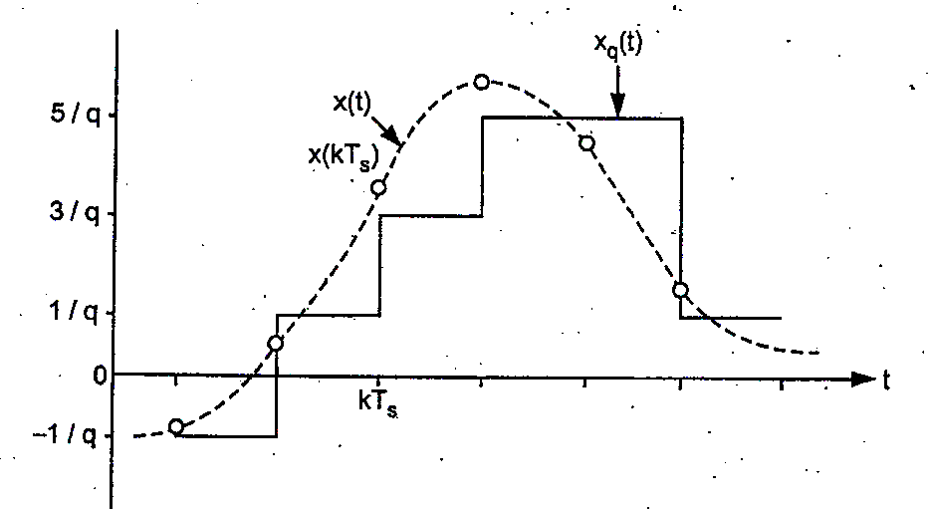
Digital Communications
CTE Department -3rd stage
Figure 2-5: Reconstructed waveform
2-3 Quantization Noise in PCM:
The quantization error is expressed as:
𝜀 = 𝑥_{𝑞}(𝑛𝑇_{𝑠}) + 𝑥(𝑛𝑇_{𝑠})
The range of amplitude of input 𝑥(𝑛𝑇_{𝑠}) is −𝑥_{𝑚𝑎𝑥} 𝑡𝑜 + 𝑥_{𝑚𝑎𝑥} and it is mapped into q levels. So that total amplitude range 2𝑥_{𝑚𝑎𝑥} is divided into q levels with step size 𝛿.
^{2𝑥}𝑚𝑎𝑥
𝛿 =
𝑞

Slide 7
Digital Communications
CTE Department -3rd stage
𝛿 𝛿
We have the maximum quantization error is ± ₂, or 𝜀_{𝑚𝑎𝑥} = |₂|
The mean square value of quantization error is:
𝛿 2
𝛿 2
𝛿
1 𝜀³ ²
1
𝐸(𝜀²) = ∫ 𝜀²𝑓_{𝜀}(𝜀)𝑑𝜀 = ∫ 𝜀² 𝑑𝜀 = [ ]
𝛿
𝛿 3 𝛿
𝛿 𝛿
−₂ −₂
−₂
1
3
1
3
_{𝛿}3 _{𝛿}3 _{𝛿}2
12
1
( ) ( )
1
𝐸(𝜀²) =
[ 𝛿 ₊ 𝛿 _{] =}
[ + ] =
𝛿 3
3
3𝛿 8 8
_{𝑉}2
The noise power= ^{𝑛𝑜𝑖𝑠𝑒}
𝑅
_{𝑉}2
Assume R=1, then the noise power (normalized)= ^{𝑛𝑜𝑖𝑠𝑒}
1
_{𝛿}2
12
𝐸(𝜀²) =
𝛿²/12
=
1
The maximum signal power to quantization noise ratio:

Slide 8
Digital Communications
CTE Department -3rd stage
𝑆 𝑁𝑜𝑟𝑚𝑎𝑙𝑖𝑧𝑒𝑑 𝑠𝑖𝑔𝑛𝑎𝑙 𝑝𝑜𝑤𝑒𝑟
_{𝑁} =
𝛿²/12
We have 𝑞 = 2^{𝑣}, so:
^{2𝑥}𝑚𝑎𝑥 ^{2𝑥}𝑚𝑎𝑥
𝛿 = =
𝑞
₂𝑣
𝑆
Substituting in above equation:
𝑁
𝑆 𝑁𝑜𝑟𝑚𝑎𝑙𝑖𝑧𝑒𝑑 𝑠𝑖𝑔𝑛𝑎𝑙 𝑝𝑜𝑤𝑒𝑟
𝑁
=
2
₍2 𝑥_{𝑚𝑎𝑥)}
₂𝑣
12
Let normalized signal power as P
𝑆
=
𝑃
=
3𝑃
_{× 2}2𝑣
𝑁
^{2𝑥}𝑚𝑎𝑥
2
) /12
(𝑥² )
(
₂𝑣
𝑚𝑎𝑥
This equation shows that the signal to noise power ratio of quantizer increases exponentially with increasing bits per sample. For normalized 𝑥_{𝑚𝑎𝑥}
𝑆
= 3 × 2^{2𝑣} × 𝑃
𝑁
𝑆
𝑆
(_{𝑁}) 𝑑𝐵 = 10𝑙𝑜𝑔
10
( ) 𝑑𝐵 = 10𝑙𝑜𝑔 (3 × 2^{2𝑣}) = (4.8 + 6𝑣)𝑑𝐵
𝑁
10

Slide 9
Digital Communications CTE Department -3rd stage
For normalized values of power the destination signal power ‘P’ is less than 1 So that
𝑆
( ) 𝑑𝐵 ≤ (4.8 + 6𝑣)𝑑𝐵
𝑁

