Slide 1


2018-2019
رهاط ةزمحلا .م : ةداملا سردم
Digital Communications
CTE Department -3rd stage
Reference: Digital Communications Fundamentals and Applications,
2nd Addition, by FernardSklar
Dr. Hussam Dheaa Kamel
Al-Mustafa University Collage CTE Department 2018-2019

Slide 2
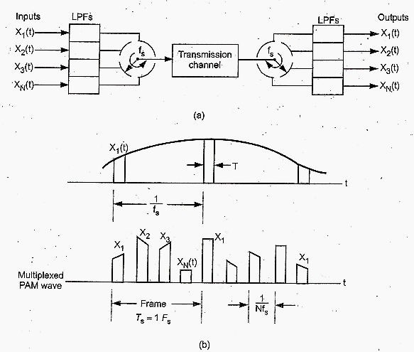
Digital Communications
CTE Department -3rd stage
2.2 Time Division Multiplexing (TDM):
In PAM, PWM and PPM the pulses is present for short duration and the most time between two pulses is free space, which can be occupied by pulses from other channels. This called TDM. The following figure shows the block diagram of TDM in
(a) and the waveforms in (b).
If the highest signal frequency is W and its sampling rat 𝑓_{𝑠} should be 𝑓_{𝑠} ≥ 2𝑊, therefore the time space between two pulses
𝑇_{𝑠} = ¹ , thus the time interval 𝑇_{𝑠} should contain one sample from each N input channel. That is on frame of 𝑇_{𝑠} seconds
𝑓_{𝑠}

Slide 3
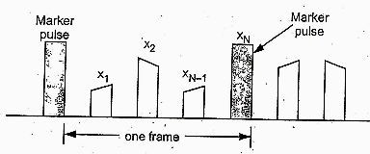
Digital Communications
CTE Department -3rd stage
contain total N samples. So that the space between two samples= ^{𝑇𝑠} =
1
𝑠𝑒𝑐, and number of pulses per second is = ^{𝑁} =
𝑁 𝑁𝑓_{𝑠}
𝑇_{𝑠}
𝑁 1/𝑓_{𝑠}
= 𝑁𝑓_{𝑠}, or the signaling rate 𝑟 = 𝑁𝑓_{𝑠}, and we have 𝑓_{𝑠} ≥ 2𝑊, then the signaling rate 𝑟 = 2𝑁𝑊.
The TDM signal should pass through low pass filter with bandwidth B_{b} of half signaling rate:
𝐵_{𝑏} = ¹ 𝑟 = ¹ 𝑁𝑓_{𝑠}, the transmission bandwidth of TDM 𝐵_{𝑇} channel must equal to 𝐵_{𝑏}
2 2
1
𝐵_{𝑇} = 𝐵_{𝑏} = ₂ 𝑁𝑓_{𝑠} , 𝑎𝑛𝑑 𝑤𝑒 ℎ𝑎𝑣𝑒 𝑡ℎ𝑒 𝑠𝑎𝑚𝑝𝑙𝑖𝑛𝑔 𝑟𝑎𝑡𝑒 𝑓_{𝑠} = 𝑁𝑦𝑞𝑢𝑖𝑠𝑡 𝑟𝑎𝑡𝑒 = 2𝑊
1
∴ 𝐵_{𝑇} = ₂ 𝑁 × 2𝑊 = 𝑁𝑊
The receiver of TDM should operate in perfect synchronization with the transmitter. Therefor marker pulses are inserted to indicate the separation between two frames as shown in the figure:

Slide 4
Digital Communications CTE Department -3rd stage
Because each frame will increased by one pulse for the purpose of synchronization, the number of channels will reduced to N-1.
Example:
Twenty four voice signals are sampled uniformly and then time division multiplexed. The highest frequency component for each voice signal is 3.4 kHz.If the signal is pulse amplitude modulated using Nyquist rate sampling, what is the minimum channel bandwidth required.
Solution:
Here 𝑁 = 24, 𝑎𝑛𝑑 𝑊 = 3.4𝑘𝐻𝑧, 𝑠𝑜 𝑡ℎ𝑒 𝑚𝑖𝑛𝑖𝑚𝑢𝑚 𝑏𝑎𝑛𝑑 𝑟𝑒𝑞𝑢𝑖𝑟𝑒𝑑 𝑖𝑠:
𝐵_{𝑇} = 𝑁𝑊 = 24 × 3.4𝑘𝐻𝑧 = 81.6𝑘𝐻𝑧

Slide 5
Digital Communications
CTE Department -3rd stage
2.3 Noise in communication systems:
The term noise refers to unwanted electrical signals that are always present in electrical systems. Noise arise from a variety of sources, both man-made and natural.
Good engineering design can eliminate of noise or its undesirable effect through filtering, shielding, the choice of modulation, and select optimum receiver site. However there is one natural source of noise, called thermal or Johnson noise, that cannot be eliminated. We can describe thermal noise as a zero- mean Gaussian random process n(t). the value n at any arbitrary time t is statistically characterized by Gaussian probability density function:
1
2
𝑝(𝑛) =
exp [− ¹ (^{𝑛}) ]
𝜎√2𝜋
2 𝜎
Where 𝜎² is the variance of n. The normalized or standardized Gaussian density function of a zero-mean process is obtained by assuming that 𝜎 = 1. This normalized pdf is shown in Fig. 1.

Slide 6
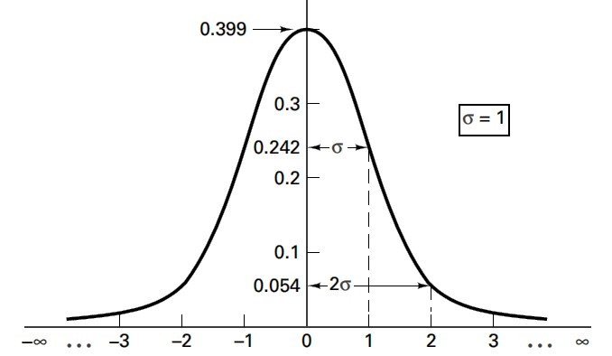
Digital Communications
CTE Department -3rd stage
]
Figure 1
The fallowing equation represent a sum of DC signal and Gaussian noise random variable:
𝑧 = 𝑎 + 𝑛
The pdf p(z) is the expressed as:
𝑝(𝑛) =
1
2
exp [− ^{1 𝑧 − 𝑎}) ]
₂ (
𝜎√2𝜋
𝜎
The primary spectral characteristic of thermal noise is that its power spectral density is the same for all frequency (from dc to about 10¹² Hz) and it is called white noise.

Slide 7
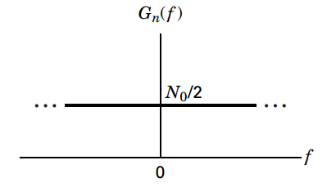
Digital Communications
CTE Department -3rd stage
𝐺 (𝑓) =
𝑁
0
𝑤𝑎𝑡𝑡𝑠/ℎ𝑒𝑟𝑡𝑠
𝑛
2
Figure 2
2.4 Baseband Demodulation:
During a given signaling interval T, a binary baseband system will transmit one of two waveforms, denoted 𝑠₁(𝑡) and 𝑠₂(𝑡). Then, for any binary channel, the transmitted signal over a symbol interval (0, T) is represented by:
𝑠 (𝑡)
0 ≤ 𝑡 ≤ 𝑇
0 ≤ 𝑡 ≤ 𝑇
𝑓𝑜𝑟 𝑎 𝑏𝑖𝑛𝑎𝑟𝑦 1
𝑓𝑜𝑟 𝑎 𝑏𝑖𝑛𝑎𝑟𝑦 0
𝑠 (𝑡) = {
1
𝑖
𝑠₂(𝑡)
The received signal represent by:

Slide 8
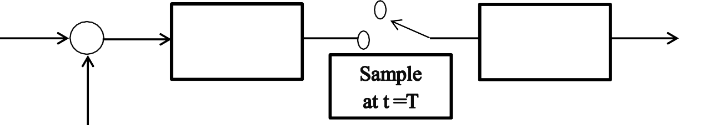
Digital Communications
CTE Department -3rd stage
𝑟(𝑡) = 𝑠_{𝑖}(𝑡) ∗ ℎ_{𝑐}(𝑡) + 𝑛(𝑡) 𝑖 = 1, … … . , 𝑀
Where ℎ_{𝑐}(𝑡) is the impulse response of the channel, 𝑛(𝑡) is Additive White Gaussian Noise (AWGN) and ∗ represent a convolutional operation. For ideal distortionless channel:
𝑟(𝑡) = 𝑠_{𝑖}(𝑡) + 𝑛(𝑡) 𝑖 = 1, 2, 0 ≤ 𝑡 ≤ 𝑇
S_{i}(t)
r(t)
Receiving Filter
Threshold
Comparison
Message
AWGN
Figure 3
The goal of the receiving filter is to recover a baseband pulse with the best possible signal to noise ratio (SNR), free of intersample interference (ISI). The optimum receiving filter for accomplishing this is called matched filter or correlator. At the output of sampler, is predetection point, yields a sample z(T), sometime called test statistic.
𝑧(𝑇) = 𝑎_{𝑖}(𝑡) + 𝑛₀(𝑇) 𝑖 = 1,2
The noise component n₀ is zero mean Gaussian random variable, and thus z(T) is a Gaussian random variable with a mean of either a₁ or a₂ depending on whether a binary one or binary zero was sent. The conditional pdfs 𝑝(𝑧│𝑠₁) and 𝑝(𝑧│𝑠₂) can be expressed as:

Slide 9
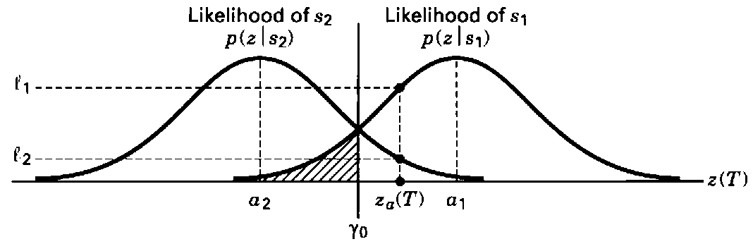
Digital Communications
CTE Department -3rd stage
𝑝(𝑧|𝑠 ) =
1
2
1
exp [− ^{1 𝑧 − 𝑎1}) ]
₂ (
𝜎√2𝜋
𝜎
and
𝑝(𝑧|𝑠 ) =
1
2
2
exp [− ^{1 𝑧 − 𝑎2}) ]
₂ (
𝜎√2𝜋
𝜎
These conditional pdfs are shown in Fig. 4. The rightmost pdf, 𝑝(𝑧|𝑠₁), called the likelihood of s₁, illustrates the pdf of the random variable z(T), given that symbol s₁ was transmitted, and similarly for s₂ as shown in Fig.4
Figure 4
Since z(T) is a voltage signal that is proportional to the energy of the received symbol, the larger the magnitude of z(T), the more error free will be the decision making process.
𝑧(𝑇)^{>𝐻1} 𝛾
<_{𝐻2}

