Slide 1


2018-2019
رهاط ةزمحلا .م : ةداملا سردم
Digital Communications
CTE Department -3rd stage
Reference: Digital Communications Fundamentals and Applications,
2nd Addition, by FernardSklar
Dr. Hussam Dheaa Kamel
Al-Mustafa University Collage CTE Department 2018-2019

Slide 2
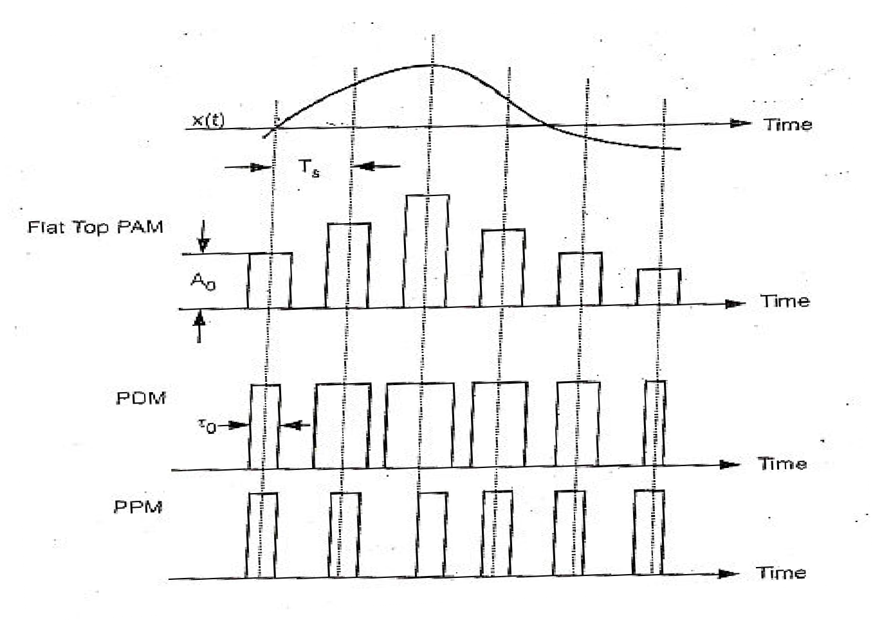
Digital Communications
CTE Department -3rd stage
Chapter Two
2.1-Analog Pulse Modulation Methods:
The continuous time signal x(t) to be transmitted is sampled at frequency 𝑓_{𝑠} sufficiently above the highest frequency present in x(t). The amplitude of modulating signal x(t) modulates some parameters of pulse train. These parameters are amplitude, duration (width) and position as shown below:

Slide 3
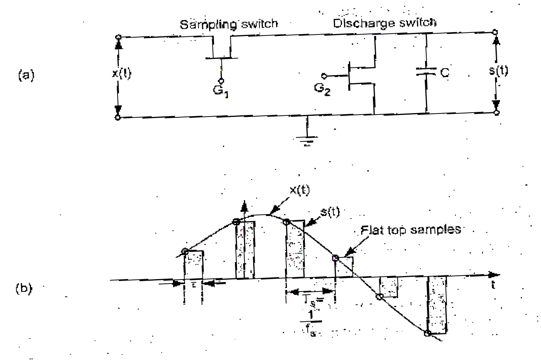
Digital Communications CTE Department -3rd stage
i-
Pulse Amplitude Modulation (PAM): ): is a form of signal modulation where the message information is encoded in the amplitude of a series of signal pulses.
In PAM, the amplitudes of regularly spaced rectangular pulses vary with the instantaneous sample values of a continuous message. It is better to use flat top PAM, because during transmission noise interferes the top of pulses. This noise can be removed easily if the PAM pulse has flat top. In case of natural sampling, it is difficult to determine the shape of noisy top of the pulse. The figure below shows the sampling and hold to introduce flat top PAM. At the sampling instance, sampling switch is closed for very small period. During this period the capacitor C voltage becomes equal to voltage of x(t) at the instant of sampling.
(a) Sampling and hold circuit. (b) Flat top PAM

Slide 4
Digital Communications CTE Department -3rd stage
The sampling switch is opened and capacitor C hold the charge for 𝜏 period thus flat top is generated. The discharge switch is then closed to discharge the capacitor to zero volts. Again after period T_{s}, sampling switch is closed to take new sample. The flat top PAM is represent by:
∞
𝑠(𝑡) = ∑ 𝑥(𝑛𝑇_{𝑠})ℎ(𝑡 − 𝑛𝑇_{𝑠})
𝑛=−∞
Here ℎ(𝑡 − 𝑛𝑇_{𝑠}) is the train of rectangular pulses. 𝑥(𝑛𝑇_{𝑠}) is the amplitude of sample at t=T_{s} and representing modulating signal. The spectrum of PAM signal is given by:
∞
𝑆(𝑓) = 𝑓_{𝑠} ∑ 𝑋(𝑓 − 𝑛𝑓_{𝑠})𝐻(𝑓)
𝑛=−∞
𝐻(𝑓) is the Fourier transform of rectangular pulse. The pulse duration 𝜏 is supposed to be very small compared to time period T_{s} between the two samples. If the maximum frequency in the signal x(t) is W then by sampling theorem, 𝑓_{𝑠} should be higher than Nyquist rate or,
1
2𝑊
𝑓_{𝑠} ≥ 2𝑊 𝑜𝑟 𝑇_{𝑠} ≤
𝑠𝑖𝑛𝑐𝑒 𝑓 = ¹
𝑠
𝑇_{𝑠}

Slide 5
Digital Communications
CTE Department -3rd stage
𝑡 ≪ 𝑇 ≤
1
𝑠
2𝑊
If ON and OFF time of the pulse is same, then frequency of the PAM pulse becomes:
1 ₌ 1
𝜏 + 𝜏 2𝜏
𝑓 =
Then
𝑓
₌ 1
𝑚𝑎𝑥
2𝜏
The bandwidth required of PAM signal will be equal to maximum frequency 𝐵_{𝑇} ≥ 𝑓_{𝑚𝑎𝑥}
𝑜𝑟 𝐵_{𝑇} ≥ ¹ 𝑎𝑛𝑑 𝑠𝑖𝑛𝑐𝑒 𝜏 ≪ ¹
2𝜏 2𝑊
𝐵_{𝑇} ≥ ¹ ≫ 𝑊
2𝜏
The transmission bandwidth of PAM signal 𝐵_{𝑇} ≫ 𝑊

Slide 6
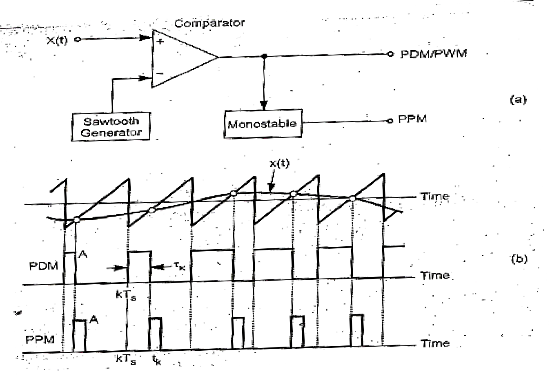
Digital Communications CTE Department -3rd stage
ii- Pulse Duration and Pulse position Modulation (PDM &PPM):
Pulse-width modulation (PWM) is a modulation process used for encoding the amplitude of a signal right into a pulse width or duration of another signal.
Pulse-position modulation (PPM) is a form of signal modulation in which M message bits are encoded by transmitting a single pulse in one of possible required time shifts.
Pulse Duration Modulation (PDM) or Pulse Width Modulation (PWM) and PPM are both modulate the time parameter of the pulses. PPM has fixed width whereas the width of PWM is varied. The generation of PWM and PPM shown in figure below.
(a) Block diagram of PWM and PPM generator. (b) Waveforms

Slide 7
Digital Communications
CTE Department -3rd stage
The modulating signal x(t) is applied to the noninverting input of the comparator. The output is high only when instantaneous value of x(t) is higher than that of the sawtooth waveform. Thus the leading edge of the PWM signal occurs on the fixed time period (KT_{s}), the trailing edge of the output of comparator depends on the amplitude of signal x(t). The trailing edge of output of comparator PWM is modulated by the signal x(t).
To generate PPM, the trailing edge of PWM is used to switch on the monostable with fixed period then goes low. The pulse is delayed from sampling time KT_{s} depending on the amplitude of signal x(t) at KT_{s}.
1
The rise time should be very less than T_{s} i.e., 𝑡_{𝑟} ≪ 𝑇_{𝑠}, and transmission bandwidth of PWM and PPM should be, 𝐵_{𝑇} ≥ _{2𝑡𝑟} .
The comparison between PAM, PWM and PPM is listed in the following table

Slide 8
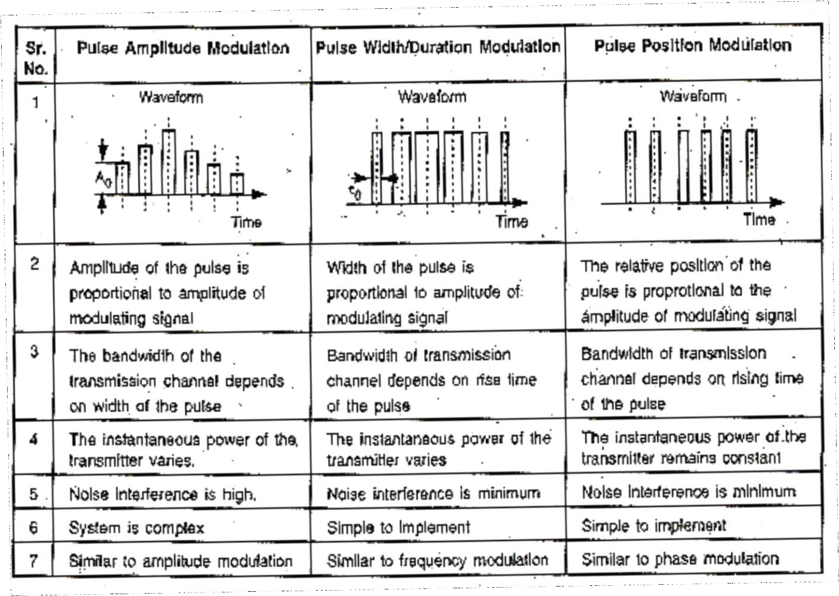
Digital Communications
CTE Department -3rd stage

Slide 9
Digital Communications
CTE Department -3rd stage
Example:
The voice signal with maximum frequency of 3𝑘𝐻𝑧, is to be transmitted using sampling frequency 𝑓_{𝑠} = 8𝑘𝐻𝑧, and pulse duration 𝜏 = 0.1 𝑇_{𝑠}, determine the required bandwidth of PAM, PWM and PPM if the rise time 𝑡_{𝑟} = 1% of pulse duration.
1 1
Solution: 𝑇_{𝑠} = _{𝑓𝑠} = _{8×103} = 0.125 𝑚𝑠𝑒𝑐
𝜏 = 0.1 𝑇_{𝑠} = 0.1 × 0.125 = 0.0125 𝑚𝑠𝑒𝑐
1
For PAM the bandwidth: 𝐵_{𝑇} ≥ _{2𝜏}
1
2 × 0.0125 × 10⁻³
𝐵 ≥
= 40𝑘𝐻𝑧
𝑇
1
For PDM and PPM the bandwidth 𝐵_{𝑇} ≥ _{2𝑡𝑟}
𝑡_{𝑟} = 0.01𝜏 = 0.01 × 0.0125𝑚𝑠𝑒𝑐 = 0.125𝜇𝑠𝑒𝑐
1
2 × 0.125 × 10⁻⁶
𝐵 ≥
= 4𝑀𝐻𝑧
𝑇

Slide 10
Digital Communications
CTE Department -3rd stage
H.W:
If the bandwidth of PAM system not exceed 4kHz is used to transmit voice signal sampled at Nyquist frequency. Calculate the bandwidth required to transmit the same signal using PPM system with rise time of 2% of pulse duration.

