Slide 1
2018-2019
رهاط ةزمحلا .م : ةداملا سردم
Digital Communications
CTE Department -3rd stage
Reference: Digital Communications Fundamentals and Applications,
2nd Addition, by FernardSklar
Dr. Hussam Dheaa Kamel
Al-Mustafa University Collage CTE Department 2018-2019

Slide 2
Digital Communications CTE Department -3rd stage
1.7 Fourier Transform: It is a technique used to transform nonperiodic and periodic signal from time domain to frequency domain and vise versa.
Foureir Transform:
∞
𝑋(𝑤) = ∫ 𝑥(𝑡)𝑒^{−𝑗𝜔𝑡}𝑑𝑡
−∞
Or
∞
𝑋(𝑓) = ∫ 𝑥(𝑡)𝑒^{−𝑗2𝜋𝑓𝑡}𝑑𝑡 𝑠𝑖𝑛𝑐 𝑤 = 2𝜋𝑓
−∞
Invers Fourier Transform:
1
2𝜋
∞
∫ 𝑋(𝑤)𝑒^{𝑗𝜔𝑡}𝑑𝑤
−∞
∞
𝑥(𝑡) =
𝑥(𝑡) = ∫ 𝑋(𝑓)𝑒^{𝑗2𝜋𝑡}𝑑𝑓
−∞

Slide 3
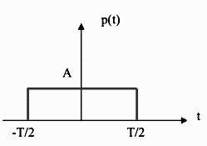
Digital Communications CTE Department -3rd stage
Example1 : Obtain the Fourier transform of rectangular pulse of duration T and amplitude A shown below: The rectangular pulse represented by:
𝑡
𝑇 𝑇
𝐴 𝑓𝑜𝑟 − ₂ < 𝑡 < ₂
𝑒𝑙𝑠𝑒𝑤ℎ𝑒𝑟𝑒
𝑟𝑒𝑐𝑡 _{𝑇} = {
0
𝑡
𝑥(𝑡) = 𝐴 𝑟𝑒𝑐𝑡 ( )
𝑇
FT for 𝑥(𝑡)
∞
𝑋(𝑓) = ∫ 𝑥(𝑡)𝑒^{−𝑗2𝜋𝑓𝑡}𝑑𝑡
−∞
𝑇 2
= ∫ 𝐴𝑒^{−𝑗2𝜋𝑓𝑡}𝑑𝑡 =
𝑇
𝐴
𝑇
_{[𝑒}−𝑗2𝜋𝑓𝑡]2 _{𝑇}
−₂
−𝑗2𝜋𝑓
−₂
𝐴
_{[𝑒}−𝑗𝜋𝑓𝑇 _{− 𝑒}𝑗𝜋𝑓𝑇 _{] =}
𝐴
𝜋𝑓
_{𝑒}−𝑗𝜋𝑓𝑇 _{− 𝑒}𝑗𝜋𝑓𝑇
=
−𝑗2𝜋𝑓
[
2𝑗
]

Slide 4
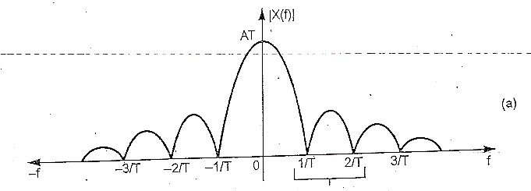
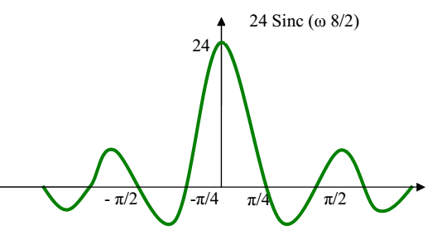
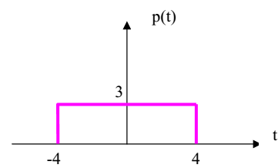
Digital Communications
CTE Department -3rd stage
𝐴
sin(𝜋𝑓𝑇)
= sin(𝜋𝑓𝑇) = 𝐴𝑇
𝜋𝑓 𝜋𝑓𝑇
∴ 𝑋(𝑓) = 𝐴𝑇𝑠𝑖𝑛𝑐(𝜋𝑓𝑇)

Slide 5
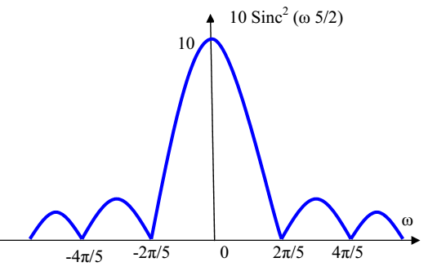
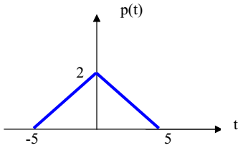
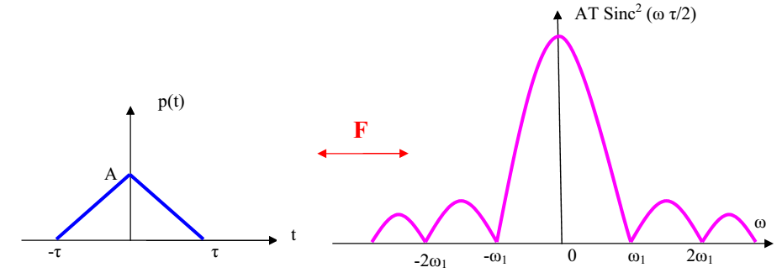
Digital Communications
CTE Department -3rd stage

Slide 6
Digital Communications
CTE Department -3rd stage
1.8 Sampling theorem:
Sampling of the signals is the fundamental operation in digital communication. A continuous time signal is first converted to discrete time signal by sampling process. Also it should be possible to recover or reconstruct the signal completely from its samples.
The sampling theorem state that:
A band limited signal of finite energy, which has no frequency components higher than W Hz, is completely described by specifying the values of the signal at instant of time separated by 1/2W second and
A band limited signal of finite energy, which has no frequency components higher than W Hz, may be completely recovered from the knowledge of its samples taken at the rate of 2W samples per second.
Proof of sampling theorem:
Let x(t) the continuous time signal shown in figure below, its band width does not contain any frequency components higher than W Hz. A sampling function samples this signal regularly at the rate of f_{S} sample per second.
Assume an analog waveform, 𝑥(𝑡) with a Fourier transform, 𝑋(𝑓), which is zero outside the interval (−𝑓_{𝑚} < 𝑓 < 𝑓_{𝑚}). The sampling of 𝑥(𝑡) can viewed as the product of 𝑥(𝑡) with periodic train of unit impulse function 𝑥_{𝛿}(𝑡) defined as

Slide 7
Digital Communications
CTE Department -3rd stage
∞
𝑥_{𝛿}(𝑡) = ∑ 𝛿(𝑡 − 𝑛𝑇_{𝑠})
𝑛=−∞
The sifting property of unit impulse state that
𝑥(𝑡)𝛿(𝑡 − 𝑡₀) = 𝑥(𝑡₀)𝛿(𝑡 − 𝑡₀)
Using this property so that:
∞
𝑥_{𝑠}(𝑡) = 𝑥(𝑡)𝑥_{𝛿}(𝑡) = ∑ 𝑥(𝑡)𝛿(𝑡 − 𝑛𝑇_{𝑠})
𝑛=−∞
∞
= ∑ 𝑥(𝑛𝑇_{𝑠})𝛿(𝑡 − 𝑛𝑇_{𝑠})
𝑛=−∞
Notice that the Fourier transform of an impulse train is another impulse train.
1
∞
𝑋_{𝛿}(𝑓) = _{𝑇} ∑ 𝛿(𝑓 − 𝑛𝑓_{𝑠})
^{𝑠} 𝑛=−∞

Slide 8
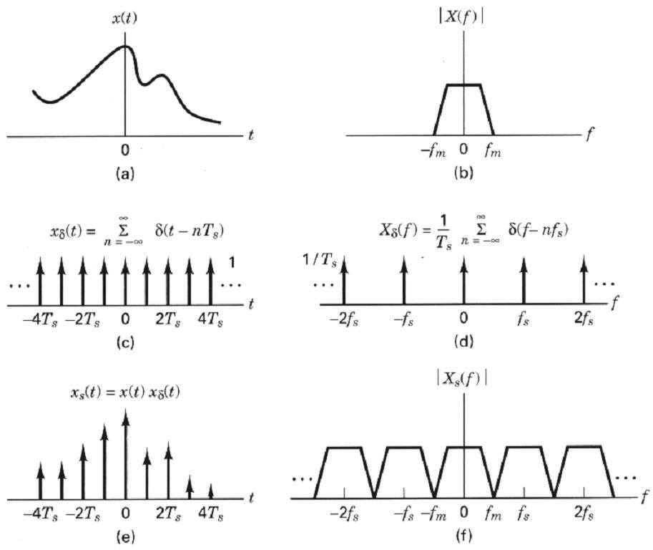
Digital Communications
CTE Department -3rd stage

Slide 9
Digital Communications CTE Department -3rd stage
Convolution with an impulse function simply shifts the original function:
𝑋(𝑓) ∗ 𝛿(𝑓 − 𝑛𝑓_{𝑠})
We can now solve for the transform 𝑋_{𝑠}(𝑓) of the sampled waveform:
𝑋(𝑓) ∗ 𝛿(𝑓 − 𝑛𝑓_{𝑠}) = 𝑋(𝑓 − 𝑛𝑓_{𝑠})
So that
∞
∑ 𝛿(𝑓 − 𝑛𝑓_{𝑠})] = _{𝑇}
∞
∑ 𝑋(𝑓 − 𝑛𝑓_{𝑠})
1
1
𝑋_{𝑠}(𝑓) = 𝑋(𝑓) ∗ 𝑋_{𝛿}(𝑓) = 𝑋(𝑓) ∗ [_{𝑇}
^{𝑠} 𝑛=−∞ ^{𝑠} 𝑛=−∞
When the sampling rate is chosen 𝑓_{𝑠} = 2𝑓_{𝑚} each spectral replicate is separated from each of its neighbors by a frequency band exactly equal to 𝑓_{𝑠} hertz, and the analog waveform ca theoretically be completely recovered from the samples, by the use of filtering. It should be clear that if 𝑓_{𝑠} > 2𝑓_{𝑚}, the replications will be move farther apart in frequency making it easier to perform the filtering operation.
When the sampling rate is reduced, such that 𝑓_{𝑠} < 2𝑓_{𝑚}, the replications will overlap, as shown in figure below, and some information will be lost. This phenomenon is called aliasing.

Slide 10
Digital Communications
CTE Department -3rd stage
Sampled spectrum 𝑓_{𝑠} > 2𝑓_{𝑚}
Sampled spectrum 𝑓_{𝑠} < 2𝑓_{𝑚}
A band limited signal having no spectral components above 𝑓_{𝑚} hertz can be determined uniquely by values sampled
1 1
at uniform intervals of 𝑇 ≤ 𝑠𝑒𝑐. The sampling rate is 𝑓 =
𝑠 𝑠
2𝑓 𝑇
𝑚 𝑠
So that 𝑓_{𝑠} ≥ 2𝑓_{𝑚}. The sampling rate 𝑓_{𝑠} = 2𝑓_{𝑚} is called Nyquist rate.

Slide 11
Digital Communications CTE Department -3rd stage
Example: Find the Nyquist rate and Nyquist interval for the following signals.
i-
_{𝑚(𝑡) =} sin(500𝜋𝑡)
𝜋𝑡
ii- 𝑚(𝑡) = ¹ cos(4000𝜋𝑡) cos(1000𝜋𝑡)
2𝜋
Solution:
i- 𝑤𝑡 = 500𝜋𝑡
∴ 2𝜋𝑓 = 500𝜋
→ 𝑓 = 250𝐻𝑧
1 1
Nyquist interval = = = 2 𝑚𝑠𝑒𝑐.
^{2𝑓}𝑚𝑎𝑥
2×250
Nyquist rate =2𝑓_{𝑚𝑎𝑥} = 2 × 250 = 500𝐻𝑧
1 1 {
(
) + cos(4000𝜋𝑡 + 1000𝜋𝑡)}]
ii- 𝑚(𝑡) = [ cos 4000𝜋𝑡 − 1000𝜋𝑡
2𝜋 2
1
= {cos(3000𝜋𝑡) + cos(5000𝜋𝑡)}
4𝜋
Then the highest frequency is 2500Hz
1 1
Nyquist interval = = = 0.2 𝑚𝑠𝑒𝑐.
^{2𝑓}𝑚𝑎𝑥
2×2500
Nyquist rate =2𝑓_{𝑚𝑎𝑥} = 2 × 2500 = 5000𝐻𝑧

Slide 12
Digital Communications
CTE Department -3rd stage
H. W:
Find the Nyquist interval and Nyquist rate for the following:
1
i- cos(400𝜋𝑡) . cos(200𝜋𝑡)
2𝜋
ii-
1
𝜋
𝑠𝑖𝑛𝜋𝑡
Example:
A waveform [20+20sin(500t+30º] is to be sampled periodically and reproduced from these sample values. Find
maximum allowable time interval between sample values, how many sample values are needed to be stored in order to reproduce 1 sec of this waveform?.
Solution:
𝑥(𝑡) = 20 + 20 sin(500𝑡 + 30⁰)
𝑤 = 500 → 2𝜋𝑓 = 500 → 𝑓 = 79.58 𝐻𝑧
Minimum sampling rate will be twice of the signal frequency:
𝑓_{𝑠(min)} = 2 × 79.58 = 159.15 𝐻𝑧
1
1
= _{159.15} = 6.283 𝑚𝑠𝑒𝑐.
^{𝑇}𝑠(𝑚𝑎𝑥) ⁼
𝑓
𝑠(min)
Number of sample in 1𝑠𝑒𝑐 =
1
= 159.16 ≈ 160 𝑠𝑎𝑚𝑝𝑙𝑒
6.283𝑚𝑠𝑒𝑐

