Slide 1
2018-2019
رهاط ةزمحلا .م : ةداملا سردم
1-
Digital Communications
CTE Department -3rd stage
Reference: Digital Communications Fundamentals and Applications,
2nd Addition, by FernardSklar
Dr. Hussam Dheaa Kamel
Al-Mustafa University Collage CTE Department 2018-2019

Slide 2
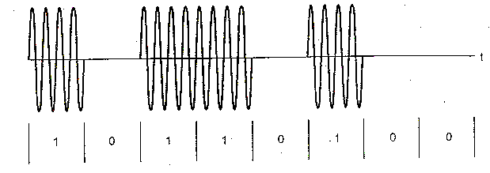
Digital Communications CTE Department -3rd stage
2- Binary Amplitude Shift Keying (BASK) or ON- OFF keying (OOK):
ASK or OOK is the simplest digital modulation technique. The ASK waveform can be represented as:
𝑠(𝑡) = √2𝑃_{𝑠} cos(2𝜋𝑓₀𝑡) to transmit symbol "1", and pulse is transmitted. To transmit symbol "0" 𝑠(𝑡) = 0, that is no signal transmitted for such symbol. Thus ASK waveform looks like an ON-OFF of the signal as shown in figure 10.
Figure 10 The ASK wave form for symbol "1" can be represented as:
𝑠(𝑡) = √𝑃_{𝑠}𝑇_{𝑏}. √2/𝑇_{𝑏} cos(2𝜋𝑓₀𝑡)
= √𝑃_{𝑠}𝑇_{𝑏}∅₁(𝑡)
2

Slide 3
Digital Communications
CTE Department -3rd stage
Thus there is only one carrier function ∅₁(𝑡). If we take ∅₁(𝑡) = √2/𝑇_{𝑏} cos(2𝜋𝑓₀𝑡) as the orthonormal basis
function. The signal space diagram will have two points on ∅₁(𝑡). One will be at zero and other will be at √𝑃_{𝑠}𝑇_{𝑏}. As shown in Fig.11:
Figure 11 Therefore the distance between the two signal points will be,
𝑑 = √𝑃_{𝑠}𝑇_{𝑏} = √𝐸_{𝑏}
3-1 Generation of BASK:
Fig. 12 shows BASK generator. The input binary sequence is applied to the product modulator. The modulator passes the carrier when the input bits is "1", and block the carrier (zero output) when input bit is "0".
Binary Input s(t)
Product Modulator
Binary ASK signal s(t)
𝐶𝑎𝑟𝑟𝑖𝑒𝑟
√2𝑃_{𝑠} cos(2𝜋𝑓₀𝑡)
3

Slide 4
Digital Communications
CTE Department -3rd stage
Figure 12
The bandwidth of ASK is
𝐵𝑊 = 𝑅(1 + 𝑟)
Where R is the bit rate and 0 < 𝑟 < 1 is related to how signal is filtered.
3-2 ASK Detector:
The ASK signal is applied to the correlator consisting of multiplier and integrator. The locally generated coherent carrier and applied to multiplier as shown in Fig. 13.
Figure 13

Slide 5
Digital Communications CTE Department -3rd stage
The output of multiplier is integrated over the bit period. The decision device takes the decision at the end of every bit period. It compare the output of integrator with the threshold.
3- Differential Phase Shift Keying (DPSK):
DPSK is differentially coherent modulation method. It does not need synchronous (coherent) carrier at the
demodulator. The input sequence of binary bits is modified such that the next bit depends upon the previous bit. Therefore in the receiver the previous received bits are used to detect the present bit.
4-1 Generator of DPSK:
The input sequence d(t), the output sequence is b(t) and 𝑏(𝑡 − 𝑇_{𝑏}) is the previous output delayed by one bit period.
Depending upon values of d(t) and 𝑏(𝑡 − 𝑇_{𝑏}), exclusive OR gate generates the output sequence b(t) as shown in Fig. 14.
Figure 14: DPSK generator

Slide 6
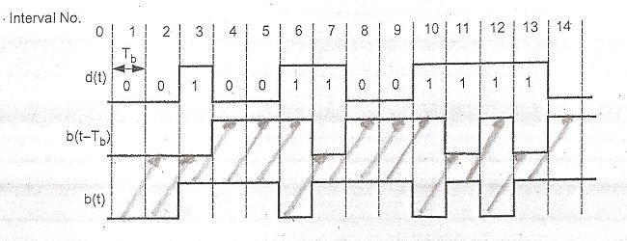
Digital Communications CTE Department -3rd stage
The truth table of exclusive OR gate is used to derive the level of waveforms shown in Fig. 15, which satisfied in any interval b(t) is given as,
𝑏(𝑡) = 𝑑(𝑡) ○ 𝑏(𝑡 − 𝑇_{𝑏})
Figure 15: DPSK waveform
Note that the output sequence b(t) changes level at the beginning of each interval in which d(t)=1 and does not change level when d(t)=0, so that symbol duration (T)= duration of two bits 2𝑇_{𝑏}. The sequence b(t) is applied to the balanced modulator as shown in Fig. 14 with carrier √2𝑃cos(2𝜋𝑓₀𝑡), the modulator output is:
𝑠(𝑡) = 𝑏(𝑡)√2𝑃 cos(2𝜋𝑓₀𝑡)
= ±√2𝑃 cos(2𝜋𝑓₀𝑡)
As shown in in Fig.15 the phase changes only when d(t)=1.

Slide 7
Digital Communications
CTE Department -3rd stage
4-2 DPSK Receiver:
During the transmission, the DPSK signal undergoes some phase shift 𝜃. Therefore the signal received at the input of receiver is
Received signal 𝑦(𝑡) = 𝑏(𝑡)√2𝑃 cos(2𝜋𝑓₀𝑡 + 𝜃)
The signal is multiplied with delayed version by one bit:
Multiplier output= 𝑏(𝑡)𝑏(𝑡 − 𝑇_{𝑏})(2𝑝) cos(2𝜋𝑓₀𝑡 + 𝜃) cos(2𝜋𝑓₀(𝑡 − 𝑇_{𝑏}) + 𝜃)
Figure 16a: QPSK receiver
This signal is fed to integrator and to the decision device. The integrator and decision is controlled by bit synchronizer to get the output binary sequence. The block diagram of such system is shown in Fig.16a, and the equivalent of this
system is shown in Fig.16b.

Slide 8
Digital Communications
CTE Department -3rd stage
4-3 Bandwidth of DPSK:
We know that one previous bit is used to decide the phase shift of next bit. Change in b(t) occurs only if input bitt is at level '1'. No change occurs if input bit is at level '0'. Since one previous bit is always used to define the phase in next bit, the symbol can be said to have two bits. Therefore one symbol duration (T) is equivalent to two bits duration (2𝑇_{𝑏}), so that
Symbol duration 𝑇 = 2𝑇_{𝑏}
Bandwidth is given as, 𝐵𝑊 = _{𝑇} = _{𝑇𝑏}
2 1
Or 𝐵𝑊 = 𝑓_{𝑏}
4-4 Advantages and disadvantages of DPSK:
Advantages:
1- DPSK does not need carrier at its receiver. Hence it is simple than BPSK.

Slide 9
Digital Communications CTE Department -3rd stage
2- The bandwidth required of DPSK is reduced compared to that of BPSK.
Disadvantages:
The probability of bit error rate of DPSK is higher than BPSK.
Error in the first bit creates error in the second bit. Hence error propagation in DPSK is more, while in PSK each bit is independent.
Noise interference in DPSK is more.
Quadrature Phase Shift Keying (QPSK):
There are two important points in communication system, transmission power and channel bandwidth. The channel
bandwidth depends upon the bit rate or signaling rate 𝑓_{𝑏}. The carrier is used as bandpass transmission over a channel. If two or more bits are combined in some symbol instead of one bit, then the signaling rate is reduced and the transmission channel bandwidth is reduced. In quadrature shift keying, two successive bits in the data sequence are grouped together.
In BPSK the phase shift occurs in two level only, the carrier is change by 180⁰. In QPSK the combination of two bits
form four distinct symbols, so that the change of carrier phase is 45⁰ (^{𝜋} 𝑟𝑎𝑑𝑖𝑎𝑛𝑠) from one symbol to the next one.
4
Table 1: Symbol and corresponding phase shift in QPSK
Sr. No. | Input successive bits | Symbol | Phase shift in carrier
𝑖 = 1 | 1(1𝑉) 0(−1𝑉) | 𝑆₁ | 𝜋/4
𝑖 = 2 | 0(−1𝑉) 0(−1𝑉) | 𝑆₂ | 3𝜋/4

Slide 10
Digital Communications
CTE Department -3rd stage
𝑖 = 3 | 0(−1𝑉) | 1(1𝑉) | 𝑆₃ | 5𝜋/4
𝑖 = 4 | 1(1𝑉) | 1(1𝑉) | 𝑆₄ | 7𝜋/4
QPSK generator:
There are two type of QPSK:
Offset QPSK (OQPSK):
Fig. 17 shows the block diagram of OQPSK generator. The input signal is converted to NRZ and called b(t), the demultiplexer divides b(t) into separated bit streams of odd numbered and even numbered.

Slide 11
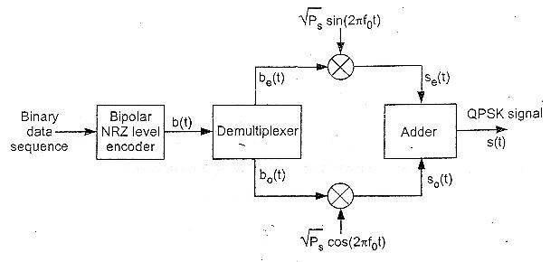
Digital Communications
CTE Department -3rd stage
Figure 17: OQPSK generator
The symbol duration of both 𝑏_{𝑜}(𝑡)and 𝑏_{𝑒}(𝑡) are 2𝑇_{𝑏} as shown in Fig. 18. Note that the first symbol of 𝑏_{𝑜}(𝑡) is delayed by one bit period with respect to symbol of 𝑏_{𝑒}(𝑡). This delay of 𝑇_{𝑏}is called offset so that the change in level cannot occur in the
same time. Each 𝑏_{𝑒}(𝑡) and 𝑏₀(𝑡) are modulate a carrier √2𝑝_{𝑠}sin(2𝜋𝑓₀𝑡) and √2𝑝_{𝑠}cos(2𝜋𝑓₀𝑡) respectivlly.

Slide 12
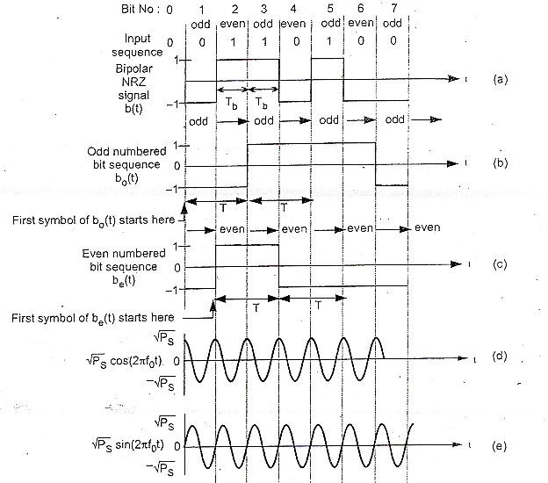
Digital Communications
CTE Department -3rd stage

Slide 13
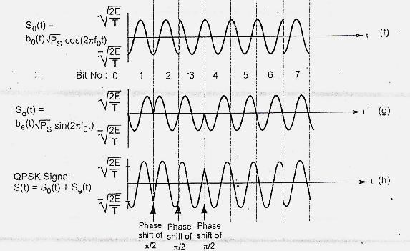
Digital Communications
CTE Department -3rd stage
𝑠_{𝑒}(𝑡) = 𝑏_{𝑒}(𝑡) √2𝑝_{𝑠}sin(2𝜋𝑓₀𝑡)
𝑠₀(𝑡) = 𝑏₀(𝑡) √2𝑝_{𝑠}sin(2𝜋𝑓₀𝑡)
Thus 𝑠_{𝑒}(𝑡)and 𝑠₀(𝑡) are basically BPSK signals but 𝑇 = 2𝑇_{𝑏}. The output of adder is OQPSK, given as:
𝑠(𝑡) = 𝑠_{𝑒}(𝑡) + 𝑠₀(𝑡)

Slide 14
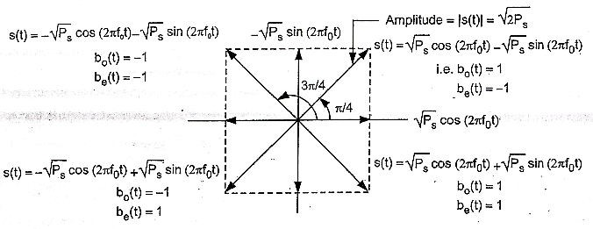
Digital Communications
CTE Department -3rd stage
=𝑏_{𝑒}(𝑡)√2𝑝_{𝑠} sin(2𝜋𝑓₀𝑡) + 𝑏₀(𝑡) √2𝑝_{𝑠}cos(2𝜋𝑓₀𝑡)
Fig.19 shows the phasor diagram of QPSK signal of above equation.
Figure 19: Phasor diagram of QPSK signal

Slide 15
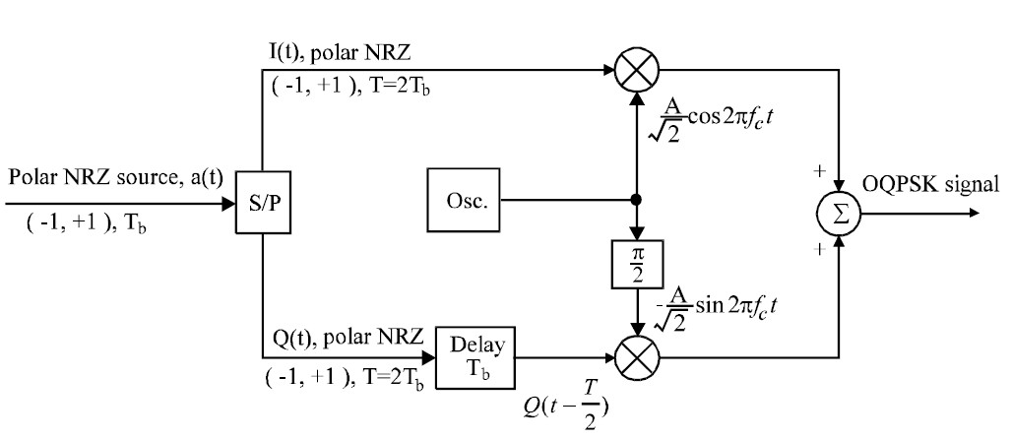
Digital Communications
CTE Department -3rd stage
Offset QPSK is essentially the same as QPSK except that the I- and Q-channel pulse trains are staggered. The modulator and the demodulator of OQPSK are shown in Figure 20, which differs from the QPSK only by an extra delay of T/2 seconds in the Q-channel. Its power spectral density is the same as that of QPSK, and its error performance is also the same as that of QPSK.
Fig. 21: OQPSK modulator

Slide 16
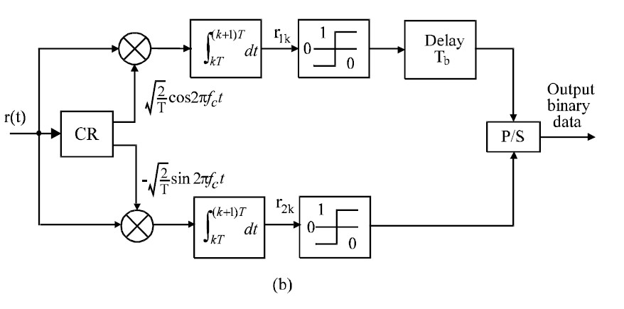
Digital Communications
CTE Department -3rd stage
Fig. 21: OQPSK demodulator

