Slide 1


2018-2019
رهاط ةزمحلا .م : ةداملا سردم
Digital Communications
CTE Department -3rd stage
Reference: Digital Communications Fundamentals and Applications,
2nd Addition, by FernardSklar
Dr. Hussam Dheaa Kamel
Al-Mustafa University Collage CTE Department 2018-2019

Slide 2
Digital Communications
CTE Department -3rd stage
Chapter One
  Introduction:
Digital communication systems are becoming increasingly attractive because of the ever-growing demand for data communication and because digital transmission offers data processing options and flexibilities not available with analog transmission. The principal feature of a digital communication system (DCS) is that during a finite interval of time, it sends a waveform from a finite set of possible waveforms, in contrast to an analog communication system, which sends a waveform from an infinite variety of waveform shapes with theoretically infinite resolution. In a DCS, the objective at the receiver is not to reproduce a transmitted waveform with precision; instead, the objective is to determine from a noise-perturbed signal which waveform from the finite set of waveforms was sent by the transmitter. An important measure of system performance in a DCS is the probability of error (PE).
  Advantages of Digital Communication:
There are many reasons. The primary advantage is the ease with which digital signals, compared with analog signals, are regenerated. Figure 1 illustrates an ideal binary digital pulse propagating along a transmission line.

Slide 3
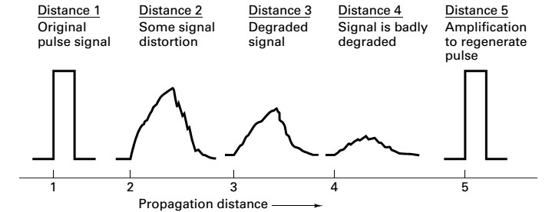
Digital Communications
CTE Department -3rd stage
During the time that the transmitted pulse can still be reliably identified (before it is degraded to an ambiguous state), the pulse is amplified by a digital amplifier that recovers its original ideal shape. The pulse is thus “reborn” or regenerated. Circuits that perform this function at regular intervals along a transmission system are called regenerative repeaters.
Digital circuits are less subject to distortion and interference than are analog circuits. Because binary digital circuits operate in one of two states—fully on or fully off—to be meaningful, a disturbance must be large enough to change the circuit operating point from one state to the other.
With digital techniques, extremely low error rates producing high signal fidelity are possible through error detection and correction but similar procedures are not available with analog.
Security is another priority of messaging services in modern days. Digital communication provides better security to messages than the analog communication. It can be achieved through various coding techniques available in digital communication.

Slide 4
Digital Communications CTE Department -3rd stage
Digital circuits are more reliable and can be produced at a lower cost than analog circuits. Also, digital hardware lends itself to more flexible implementation than analog hardware.
  Disadvantages of Digital Communications:
Digital communications require greater bandwidth than analogue to transmit the same information.
The detection of digital signals requires the communications system to be synchronized, whereas generally speaking this is not the case with analogue systems.
The noise of sampling error.
When the signal-to-noise ratio drops below a certain threshold, the quality of service can change suddenly from very good to
very poor. In contrast, most analog communication systems degrade more gracefully.
  Typical Block Diagram and Transformations
The functional block diagram is shown in Fig.2.The upper blocks—format, source encode, encrypt, channel encode, multiplex, pulse modulate, bandpass modulate, frequency spread, and multiple access—denote signal transformations from the source to the transmitter (XMT). The lower blocks denote signal transformations from the receiver (RCV) to the sink, essentially reversing the signal processing steps performed by the upper blocks. The modulate and demodulate/detectblocks together are called a modem.

Slide 5
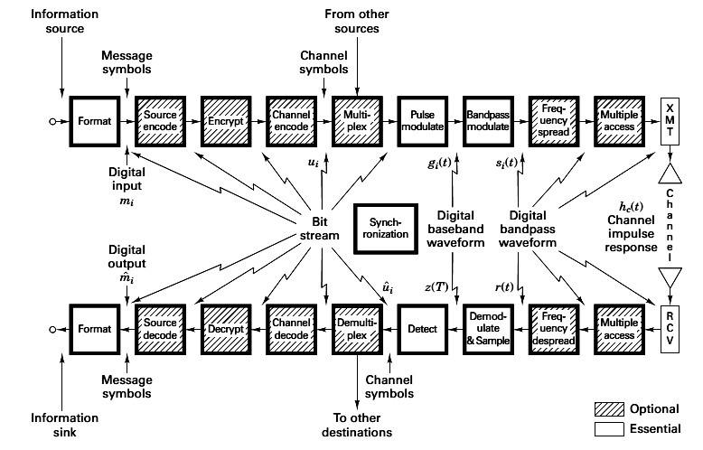
Digital Communications
CTE Department -3rd stage
Figure 2 Block diagram of a typical digital communication system.
Information source. This is the device producing information to be communicated by means of the DCS. Information sources can be analog or discrete. Analog information sources can be transformed into digital sources through the use of sampling and quantization. Sampling and quantization techniques called formatting and source coding.
Binary digit (bit).This is the fundamental information unit for all digital systems. The term bit also is used as a unit of information content.

Slide 6
Digital Communications CTE Department -3rd stage
Bit stream. This is a sequence of binary digits (ones and zeros). A bit stream is often termed a baseband signal, which implies that its spectral content extends from (or near) dc up to some finite value, usually less than a few megahertz.
Symbol (digital message).A symbol is a group of kbits considered as a unit. We refer to this unit as a message symbol mi(i=1,
. . . , M) from a finite symbol set or alphabet. The size of the alphabet,𝑀, 𝑖𝑠 𝑀 = 2^{𝑘},where kis the number of bits in the symbol. For baseband transmission, each mi symbol will be represented by one of a set of baseband pulse waveforms𝑔₁(𝑡), 𝑔₂(𝑡), … … 𝑔_{𝑀}(𝑡). When transmitting a sequence of such pulses, the unitbaudis sometimes used to express pulse rate (symbol rate). For typical bandpass transmission, each 𝑔_{𝑖}(𝑡) pulse will then be represented by one of a set of bandpass waveform 𝑠(𝑡), 𝑠₂(𝑡), … … 𝑠_{𝑀}(𝑡).
Digital waveform. This is a voltage or current waveform (a pulse for baseband transmission, or a sinusoid for bandpass transmission) that represents a digital symbol.
1
Data rate. This quantity in bits per second (bits/s) is given by 𝑅 = ^{𝐾} = ( ) 𝑙𝑜𝑔 𝑀𝑏𝑖𝑡𝑠/𝑠, where k-bits identify a symbol
𝑇 𝑇
2
from an 𝑀 = 2^{𝑘}-symbol alphabet, and T is the k-bit symbol duration.

Slide 7
Digital Communications
CTE Department -3rd stage
  Classification of Signals:
    Deterministic and Random Signals: Deterministic signals or waveforms are modeled by explicit mathematical expressions, such as x(t) =5 cos 10t. For a random waveform it is not possible to write such an explicit expression. However, when examined over a long period, a random waveform, also referred to as a random process, may exhibit certain regularities that can be described in terms of probabilities and statistical averages.
    Periodic and Nonperiodic Signals: A signal x(t) is called periodic in time if there exists a constant T0>0 such that
𝑥(𝑡) = 𝑥(𝑡 + 𝑇₀) 𝑓𝑜𝑟 − ∞ < 𝑡 < ∞
where t denotes time. The smallest value of T0 that satisfies this condition is called the period of x(t). The period T0 defines the duration of one complete cycle of x(t).A signal for which there is no value of T0 that satisfies above Equation is called anonperiodic signal.
    Analog and Discrete Signals: An analog signal x(t) is a continuous function of time; that is, x(t) is uniquely defined
for all t. An electrical analog signal arises when a physical waveform (e.g., speech) is converted into an electrical signal by means of a transducer. By comparison, a discrete signal x(kT) is one that exists only at discrete times; it is characterized by a sequence of numbers defined for each time, kT, where k is an integer and T is a fixed time interval.
    Energy and Power Signals: An electrical signal can be represented as a voltage v(t) or a current i(t) with instantaneous power p(t) across a resistor R defined by
𝑃(𝑡) = ^{𝑣2(𝑡)}⁄
𝑅
or
𝑃(𝑡) = 𝑖²(𝑡)𝑅

Slide 8
Digital Communications CTE Department -3rd stage
In communication systems, power is often normalized by assuming R to be 1Ω, although R may be another value in the actual circuit. Therefore, regardless of whether the signal is a voltage or current waveform, the normalization convention allows us to express the instantaneous power as
𝑃(𝑡) = 𝑥²(𝑡)
The energy dissipated during the time interval (−T/2, T/2)
𝑇 2
𝐸^{𝑇} = ∫ 𝑥²(𝑡) 𝑑𝑡
𝑥
𝑇
−₂
and the average power dissipated by the signal during the interval is
𝑇 2
𝑇
1 1
𝑇 2
𝑃 = 𝐸 = ∫ 𝑥 (𝑡) 𝑑𝑡
𝑥
𝑥
𝑇 𝑇
₋𝑇
2
5- The Unit Impulse Function: A useful function in communication theory is the unit impulse or Dirac delta function
𝛿(t).The impulse function is an abstraction—an infinitely large amplitude pulse, with zero pulse width, and unity weight (area under the pulse), concentrated at the point where its argument is zero. The unit impulse is characterized by the following relationships:
∞
∫ 𝛿²(𝑡) 𝑑𝑡 = 1
−∞
𝛿(𝑡) = 0 𝑓𝑜𝑟 𝑡 ≠ 0
𝛿(𝑡) is unbounded at t=0

Slide 9
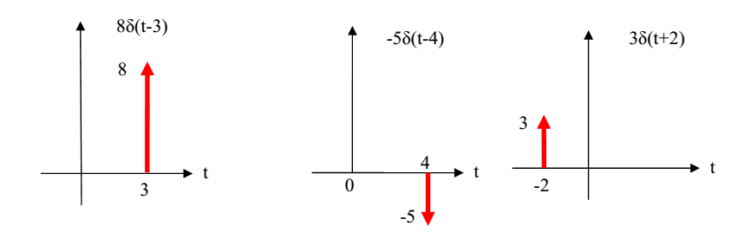
Digital Communications
CTE Department -3rd stage
∞
∫ 𝑥(𝑡)𝛿(𝑡 − 𝑡₀) 𝑑𝑡 = 𝑥(𝑡₀)
−∞
+∞
𝑃(𝑡) = ∑ 𝑎𝛿(𝑡 − 𝑛𝑇_{𝑠})
𝑛=−∞

Slide 10
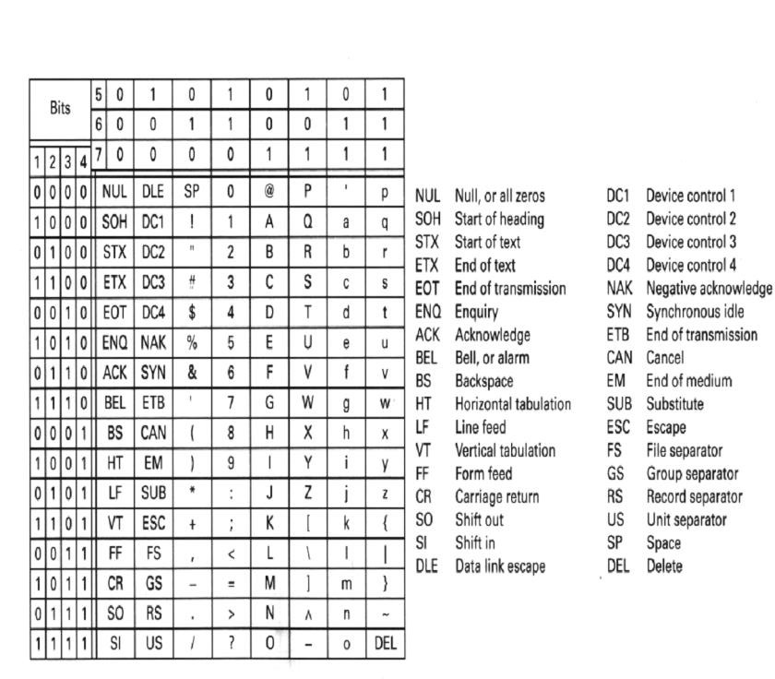
Digital Communications CTE Department -3rd stage
1.6 Digital Coding:
If the data consist of alphanumeric text, they will be character encoded with one of several standard formats; examples include the American Standard Code for Information Interchange (ASCII).
The textual message is word “THINK” using 6-bit ASCII character coding yeldes a bit stream comprising 30 bits. The symbol set size, M, has been chosen to be 8 (each symbol represents an 8- ary digit). The bits are therfore partitioned into groups of three (𝑘 = log₂ 8). The transmitter must have a repertoire of eight waveforms 𝑆_{𝑖}(𝑡), 𝑤ℎ𝑒𝑟𝑒 𝑖 = 1, … . . , 8. to represent the possible symbols, any one of which may be transmitted during a symbol time.

Slide 11
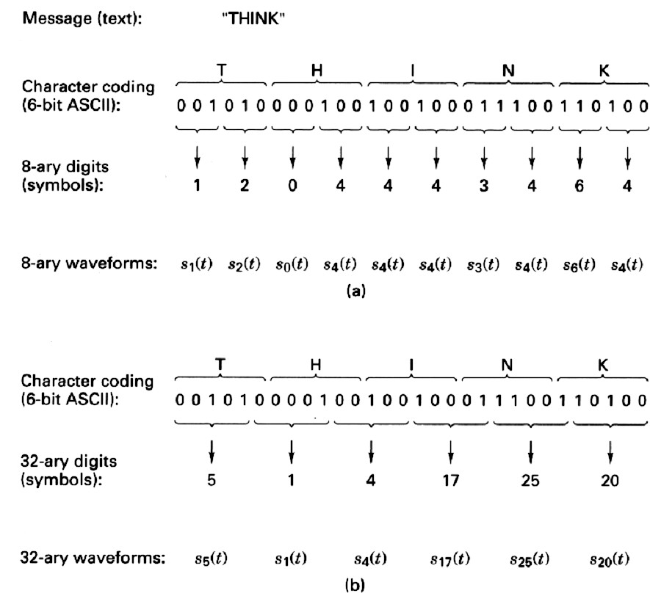
Digital Communications
CTE Department -3rd stage

