Slide 1


Engineering Analysis
المرحلة الثالثة
Assit.Lec. Shaimaa Shukri

Slide 2
Fourth lecture

Slide 3
Inverse z-Transform
The inverse z-transform can be derived by using Cauchy’s integral theorem. Start with the z-transform
Multiply both sides by z^{k-1} and integrate with a contour integral for which the contour of integration encloses the origin and lies entirely within the region of convergence of X(z):

Slide 4
Z-Transform/Inverse Z-Transform
u (k)=0.7^{k}
LTI: y_{impuse}(k)=0.3^{k-1}
y (k)?
*
(convolution)
=
Z⁻¹
Z
Transfer Function
Z
·
(multiplication)
=

Slide 5
Inverse Z-Transform
u(k)
Z
U(z)
Z⁻¹?
Table Lookup – if the Z-Transform looks familiar, look it up in the Z-Transform table!
Long Division
Partial Fraction Expansion
Z⁻¹?

Slide 6
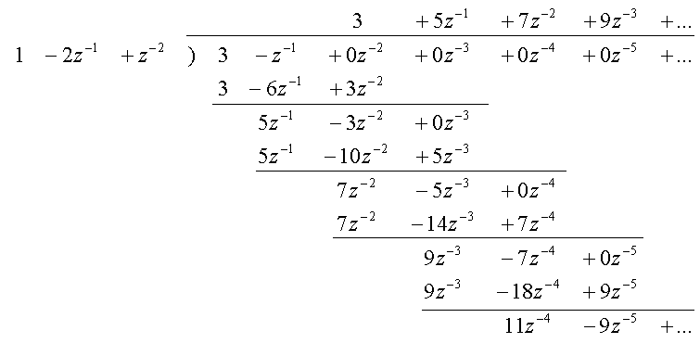
Long Division
Sort both nominator and denominator with descending order of z first
u(0)=3, u(1)=5, u(2)=7, u(3)=9, …, guess: u(k)=3u_{step}(k)+2u_{ramp}(k)

Slide 7
Partial Fraction Expansion
Many Z-transforms of interest can be expressed as division of polynomials of z
May be trickier:
complex root
duplicate root
where
k>0

Slide 8
Real Unique Poles

Slide 9
Repeat Real Poles(1)

Slide 10
Repeat Real Poles(2)

Slide 11
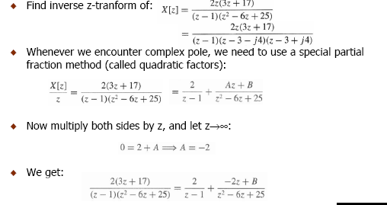
Complex Poles(1)

Slide 12
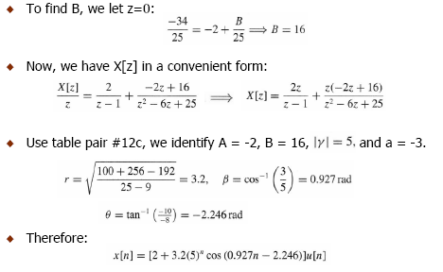
Complex Poles(2)

Slide 13
An Example
(z-2)(z-4)
Z⁻¹
U₁(z)=c₀
u₁(k)=c₀*u_{impulse}(k)
Z⁻¹
u₂(k)=c₁*2^{k-1}, k>0
Z⁻¹
u₂(k)=c₂*4^{k-1}, k>0
c₀? c₁? c₂?

Slide 14
Get The Constants!
(z-2)(z-4)

Slide 15
Partial Fraction Expansion – cont’d
How to get c₀ and c_{j}’s ?
define

Slide 16
An Example – Complete Solution

