Slide 1
Electronic branch
Fourth Class
Interface Circuits Design
Real Time System
Asst. Lec. Lubna A. Alnabi

Slide 2
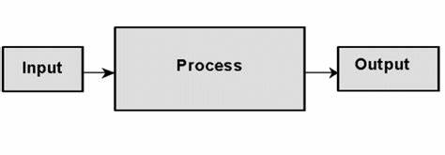
Real Time System
It is one in which the correctness of the system depends not only on the logical result of computation, but also on the time which the results are generated.
A real-time system is one whose logical correctness is based on both the correctness of the outputs and their timeliness.
A system is a mapping of a set of inputs into a set of outputs.

Slide 3
Terms Associated with RTS
Tasks
Periodic
Time-driven. Characteristics are known a priori.
E.g.: Task monitoring temperature of a patient in an ICU.
Aperiodic Event-driven. Characteristics are not known a priori.
E.g.: Task activated upon detecting change in patient’s condition.
Release time of a job: the time instant the task becomes ready to execute.
Deadline of a job: the time instant by which the task must complete execution.
Relative deadline of a job: Deadline - Release time.
Response time of a job: Completion time - Release time.

Slide 4
Types of RTS
Hard System
Soft System
Firm System

Slide 5
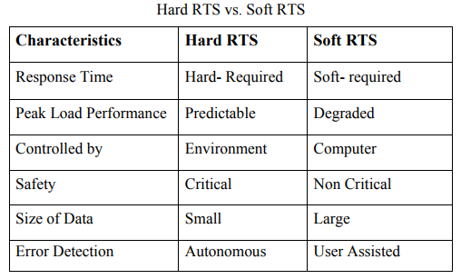
Comparison between hard and soft system

Slide 6
Data and Signal
Data – information formatted in human/machine readable form.
Signal – electric or electromagnetic representation of data.

Slide 7
Data and Signal

Slide 8
Analog vs. Digital Data
• Analog data – representation variable takes on continuous values, e.g. voice, temperature, etc.
• Digital data – representation variable takes on discrete values, e.g. text, digitized images, etc.
Analog signal – signal that is continuous in time and can provide an infinite number of values in a given range (continuous in time and value).

Slide 9
Analog vs. Digital Data

Slide 10
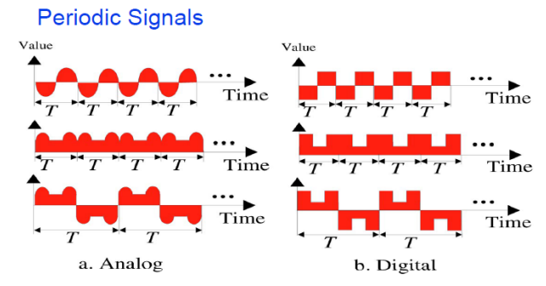
Periodic Signals

Slide 11
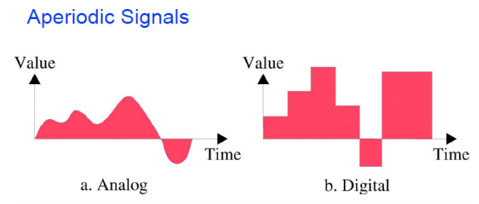
Aperiodic Signals

Slide 12
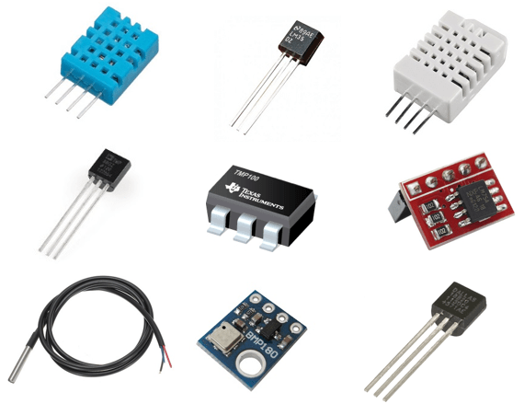
Sensors and Transducers
A sensor is a device that detects and responds to some type of input from the physical environment.

Slide 13
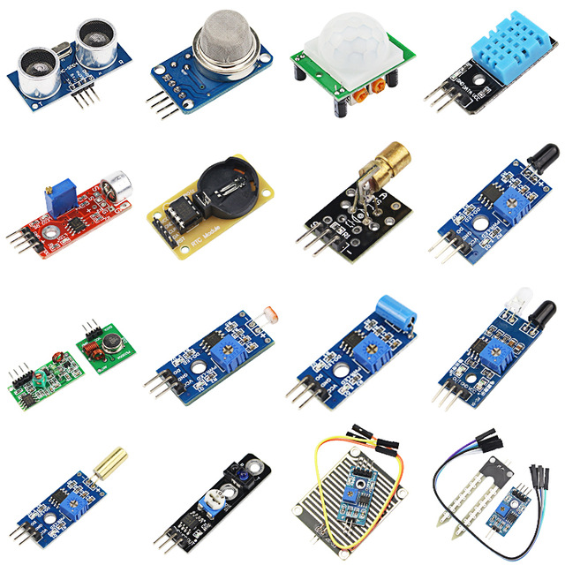
What are some quantities that can be sensed?
Motion,
position,
displacement.
Velocity and acceleration.
Force, strain.
Pressure.
Flow.
Sound.
Moisture.
Light. Radiation.
Temperature.
Chemical presence.

Slide 14
A transducer
A transducer is a device that converts one form of energy to another

Slide 15
Block Diagram of Transducers

Slide 16
Classification of transducers
Based on principle of transduction.
• Thermo electric.
• Magneto resistive.
• Electro kinetic
. • Optical.
2. Active & passive.
3. Analog & digital.
4. Inverse transducer.

Slide 17
Comparison between active and passive transducer
Active transducers:
• These transducers do not need any external source of power for their operation. Therefore they are also called as self-generating type transducers.
• The active transducers are self-generating devices which operate under the energy conversion principle.
• As the output of active transducers we get an equivalent electrical output signal e.g. temperature or strain to electric potential, without any external source of energy being used.
• E.g. Piezoelectric used for acceleration measurement.
Passive Transducers:
• These transducers need external source of power for their operation. So they are not self-generating type transducers.
• A DC power supply or an audio frequency generator is used as an external power source.
• These transducers produce the output signal in the form of variation in resistance, capacitance, inductance or some other electrical parameter in response to the quantity to be measured.
• E.g. Resistive, inductive, capacitive without power they will not work.

