Slide 1
Electronic branch
Fourth Class
Interface Circuits Design
Digital to Analog Converters
Asst. Lec. Lubna A. Alnabi

Slide 2
Digital to Analog Converters
What is the D/A? why is it needed? Do we always need it?
(DAC) converts a digital signal or values to an analog voltage or current output.

Slide 3
Derive the equation for Vout for a binary weighted resister with Rf=R/2.
$$V_{out}=−I R_{f}$$
$$= −R_{f }\left(\frac{V_{1}}{R}+\frac{V_{2}}{2R}+\frac{V_{3}}{4R}+…\frac{V_{n}}{2^{n−1}R}\right)$$
IF $R_{f}=R/2$
${ V}_{out}=−\left(\frac{V_{1}}{2}+\frac{V_{2}}{4}+\frac{V_{3}}{8}+…\frac{V_{n}}{2^{n}}\right)$
For example, a 4-Bit converter yield
${ V}_{out}= −{ V}_{ref}({ b}_{3}\frac{1}{2}+{ b}_{2}\frac{1}{4}+{ b}_{1}\frac{1}{8}{+b}_{0}\frac{1}{16})$
Where b corresponds to Bit-3, b to Bit-2, etc.

Slide 4
Derive the equation for Vout for a binary weighted resister with Rf=R/3. Draw the block-diagram of a binary-weighted resistor cct.
$$V_{out}=−I R_{f}$$
$$= −R_{f }\left(\frac{V_{1}}{R}+\frac{V_{2}}{2R}+\frac{V_{3}}{4R}+…\frac{V_{n}}{2^{n−1}R}\right)$$
IF $R_{f}=\frac{R}{3}$
${ V}_{out}=−\left(\frac{V_{1}}{3}+\frac{V_{2}}{6}+\frac{V_{3}}{12}+…\frac{V_{n}}{2^{n}}\right)$
For example, a 4-Bit converter yield
${ V}_{out}= −{ V}_{ref}({ b}_{3}\frac{1}{3}+{ b}_{2}\frac{1}{6}+{ b}_{1}\frac{1}{12}{+b}_{0}\frac{1}{24})$
Where b corresponds to Bit-3, b to Bit-2, etc.

Slide 5
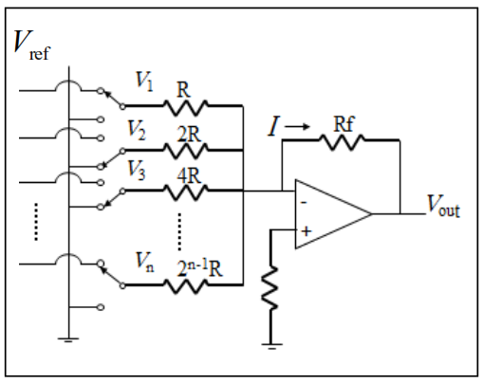

Slide 6
Derive the equation for Vout for a binary weighted resister with Rf=R/6.
$$V_{out}=−I R_{f}$$
$$= −R_{f }\left(\frac{V_{1}}{R}+\frac{V_{2}}{2R}+\frac{V_{3}}{4R}+…\frac{V_{n}}{2^{n−1}R}\right)$$
IF $R_{f}=\frac{R}{6}$
${ V}_{out}=−\left(\frac{V_{1}}{6}+\frac{V_{2}}{12}+\frac{V_{3}}{24}+…\frac{V_{n}}{2^{n}}\right)$
For example, a 4-Bit converter yield
${ V}_{out}= −{ V}_{ref}({ b}_{3}\frac{1}{6}+{ b}_{2}\frac{1}{12}+{ b}_{1}\frac{1}{24}{+b}_{0}\frac{1}{42})$
Where b corresponds to Bit-3, b to Bit-2, etc.

Slide 7
Find Vout for a binary weighted resistor D/A with Vref=5 Volts, and codeword = 101111
For a 6-Bit converter yield
${ V}_{out}= −{ V}_{ref}\left({{ b}_{5}\frac{1}{2}+{ b}_{4}\frac{1}{4}+b}_{3}\frac{1}{8}+{ b}_{2}\frac{1}{16}+{ b}_{1}\frac{1}{32}{+b}_{0}\frac{1}{64}\right)$
${ V}_{out}=−5\left({1∗\frac{1}{2}+0∗\frac{1}{4}+1}_{∗}\frac{1}{8}+1∗\frac{1}{16}+1∗\frac{1}{32}+1 ∗\frac{1}{64}\right)$= -3.6718

Slide 8
Find Vout for a binary weighted resistor D/A with Vref=3.3 Volts, and codeword = 101101
For a 6-Bit converter yield
${ V}_{out}= −{ V}_{ref}\left({{ b}_{5}\frac{1}{2}+{ b}_{4}\frac{1}{4}+b}_{3}\frac{1}{8}+{ b}_{2}\frac{1}{16}+{ b}_{1}\frac{1}{32}{+b}_{0}\frac{1}{64}\right)$
${ V}_{out}=−3.3\left({1∗\frac{1}{2}+0∗\frac{1}{4}+1}_{∗}\frac{1}{8}+1∗\frac{1}{16}+0∗\frac{1}{32}+1 ∗\frac{1}{64}\right)$=-2,3203

Slide 9
Derive the equation of Vout in a R-2R ladder D/A, draw the cct and the minimizations and show the equivalent resistors and voltage markings as well.
$$R_{eq }=\frac{2R∗2R}{2R+2R}=R$$
$V_{3 }=\frac{R}{R+R}V_{2 }=\frac{1}{2} V_{2 }$
$${ V}_{2 }=\frac{1}{2} V_{1 }$$
$$V_{1 }=\frac{1}{2} V_{ref }$$
$$V_{3 }=\frac{1}{2} \left(\frac{1}{2} V_{1 }\right)=\frac{1}{2} \left(\frac{1}{2} (\frac{1}{2} V_{ref })\right)=\frac{1}{8} V_{ref }$$
$$V_{2 }=\frac{1}{4} V_{ref }$$
$$V_{1 }=\frac{1}{2} V_{ref }$$

Slide 10
$$V_{out =−IR}$$
$${ V}_{out}= −R\left({{ b}_{3}\frac{{ V}_{ref}}{2R}+{ b}_{2}\frac{{ V}_{ref}}{4R}+{ b}_{1}\frac{{ V}_{ref}}{8R}+{ b}_{0}\frac{{ V}_{ref}}{16R}}_{}\right)$$
Where b corresponds to Bit-3, b to Bit-2, etc.
For a 4-Bit R-2R Ladder
$${ V}_{out}= −{ V}_{ref}\left({{ b}_{3}\frac{1}{2}+{ b}_{2}\frac{1}{4}+{ b}_{1}\frac{1}{8}+{ b}_{0}\frac{1}{16}}_{}\right)$$
For general n-Bit R-2R Ladder or Binary Weighted Resister DAC
$${\begin{aligned} \\ V\end{aligned}}_{out}= −{ V}_{ref}\left(\text{∑}b{\frac{1}{2}}_{}\right)$$

Slide 11
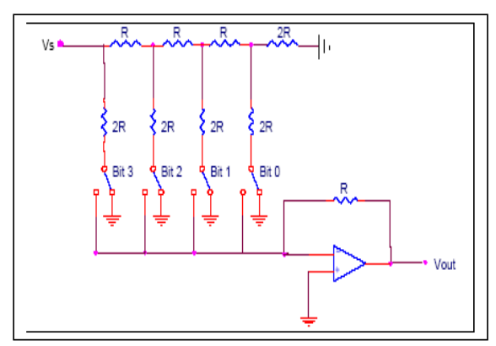

Slide 12
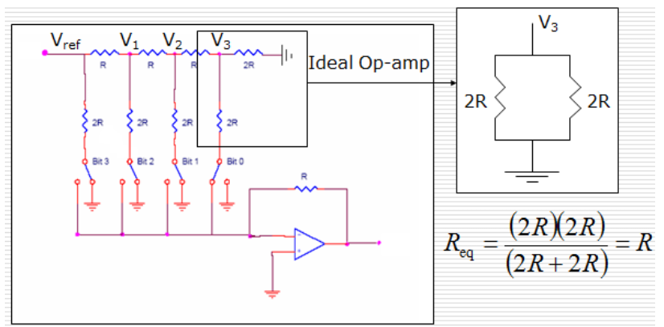

Slide 13
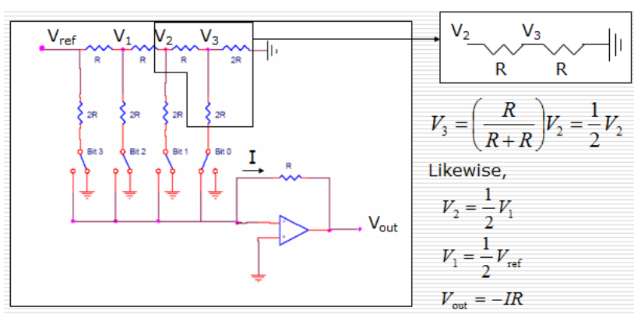

Slide 14
Find Vout for an R-2R ladder D/A with Vref=3.3 Volts, and codeword = 101101
$${ V}_{out}=−{ V}_{ref}\left({{ b}_{5}\frac{1}{2}+{ b}_{4}\frac{1}{4}+{ b}_{3}\frac{1}{8}+{ b}_{2}\frac{1}{16}+{ b}_{1}\frac{1}{32}+{ b}_{0}\frac{1}{64}}_{}\right)$$
${ V}_{out}=−3.3\left({1∗\frac{1}{2}+0∗\frac{1}{4}+1∗\frac{1}{8}+1∗\frac{1}{16}+0∗\frac{1}{32}+1∗\frac{1}{64}}_{}\right)$ =-54.914

Slide 15
Find Vout for an R-2R ladder D/A with Vref=5 Volts, and codeword = 101101
$${ V}_{out}=−{ V}_{ref}\left({{ b}_{5}\frac{1}{2}+{ b}_{4}\frac{1}{4}+{ b}_{3}\frac{1}{8}+{ b}_{2}\frac{1}{16}+{ b}_{1}\frac{1}{32}+{ b}_{0}\frac{1}{64}}_{}\right)$$
${ V}_{out}=−5\left({1∗\frac{1}{2}+0∗\frac{1}{4}+1∗\frac{1}{8}+1∗\frac{1}{16}+0∗\frac{1}{32}+1∗\frac{1}{64}}_{}\right)$ =-3.5156

Slide 16
Find Vout for an R-2R ladder D/A with Vref=3.3 Volts, and codeword = 101101, (assume the switch that is responsible for the LSB is not working and it is stuck in the open state).
$${ V}_{out}=−{ V}_{ref}\left({{ b}_{5}\frac{1}{2}+{ b}_{4}\frac{1}{4}+{ b}_{3}\frac{1}{8}+{ b}_{2}\frac{1}{16}+{ b}_{1}\frac{1}{32}+{ b}_{0}\frac{1}{64}}_{}\right)$$
${ V}_{out}=−3.3\left({1∗\frac{1}{2}+0∗\frac{1}{4}+1∗\frac{1}{8}+1∗\frac{1}{16}+0∗\frac{1}{32}+0∗\frac{1}{64}}_{}\right)$ =-2.2687

