Slide 1
Electronic branch
Fourth Class
Interface Circuits Design
Analog to Digital Converters
Asst. Lec. Lubna A. Alnabi

Slide 2
Analog to Digital Converters
What is an A/D Converter? What is the usual trade-off in A/Ds ?
(ADC) are an electronic integrated circuit (IC) which transforms a signal from analog to digital form.
The tradeoff between ADC groups are
Accuracy and Speed

Slide 3
Analog to Digital Converters
All microprocessors works with digital signal so ADC Provides a link between the analog and the digital worlds of signal processing.
Why ADC is needed?

Slide 4
Analog to Digital Converters
What are the most common types of ADC ? And how are they used?
The first group includes SAR, and flash-type converters.
used as data loggers
2) The second group includes integrator and voltage to frequency converters.
used as digital meter

Slide 5
Analog to Digital Converters
What are the A/D processes?
Sampling and Holding
Quantizing and Encoding

Slide 6
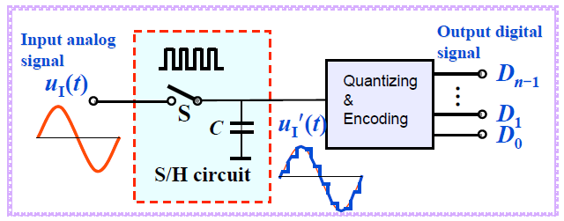
Analog to Digital Converters

Slide 7
Analog to Digital Converters
What is sample and hold?
It is a process of taking a sufficient number of discrete values at point on a waveform that will define the shape of waveform.
What is Quantization and Encoding?
Quantizing - is the process of converting the sampled continuous signals into discrete valued data
Encoding - assigning a digital word or number to each state and matching it to the input signal.

Slide 8
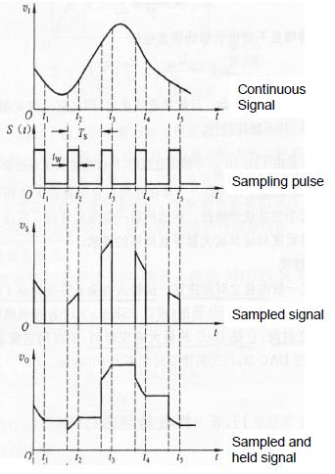

Slide 9
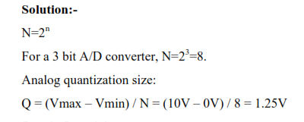
For a 3 bit A/D, with Vmin=0 V, V max=10 V, what is the code-word for Vin=5.7 Volts?

Slide 10
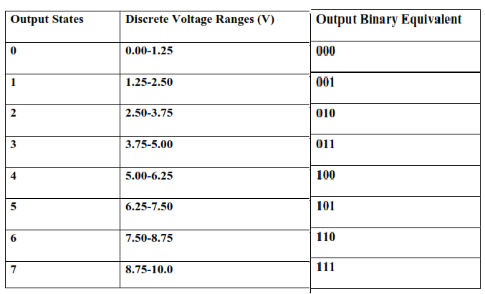
If Vin=5.7 then the code is 100

Slide 11
For a 4 bit A/D, with Vmin=1 V, V max=9 V, what is the code-word for Vin=3.1 Volts? What is the quantization error AVG, and quantization error Max.

Slide 12
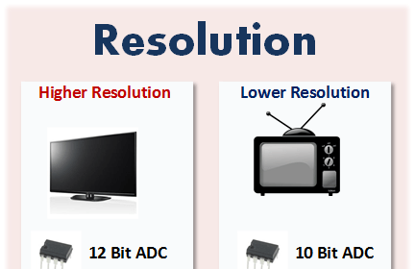
Analog to Digital Converters
What is the resolution of an A/D?
Resolution is the number of bits used for conversion (8 bits, 12 bits, …)

Slide 13
Analog to Digital Converters
How to increase the accuracy of A/D Conversion?
Increasing the resolution
Increasing the sampling rate

Slide 14
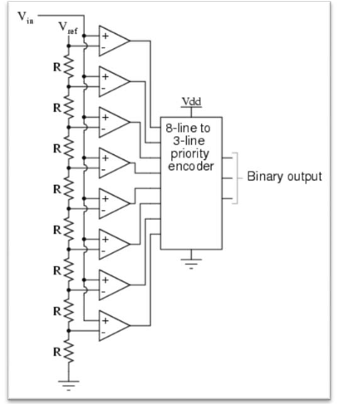
Flash A/D Converter
What are the components of a Flash type A/D, draw the CCT?
Resistors use the resistors to form a ladder voltage divider
2) Comparators comparing input signal to reference voltage.
3) Priority encoder produces a binary output.

Slide 15
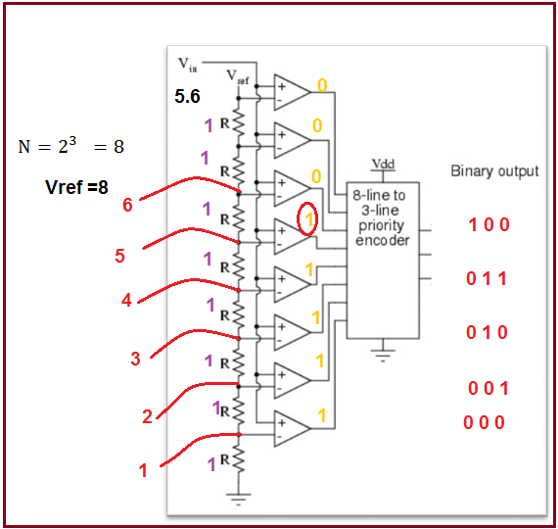
Find the code-word for a 3 bit, flash A/D with Vref=8V with Vin=5.6V.
Vref ÷N = 1
If Vin> Vref=1
else 0

Slide 16
Find the code-word for Vin=4.1V, and number of bits =3 with Vref=12V.

Slide 17
How Does a Flash type A/D work?
1- Vref is divided over the resistors
2- The voltage on the resistors is compared with Vin
3- The output of the comparator is fed to the priority encoder.

Slide 18
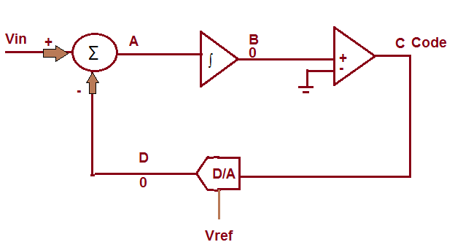
What are the components of a sigma-delta A/D, draw the CCT
1- Adder
2- Integrator
3- Comparator
4- D/A

Slide 19
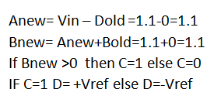
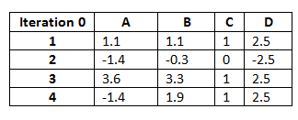
Find the code-word for a 4 bit, sigma-delta A/D with Vref=2.5V with Vin=1.1V.

Slide 20
Find the code-word for a 5 bit, sigma-delta A/D with Vref=3.3V with Vin=2.7V.

Slide 21
How does the Dual Slope A/D work?
1- Control Logic switches to Vin and starts the counter.
2- Charging starts and lasts for Tch.
3- Control logic Switches to -Vref and restart the counter.
4- Discharge for Tdis until reaches the threshold and Enable output latch.

Slide 22
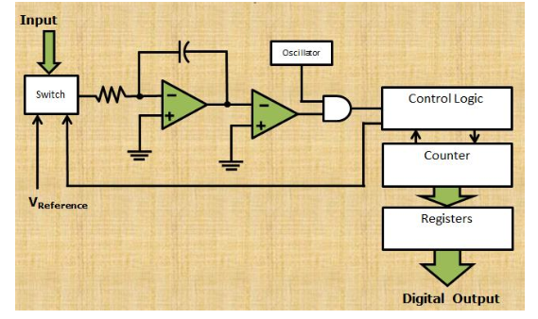
What are dual slope A/D Converter Components draw the CCT
Integrator
Electronically Cont
Counter
Clock
Control Logic
Comparator

Slide 23
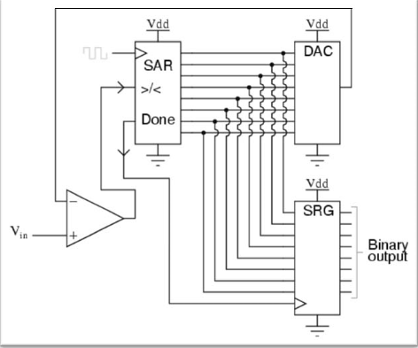
What is SAR A/D Converter Components draw the CCT
1Comparator
2- SAR unit
3- DAC
4- Output Register

Slide 24
What are the components of a SAR A/D, sigma-delta A/D, Dual-slope A/D and a flash-type A/D?

Slide 25
Find the code-word for a 5 Bit SAR A/D with Vin=0.6V while Vref=1V.
MSB (bit 5)
Vref /2
If Vin > than Vref /2 , turn MSB on (1)
If Vin < Vref /2 , turn MSB off (0)
Vin =0.6V and V=0.5
Since Vin>V, MSB = 1 (on)
 |  |  |  | 1

Slide 26
Next Calculate (bit 4)
V=Vref/2 + Vref/4= 0.5+0.25 =0.75V
Since Vin < 0.75, bit 4= 0
(bit 3)
V=Vref/2(0.5) + Vref/8 =0.625
Since 0.6<0.625, MSB is turned off bit 3 = 0
(bit 2)
V=Vref/2(0.5) + Vref/16 =0.5625
Since 0.6>0.5625 MSB is turned off bit 2 = 1
(bit 2)
V=0.5625 + Vref/32 =0.59375
Since 0.6>0.59375 MSB is turned off bit 2 = 1
1 | 1 | 0 | 0 | 1

Slide 27
Conversion time is the time required to complete a conversion of the input
signal, in other words it's the time it takes for an analog-to-digital conversion.
Quantization error is defined as the difference between the actual analog input
and the digital representation of that value.
Ex:
1. An ADC has a conversion time of 100 μs. what is the maximum frequency that can
be converted?
2. A 1 Khz sinusoidal signal to be digitized using 8-bit ADC. Find the conversion
time that can be used?

Slide 28
Ex:
An 8-bits ADC is used to digitize a five volt (5v) full scale signal. What is the
resolution?
Maximum Quantization (qmax)
Average Quantization (qav)
Where A is the amplitude and n is the number of bits.
Ex:
An analog signal of amplitude 12v is sampled with an 8bit ADC; calculate the
maximum and average quantization error?

