Slide 1
Electronic branch
Fourth Class
Interface Circuits Design
microcontroller
Asst. Lec. Lubna A. Alnabi

Slide 2
Why do we need to learn Microcontroller
cell phone

Slide 4
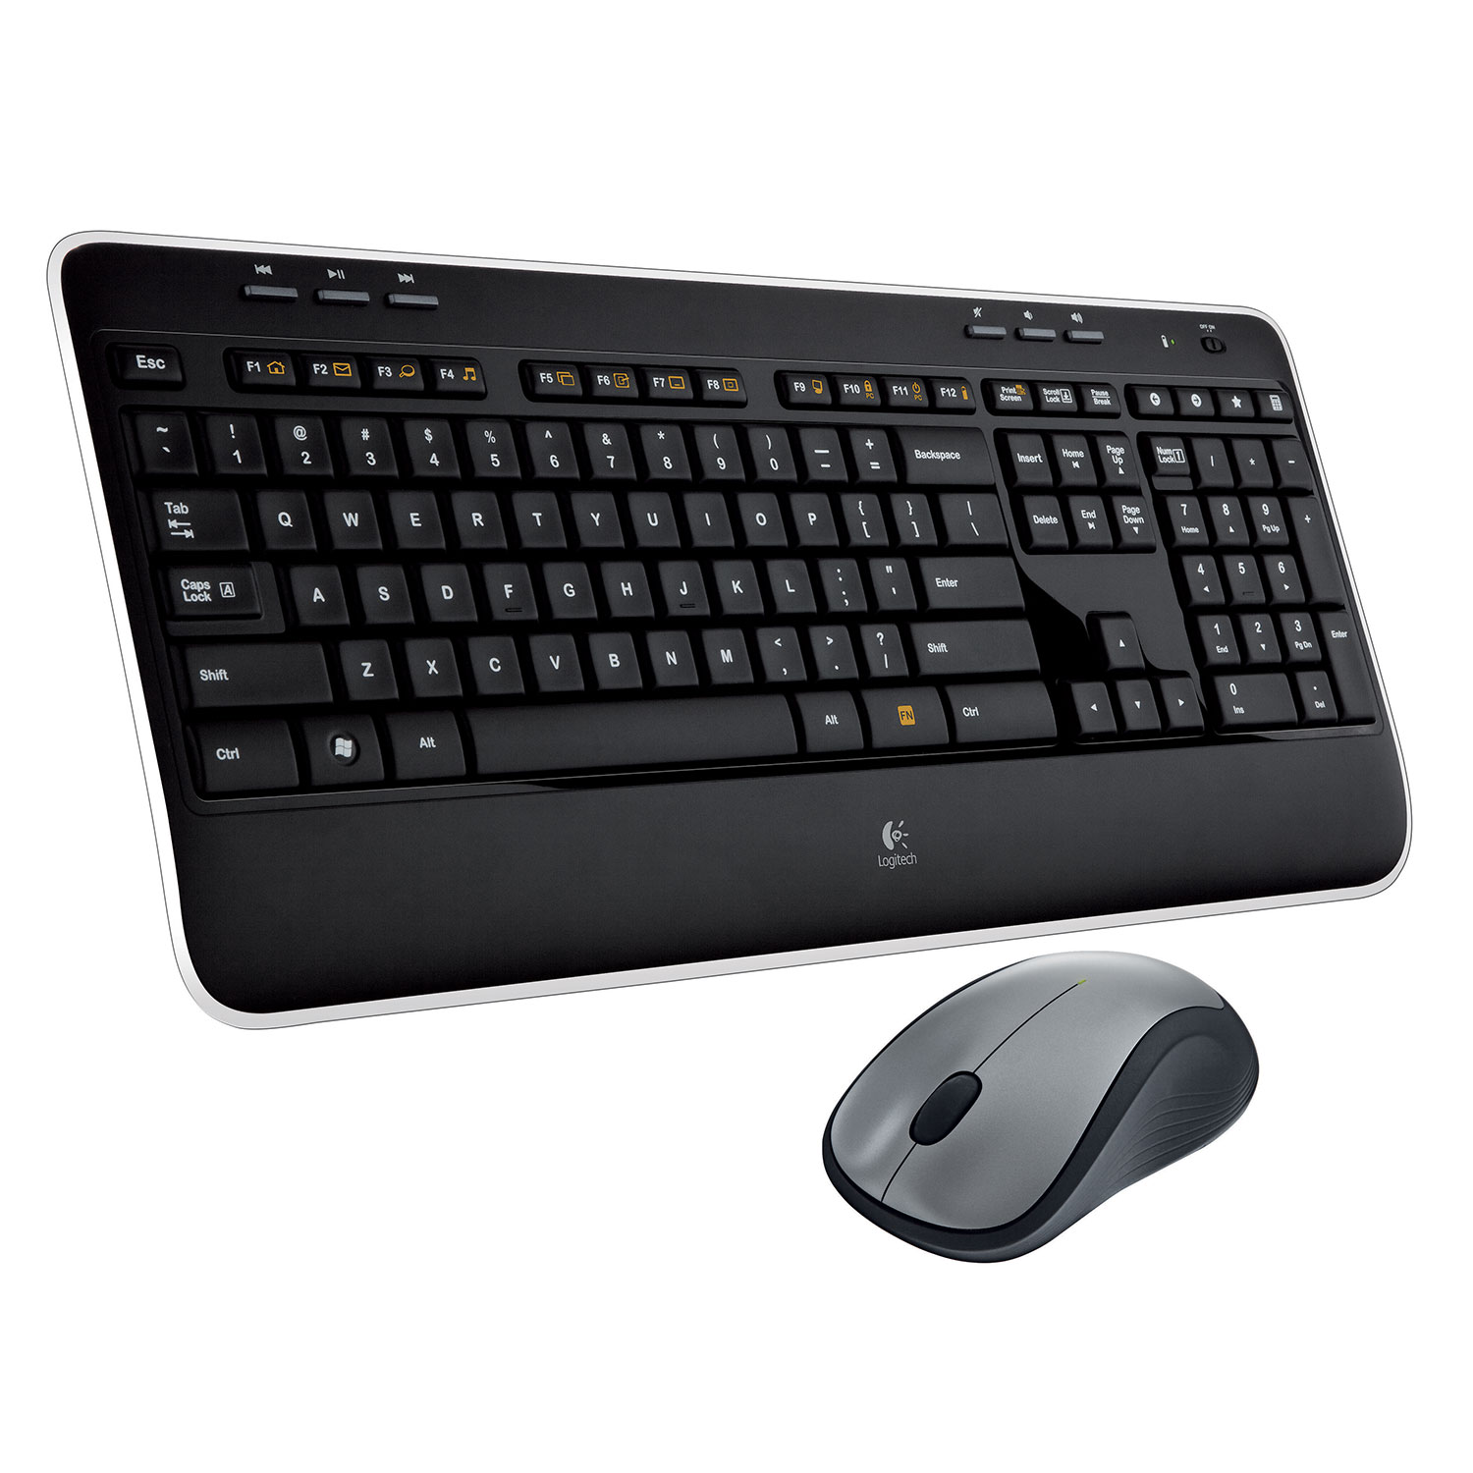
mouse, keyboard

Slide 5
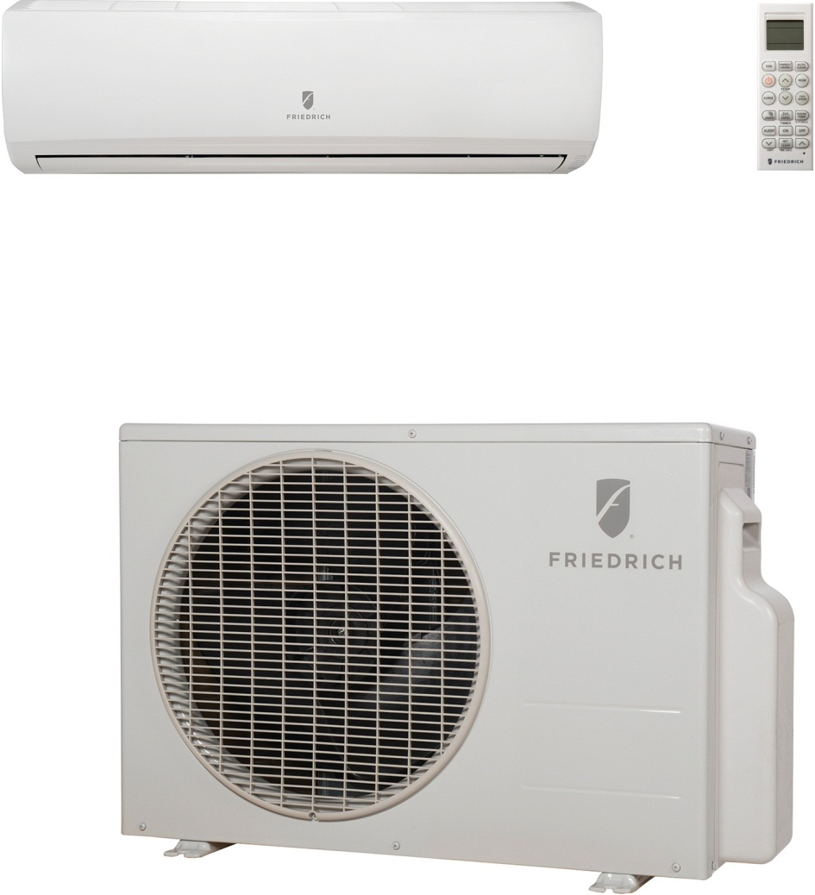
air conditioner, washer/dryer

Slide 6
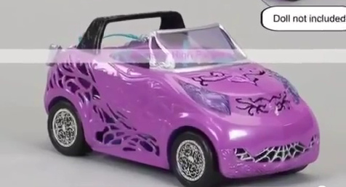
Toys

Slide 8
Component of microcontroller

Slide 9
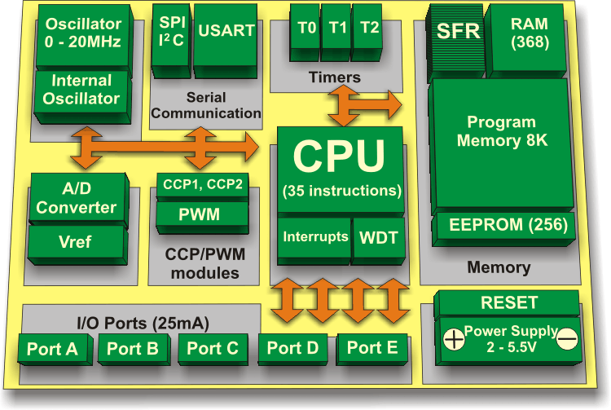
Component of microcontroller

Slide 10
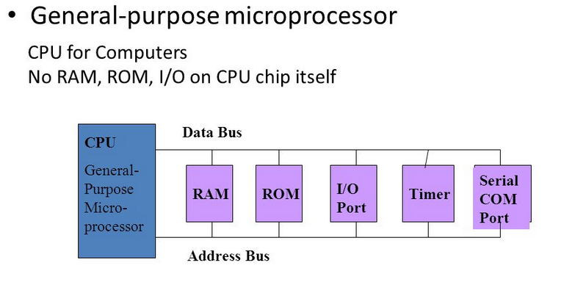

Slide 11
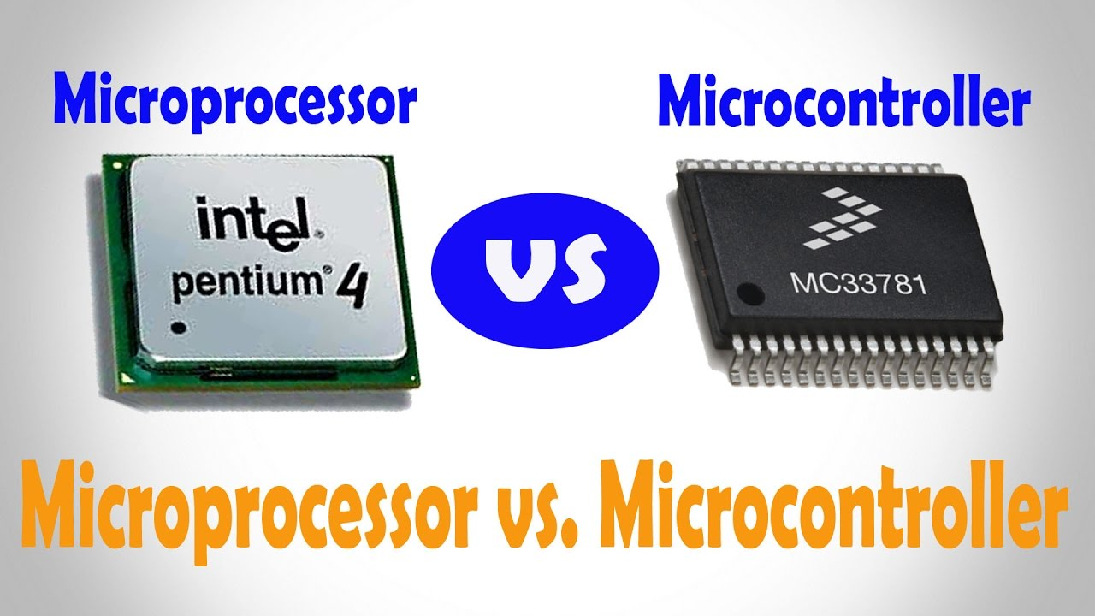

Slide 13
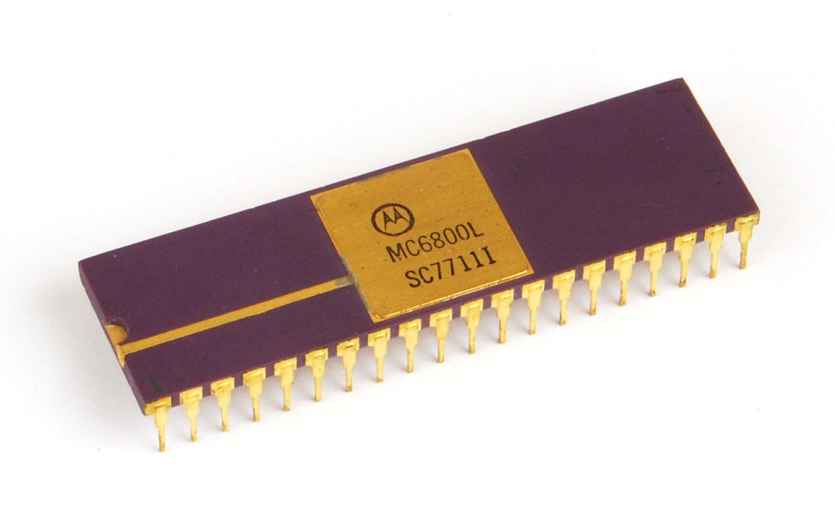
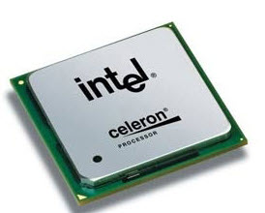
Types of Microcontroller

Slide 14
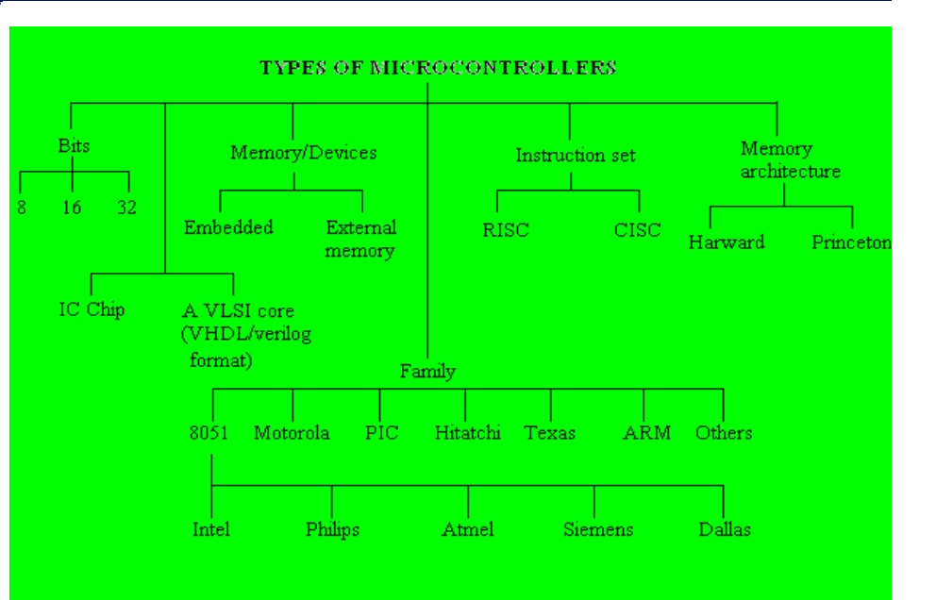

Slide 16
What is microcontroller
Microcontroller components
Differences between microcontroller
and microprocessor

