Slide 1
Image Processing
المرحلة الرابعة
Seventh lecture
by
Assit.Lec. Shaimaa Shukri

Slide 2
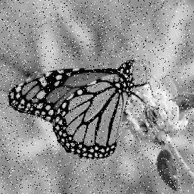
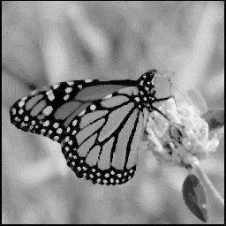
Chapter_ Two
Image Analysis
a. Salt and pepper noise b. Median filtered image (3x3)
Figure (2.14): Median Filter
Example:
Given the following 3X3 neighborhood
5
3
3
5
4
4
6
5
7
We first sort the value in order of size (3,3,4,4,5,5,5,6,7) ; then we select the middle value ,in this case it is 5. This 5 is then placed in centre location.
A median filter can use a neighbourhood of any size, but 3X3, 5X5 and 7X7 are typical. Note that the output image must be written to a separate image (a buffer); so that the results are not corrupted as this process is performed.
(The median filtering operation is performed on an image by applying the sliding window concepts, similar to what is done with convolution).
The window is overlaid on the upper left corner of the image, and the median is determined. This value is put into the output image (buffer)
corresponding to the centre location of the window. The window is then slide one pixel over, and the process is repeated.

Slide 3
Chapter_ Two Image Analysis
When the end of the row is reached, the window is slide back to the left side of the image and down one row, and the process is repeated. This process continues until the entire image has been processed.
Note that the outer rows and columns are not replaced. In practice this is usually not a problem due to the fact that the images are much larger than the masks. And these “wasted” rows and columns are often filled with zeros (or cropped off the image). For example, with 3X3 mask, we lose one outer row and column, a 5X5 mask we lose two rows and columns. This is not visually significant for a typical 256X256 or 512X512 images.
The maximum and minimum filters are two order filters that can be used for elimination of salt- and-pepper noise. The maximum filter selects the
largest value within an ordered window of pixels values; where as the minimum filter selects the smallest value.
The minimum filters works best for salt- type noise (High value), and the maximum filters work best for pepper-type noise.
In a manner similar to the median, minimum and maximum filter, order
filter can be defined to select a specific pixel rank within the ordered set. For example we may find for certain type of pepper noise that selecting the second highest values works better than selecting the maximum value. This type of ordered selection is very sensitive to their type of images and their use it is application specific. It should note that, in general a minimum or low rank filter will tend to darken an image and a maximum or high rank filter will tend to brighten an image.
The midpoint filter is actually both order and mean filter because it rely on
ordering the pixel values , but then calculated by an averaging process. This midpoint filter is the average of the maximum and minimum within the window as follows:

Slide 4
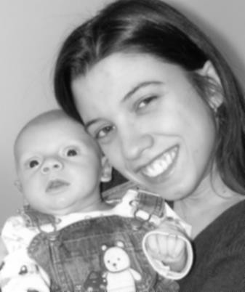
Chapter_ Two
Image Analysis
2
Order set = I1 ≤ I2 ≤ I3...…………………≤IN .
2
Midpoint = (I1+IN )/2
The midpoint filter is most useful for Gaussian and uniform noise.
2.5.3 The Enhancement filter: The enhancement filters are:
Laplacian type.
Difference filter.
These filters will tend to bring out, or enhance details in the image. Example of convolution masks for the Laplacian-type filters are:
0 | -1 | 0 | -1 | -1 | -1 | -2 | 1 | -2
-1 | 5 | -1 | -1 | 9 | -1 | 1 | 5 | 1
0 | -1 | 0 | -1 | -1 | -1 | -2 | 1 | -2
The Laplacian type filters will enhance details in all directions equally.
a. Original image
b. Laplacian filtered image
Figure (2.15): Laplacian Filter.

Slide 5
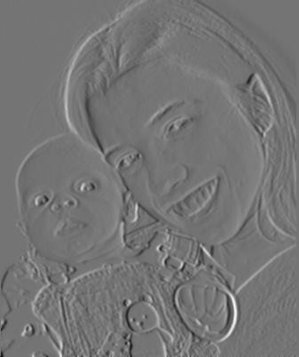
Chapter_ Two Image Analysis
The difference filters will enhance details in the direction specific to the mask selected. There are four different filter convolution masks, corresponding to lines in the vertical, horizontal and two diagonal directions.
Vertical Horizontal
0 | 1 | 0 | 0 | 0 | 0
0 | 1 | 0 | 1 | 1 | -1
0 | -1 | 0 | 0 | 0 | 0
Diagonal 1
Diagonal 2
1 | 0 | 0 | 0 | 0 | 1
0 | 1 | 0 | 0 | 1 | 0
0 | 0 | -1 | -1 | 0 | 0
a. Original image
b. Difference filtered image
Figure (2.16): Difference Filter

