Slide 1
Image Processing
المرحلة الرابعة
Third lecture
by
Assit.Lec. Shaimaa Shukri

Slide 2
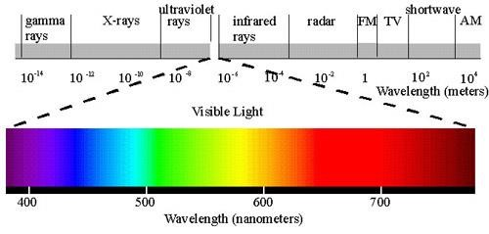
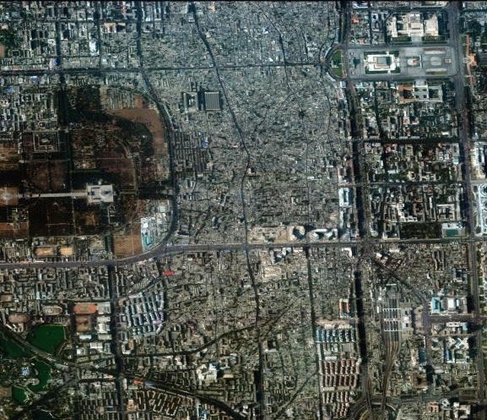
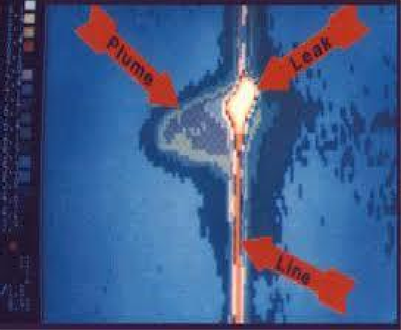
Chapter One
Introduction to Computer Vision and Image Processing
4. Multispectral Images
A multispectral image is one that captures image data at specific frequencies across the electromagnetic spectrum. Multispectral images typically contain information outside the normal human perceptual range. This may include infrared (ءارمحلا تحت), ultraviolet (هيجسفنبلا قوف), X-ray, acoustic (يعمس ) or radar data. Source of these types of image include satellite systems, underwater sonar systems and medical diagnostics imaging systems.
Figure (1.12): Electromagnetic spectrum.
Figure (1.13): Multispectral images

Slide 3
Chapter One
Introduction to Computer Vision and Image Processing
1.10 Computer Graphics :
Computer graphics is a specialized field within that refers to the computer science realm that refers to the reproduction of visual data through the use of computer.
In computer graphics, types of image data are divided into two primarily categories:
Bitmap image (or raster image): can represented by our image model I(r, c), where we have pixel data and corresponding brightness
values stored in file format.
Vector images: refer to the methods of representing lines, curves shapes by storing only the key points. These key points are sufficient to define the shapes, and the process of turing theses into an image is
called rending after the image has been rendered, it can be thought of as being in bit map format where each pixel has specific values associated with it.
What is the difference between vector and raster graphics?
Raster graphics are composed of pixels, while vector graphics are composed of paths.
A raster graphic, such as a gif or jpeg, is an array of pixels of various colors, which together form an image. A vector graphic, such as an
.eps file or Adobe Illustrator file, is composed of paths, or lines, that are either straight or curved.
Because vector graphics are not made of pixels, the images can be scaled to be very large without losing quality. Raster graphics, on the other hand, become "blocky," since each pixel increases in size as the image is made larger.

Slide 4
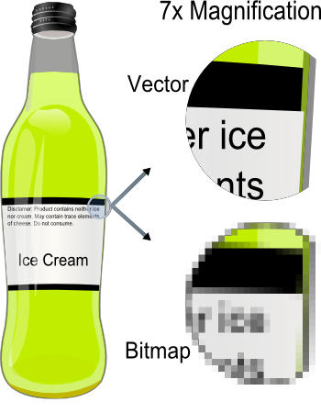
Chapter One
Introduction to Computer Vision and Image Processing
Figure (1.14): vector and bitmap image.
1.11 Digital Image File Format
Image file formats are standardized means of organizing and storing digital images. Image files are composed of digital data in one of these formats that can be rasterized (هطيقنت ) for use on a computer display or printer. An image file format may store data in uncompressed, compressed, or vector formats. Once rasterized, an image becomes a grid of pixels, each of which has a number of bits to designate its color equal to the color depth of the device displaying it.
Why do we need so many different types of image file format?
The short answer is that there are many different types of images and application with varying requirements.
A more complete answer, also considers market share proprietary information, and a lack of coordination within the imaging industry.
Many image types can be converted to one of other type by easily available image conversion software. Field related to computer imaging is that computer graphics.

Slide 5
Chapter One
Introduction to Computer Vision and Image Processing
Most the type of file format fall into category of bitmap images. In general, these types of images contain both header information and the raw pixel data. The header information contain information regarding
1.
2.
3.
4.
5.
6.
The number of rows(height) The number of columns(Width) The number of bands.
The number of bit per pixel. the file type
Additionally, with some of the more complex file formats, the
header may contain information about the type of compression used and other necessary parameters to create the image, I(r,c).
Image File Format :
BMP format (Bitmap image File Format )
The BMP file format, also known as bitmap image file or device independent bitmap (DIB) file format or simply a bitmap, is a raster graphics image file format used to store bitmap digital images,
independently of the display device (such as a graphics adapter), especially on Microsoft Windows and OS/2 operating systems.
The BMP file format is capable of storing 2D digital images of arbitrary width, height, and resolution, both monochrome and color, in various
color depths, and optionally with data compression, alpha channels, and color profiles.
TIFF (Tagged Image File Format)
Tagged Image File Format is one of the most popular and flexible of the current public domain raster file formats. They are used on World

Slide 6
Chapter One
Introduction to Computer Vision and Image Processing
Wide Web (WWW). GIF files are limited to a maximum of 8 bits/pixel and allows for a type of compression called LZW. The GIF image header is 13 byte long & contains basic information.
JPEG (Joint Photo Graphic Experts Group)
This is the right format for those photo images which must be very small files, for example, for web sites or for email. JPG is often used on
digital camera memory cards. The JPG file is wonderfully small, often compressed to perhaps only 1/10 of the size of the original data, which is a good thing when modems are involved. However, this fantastic compression efficiency comes with a high price. JPG uses lossy compression (lossy meaning "with losses to quality"). Lossy means that
some image quality is lost when the JPG data is compressed and saved, and this quality can never be recovered. JPEG images compression is
being used extensively on the WWW. It’s, flexible, so it can create large files with excellent image equality.
VIP(visualization in image processing )formats:
It is developed for the CVIP tools software, when performing temporary images are created that use floating point representation which
is beyond the standard 8 bit/pixel. To represent this type of data the
remapping is used, which is the process of taking original image and adding an equation to translate it to the rang (0-225).
Questions:
Q1/ What are the applications of computer vision?
Q2/What are the applications of image processing, describe them?
Q3/What are the different between raster image and vector image?
Q4/ Find the number of gray level , and the number of bit for (512 × 512 ) image, note that the image contains 8 bit / pixel ?

Slide 7
Chapter One
Introduction to Computer Vision and Image Processing
BMP image format
Introduction
BMP files are an historic (but still commonly used) file format for the historic (but still commonly used) operating system called "Windows". BMP images can range from black and white (1 bit per pixel) up to 24 bit colour
(16.7 million colours). While the images can be compressed, this is rarely used in practice and won't be discussed in detail here.
Structure
A BMP file consists of either 3 or 4 parts as shown in the following diagram
The first part is a header, this is followed by an information section, if the image is indexed colour then the palette follows, and last of all is the pixel data. Information such as the image width and height, the type of compression, the number of colours is contained in the information header.
Header
The header consists of the following fields. Note that we are assuming short
int of 2 bytes, int of 4 bytes, and long int of 8 bytes.

Slide 8
Chapter One
Introduction to Computer Vision and Image Processing
Magic identifier (1+1= 2 Byte).
File Size in byte( 4 Byte)
Resereved1+ Reserved2 (2+2 Byte)
Offset to image data (4 Byte)
14 Byte
The useful fields in this structure are the type field (should be 'BM') which is a simple check that this is likely to be a legitimate ةعورشملا BMP file, and the offset field which gives the number of bytes before the actual pixel data (this is relative to the start of the file).
Information
The image info data that follows is 40 bytes in length, it is described in the
struct given below. The fields of most interest below are the image width and height, the number of bits per pixel (should be 1, 4, 8 or 24), the number of planes (assumed to be 1 here), and the compression type (assumed to be 0 here).
Header size in bytes ( 4 Byte)
Width and height of image ( 4 + 4 Byte)
Number of colour planes ( 2 Byte)
Bits per pixel ( 2 Byte)
Compression type (4 Byte)
Image size in bytes (4 Byte)
Pixels per meter (x_ resolution , y_ resolution) ( 4 + 4 Byte)
Number of colours (4 Byte)
Important colours (4 Byte)
40 Byte
The compression types supported by BMP are listed below :

Slide 9
Chapter One
Introduction to Computer Vision and Image Processing
- no compression
- 8 bit run length encoding 2 - 4 bit run length encoding
3 - RGB bitmap

Slide 10
Chapter One
Introduction to Computer Vision and Image Processing
Algorithms:
1. Transform Image to Binary Level Image.
Input: Image File (Picture1),Threshold Value.
Output : Binary Level Image File (Picture2)
Step1 :
For I = 0 to width of input image For J = 0 to height of input image
For each Picture1. point (Pixel) do the following:
Red = Pixel (I, J) Mod 256
Green = ((Pixel(I,J) And &HFF00FF00) / 256 &) Blue = ((pixel (I, J) And &HFF0000) / 65536)
Bin = Round((Red * 0.3) + (Green * 0.59) + (Blue * 0.11))
If (Bin > Threshold) Then Bin = 255 If (Bin < Threshold) Then Bin = 0
Draw Bin { Picture2.PSet (I, J), RGB(Bin,Bin,bin)}
End of loop 1 End of loop2

Slide 11
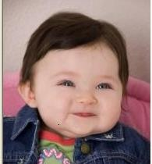
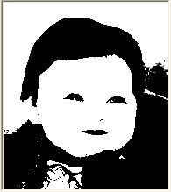
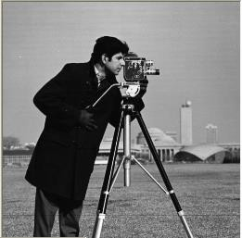
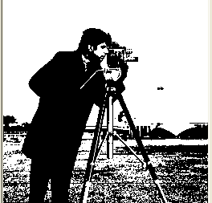
Chapter One
Introduction to Computer Vision and Image Processing
Color Image | Binary Image
Gray Image | Binary Image
Figure (1) : Transform Color Image to Binary Level Image.

