Slide 1
Image Processing
المرحلة الرابعة
First lecture
by
Assit.Lec. Shaimaa Shukri

Slide 2
Introduction to Computer Vision and Image Processing
Computer Imaging
Can be defined a acquisition and processing of visual information by computer. Computer representation of an image requires the equivalent of many thousands of words of data, so the massive amount of data required for image is a primary reason for the development of many sub areas with field of computer imaging, such as image compression and segmentation .Another important aspect of computer imaging involves the ultimate “receiver” of visual information in some case the human visual system and in some cases the human visual system and in others the computer itself.
Computer imaging can be separate into two primary categories:
Computer Vision.
Image Processing.
(In computer vision application the processed images output for use by a
computer, whereas in image processing applications the output images are for human consumption).
These two categories are not totally separate and distinct. The boundaries that separate the two are fuzzy, but this definition allows us to explore the
differences between the two and to explore the difference between the two and to understand how they fit together (Figure 1.1).

Slide 3
Chapter One
Introduction to Computer Vision and Image Processing
Computer imaging can be separated into two different but overlapping
areas.
Computer Vision
Image Processing
Figure (1.1): Computer Imaging [1].
Historically, the field of image processing grew from electrical engineering as an extension of the signal processing branch, whereas are the computer science discipline was largely responsible for developments in
computer vision.
1.2 Computer Vision
Computer vision is a computer imaging where the application doses not involve a human being in visual loop. One of the major topics within this field of computer vision is image analysis.
1.
The image analysis process involves two other topics:
Image Analysis: involves the examination of the image data to facilitate solving vision problem.
•
Feature Extraction: is the process of acquiring higher level image information, such as shape or color information.
Pattern Classification: is the act of taking this higher –level information and identifying objects within the image.
Computer vision systems are used in many and various types of environments, such as:

Slide 4
Chapter One
Introduction to Computer Vision and Image Processing
Manufacturing Systems: computer vision is often used for quality control, where the computer vision system will scan manufactured items for defects, and provide control signals to a robotics manipulator to remove detective part automatically.
Medical Community: current example of medical systems to aid neurosurgeons ……..during brain surgery, systems to diagnose skin tumors ( ……..) automatically.
The field of Law Enforcement and security in an active area for computer vision system development, with application ranging from automatic identification of fingerprints to DNA analysis.
Infrared Imaging (
Satellites Orbitin).
1.3 Image Processing
Image processing is computer imaging where application involves a human being in the visual loop. In other words the image are to be examined and a acted upon by people.
The major topics within the field of image processing include:
Image restoration.
Image enhancement.
Image compression.
1.3.1 Image Restoration
Is the process of taking an image with some known, or estimated degradation, and restoring it to its original appearance. Image restoration is often used in the field of photography or publishing where an image was

Slide 5
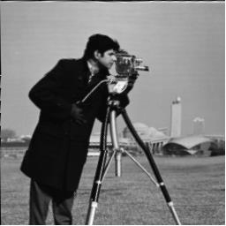
Chapter One
Introduction to Computer Vision and Image Processing
somehow degraded but needs to be improved before it can be printed(Figure 1.2).
a. Image with distortion b. Restored image Figure (1.2) Image Restoration
1.3.2 Image Enhancement
Involves taking an image and improving it visually, typically by taking advantages of human Visual Systems responses. One of the simplest enhancement techniques is to simply stretch the contrast of an image.
Enhancement methods tend to be problem specific. For example, a method that is used to enhance satellite images may not suitable for enhancing medical images.
Although enhancement and restoration are similar in aim, to make an image
look better. They differ in how they approach the problem. Restoration method attempt to model the distortion to the image and reverse the degradation, where enhancement methods use knowledge of the human visual systems responses to improve an image visually.

Slide 6
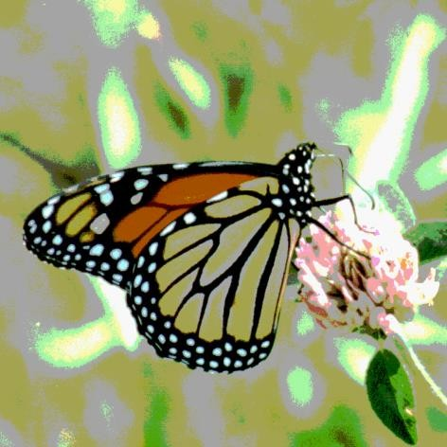
Chapter One
Introduction to Computer Vision and Image Processing
a. image with poor contrast
b. Image enhancement by contrast stretching
Figure (1.3) Image Enhancement
Image Compression
Involves reducing the typically massive amount of data needed to represent an image. This done by eliminating data that are visually unnecessary and by taking advantage of the redundancy that is inherent in most images. Image data can be reduced 10 to 50 times, and motion image data (video) can be reduced by factors of 100 or even 200.
Image processing systems are used in many and various types of environments, such as:
Medical community has many important applications for image processing involving various type diagnostics imaging , as an example
MRI(Magnetics Resonance Imaging ( ) scanning, that allows the
medical professional to look into the human body without the need to cut it open .
Computer – Aided Design , which uses tools from image processing and computer graphics , allows the user to design a new building or
spacecraft and explore it from the inside out .

Slide 7
Chapter One
Introduction to Computer Vision and Image Processing
Virtual Reality is one application that exemplifies ( لثمي ) future possibilities
Image Processing is being used enable people to see what they look like with new haircut, a new pair of eyeglasses, or even anew noise.
a. Image before compression
(92) KB
b. Image after compression (6.59)KB
Figure (1.4): Image Compression.
Computer Imaging Systems
Computer imaging systems are comprised of two primary components types, hardware and software. The hard ware components can be divided into image acquiring sub system (computer, scanner, and camera) and display devices (monitor, printer).The software allows us to manipulate the image and perform any desired processing on the image data.
Digitization
The process of transforming a standard video signal into digital image. This transformation is necessary because the standard video signal in analog (continuous) form and the computer requires a digitized or sampled version of that continuous signal. The analog video signal is turned into a digital image by sampling the continuous signal at affixed rate. In the figure

