Slide 1
Electronic branch
Fourth Class
Interface Circuits Design
Power Supply
Asst. Lec. Lubna A. Alnabi

Slide 2
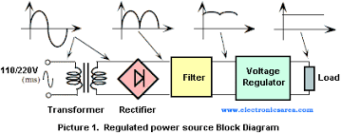
DC Power Supply
The aim of a DC power supply is to provide the required level of DC power to the load using an AC supply at the input. DC power supplies usually have the following parts: Transformer, Rectifier, Smoothing, and Regulation.

Slide 4
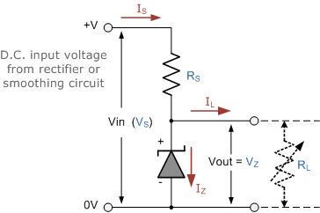
power supply using Zener diode
The simplest way of generating a fixed voltage is to use Zener diodes. The regulated voltage can vary from 2.4V to 75V using the BZX79 series diodes. The diodes in this series are rated at 500 mW and the tolerance of the stabilizing voltage is
5%.

Slide 5
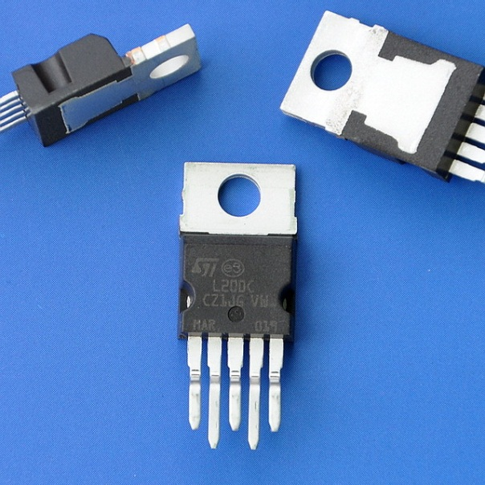
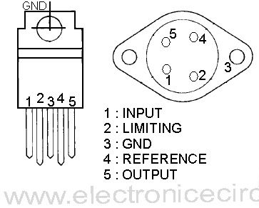
Voltage Regulator
a L200C adjustable voltage regulator. It can supply a regulated voltage from 2.85 to 36V with an output current up to 2 A. It features current limiting, thermal shutdown and input over voltage protection up to 60V. The quiescent current is typically 4.2 mA.

Slide 6
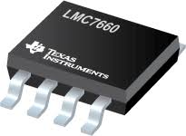
Voltage Converters
a voltage inverter which converts +5V voltage to-5V using an SI7660CJ voltage converter (Siliconix). The chip is able to generate a negative voltage output which is equal to the positive voltage input in the range 1.5V to 10V.

Slide 7
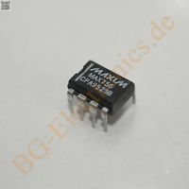
Voltage Converters
MAX680CPA converts a +5V voltage to +10V and-10V it is doubler and inverter (Maxim). The input voltage ranges from 2V to 6V. The internal resistances for the positive and negative output are 150 ~and 90Ω respectively. If a 10 mA current is drawn from both outputs, the positive voltage falls to 7V and the negative voltage becomes -6.1V. The quiescent current of the device is typically 1 mA for a 5V power supply.

Slide 8
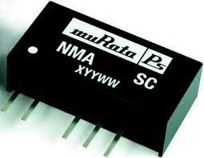
Isolated voltage supply circuits
This circuit is used when a complete isolation between two circuits is required. NME and NMA series DC-to-DC converters are high efficiency voltage converters.
The NME series operate from a 5V or 12V DC input and provide an isolated +5V, 12V or 15V output, depending on types. Up to 200 mA supply current is available from the 5V type, 84 mA from the 12V type and 67 mA from the 15V type. The NMA series provide dual +-5V, +-12V and +-15V DC supplies from a single 5V or 12V DC input. Up to 100 mA is available from the 5V type and 42 mA from the 15V type

Slide 9
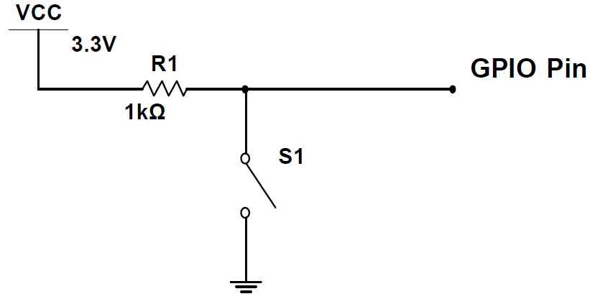
Digital signal generators
an eight-channel logic status generator circuit. It consists of eight single pole double throw (SPDT) switches and eight l k metal film resistors.
When a switch is off, the status of the corresponding channel is high. When it is switched on, a logic low is generated. This logic generator suffers that the output signal is not 'clean' when it changes the status. When the switch changes position, the output signal does not change from one state to the other instantly. It consists of a number of oscillations within a very short period of time.

Slide 10
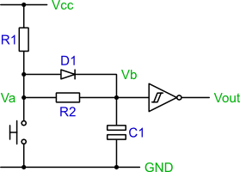
Digital signal generators
To solve this problem, a de-bouncing circuit is used. (circuit using a Schmitt trigger inverter, 74LS14). When the switch is closed, the output gives logic 1. When the switch is open, the output gives logic 0.
generator circuit with (SPDT)

