Slide 1
10
Computer Networks
Chapter Seven
DATA LINK LAYER
Error Detection
(Part I)
Asst. Prof. Dr. Mazin S. Al-Hakeem

Slide 2
Error Detection
Redundancy
Types of Errors
Single-Bit Error
Burst Error
Error Detection Methods
Single Error Parity
Two-Dimensional Parity-Check Code
Checksum
CRC Error Detection

Slide 3
Error Detection Methods
Single Error Parity
Two-Dimensional Parity-Check Code
Checksum
CRC Error Detection

Slide 4
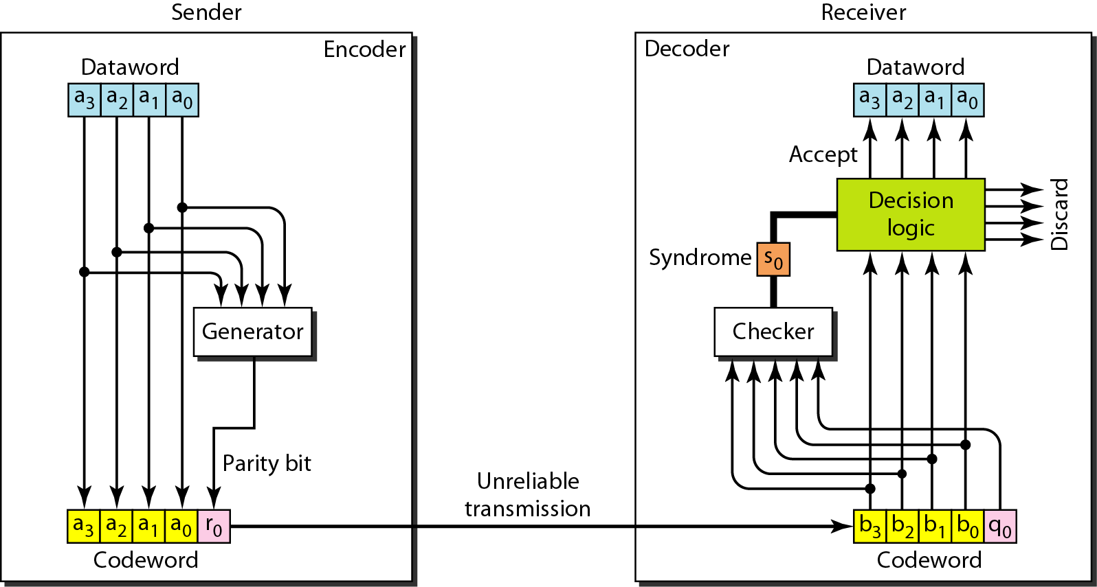
Error Detection Methods
8.2.1. Single Error Parity
A simple parity-check code can detect an odd number of errors

Slide 5
Error Detection Methods
8.2.1. Single Error Parity
Example
Let us look at some transmission scenarios. Assume the sender sends the dataword 1011.
The codeword created from this dataword is 10111, which is sent to the receiver. We examine five cases:
Dataword 1011
1
Codeword 1011

Slide 6
Error Detection Methods
a₃ a₂ a₁ a₀ r₀
Codeword 1 0 1 1 1
8.2.1. Single Error Parity
1. No error occurs; the received codeword is 10111.
The received codeword is 10111. The syndrome is 0. The dataword 1011 is created.
2. One single-bit error changes a₁ .
The received codeword is 10011. The syndrome is 1. No dataword is created.
3. One single-bit error changes r₀ .
The received codeword is 10110. The syndrome is 1. No dataword is created.
4. An error changes r₀ and a second error changes a₃ .
The received codeword is 00110. The syndrome is 0. The dataword 0011 is created at the receiver. Note that here the dataword is wrongly created due to the syndrome value.

Slide 7
Error Detection Methods
a₃ a₂ a₁ a₀ r₀
Codeword 1 0 1 1 1
8.2.1. Single Error Parity
5. Three bits—a₃, a₂, and a₁—are changed by errors.
The received codeword is 01011. The syndrome is 1. No dataword is created.
This shows that the simple parity check, guaranteed to detect one single error, can also find any odd number of errors.

Slide 8
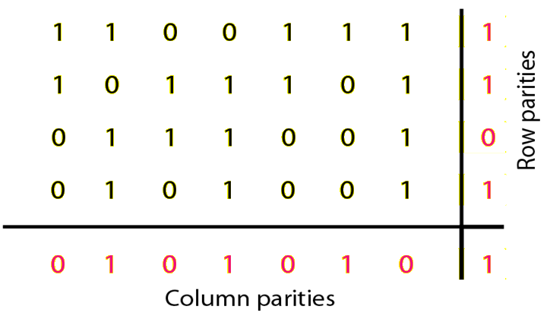
Error Detection Methods
8.2.2. Two-Dimensional Parity-Check Code

Slide 9
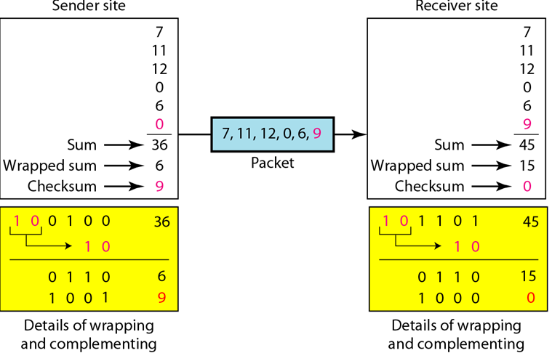
Error Detection Methods
8.2.3. Checksum
The checksum is used in the Internet by several protocols although not at the data link layer.

Slide 10
Computer Networks
Chapter Seven
DATA LINK LAYER
Error Detection (Part I)
Thanks
Asst. Prof. Dr. Mazin S. Al-Hakeem

