Slide 1
9
Computer Networks
Chapter Seven
DATA LINK LAYER
Error Detection
(Part I)
Asst. Prof. Dr. Mazin S. Al-Hakeem

Slide 2
Error Detection
Redundancy
Types of Errors
Single-Bit Error
Burst Error
Error Detection Methods
Single Error Parity
Two-Dimensional Parity-Check Code
Checksum
CRC Error Detection

Slide 3
Error Detection
Networks must be able to transfer data from one device to another with acceptable accuracy.
For most applications, a system must guarantee that the data received are identical to the data transmitted.
Any time data are transmitted from one node to the next, they can become corrupted in passage. Many factors can alter one or more bits of a message.
Some applications require a mechanism for detecting and correcting errors.

Slide 4
8.1- Types of Errors
Single-Bit Error
Burst Error
The term single-bit error means that only 1 bit of a given data unit (such as a byte, character, or packet) is changed from 1 to 0 or from 0 to 1.
The term single-bit error means that only 1 bit of a given data unit (such as a byte, character, or packet) is changed from 1 to 0 or from 0 to 1.

Slide 5
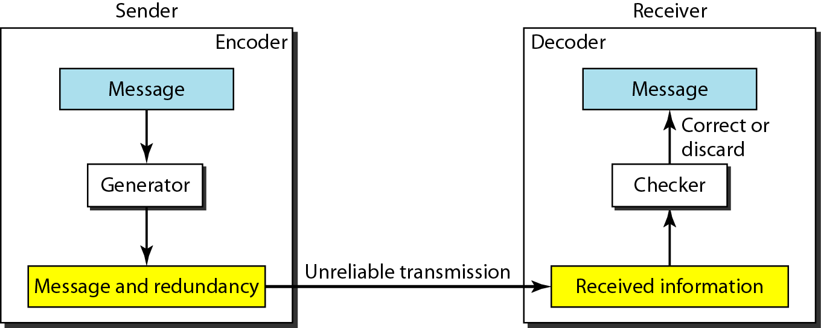
8.2- Redundancy
The central concept in detecting or correcting errors is redundancy. To be able to detect or correct errors, we need to send some extra bits with our data.
These redundant bits are added by the sender (Generator) and removed by the receiver (Checker).
Their presence allows the receiver to detect or correct corrupted bits.
The Structure of Encoder and Decoder

Slide 6
Computer Networks
Chapter Seven
DATA LINK LAYER
Error Detection (Part I)
Thanks
Asst. Prof. Dr. Mazin S. Al-Hakeem

