Slide 1
6
Computer Networks
Chapter Seven
DATA LINK LAYER
Data Link Control and Protocols
(Part IIIa)
Asst. Prof. Dr. Mazin S. Al-Hakeem

Slide 2
High-Level Data Link Control
HLDC General Protocol
Point-to-Point Access Protocol (PPP) : Dedicated Link
Multiple-Access Protocol : Common Link (Broadcast Link)
Frames Types
Point-to-Point Access Protocol (PPP)
Multiple-Access Protocol
I-frames
S-frames
U-frames
Framing
Transition Phases

Slide 3
7.8- HDLC (High-Level Data Link Control)
It is a bit-oriented protocol (general protocol) for communication over point-to-point and multipoint links.
It implements the ARQ mechanisms.
Link
Dedicated Link → Point-to-Point Access Protocol (PPP)
Common Link → Multiple-Access Protocol

Slide 4
7.9- Frames
To provide the flexibility necessary to support all the options possible in the modes and configurations just described, HDLC defines three types of frames:
Information Frames (I-frames)
used to transport user data and control information relating to user data,
Supervisory Frames (S-frames)
used only to transport control information,
Unnumbered Frames (U-frames)
used to transport Information that intended for managing the link itself.
reserved for system management.

Slide 5
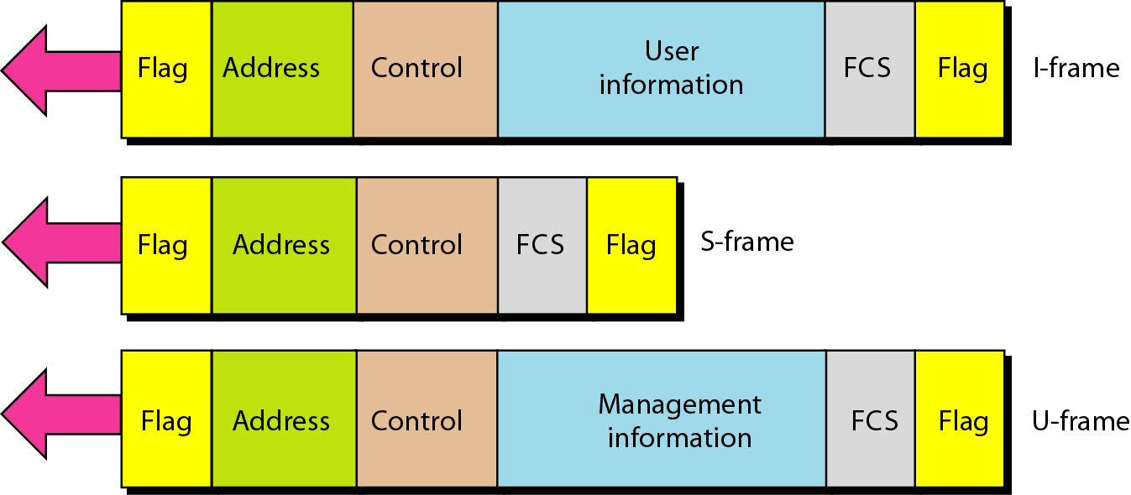
7.9- Frames (HDLC frames types)
Each type of frame serves as an envelope for the transmission of a different type of message.
Frame Format

Slide 6
Frame Format
Each type of frame serves as an envelope for the transmission of a different type of message.
Flag
Flag
Flag field: The flag field of an HDLC frame is an 8-bit sequence with the bit pattern 01111110 that identifies both the beginning and the end of a frame and serves as a synchronization pattern for the receiver.

Slide 7
Frame Format
Each type of frame serves as an envelope for the transmission of a different type of message.
Flag
Address
Flag
Address field: The second field of an HDLC frame contains the address of the secondary station.
If a primary station created the frame, it contains a to address.
If a secondary creates the frame, it contains a from address.
An address field can be 1 byte or several bytes long, depending on the network size.

Slide 8
Frame Format
Each type of frame serves as an envelope for the transmission of a different type of message.
Flag
Address
Control
Flag
Control field: The control field is a 1- or 2-byte segment of the frame used for flow and error control.
The interpretation of bits in this field depends on the frame type.

Slide 9
Frame Format
Each type of frame serves as an envelope for the transmission of a different type of message.
Flag
Address
Control
Information
Flag
Information field: The information field contains the user's information (I-Frame) from the network layer or management information (U-frame)

Slide 10
Frame Format
Each type of frame serves as an envelope for the transmission of a different type of message.
Flag
Address
Control
Information
FCS
Flag
FCS field: The frame check sequence (FCS) is the HDLC error detection field. It can contain either a 2- or 4-byte ITU-T CRC.

Slide 11
HDLC (High-Level Data Link Control)
Link
Dedicated Link → Point-to-Point Access Protocol (PPP)
Common Link → Multiple-Access Protocol
Flag
Address
Control
User
Information
FCS
Flag
I-frames
Flag
Address
Control
FCS
Flag
S-frames
Flag
Address
Control
Management
Information
FCS
Flag
U-frames

Slide 12
Computer Networks
Chapter Seven
DATA LINK LAYER
Data Link Control and Protocols (Part III a)
Thanks
Asst. Prof. Dr. Mazin S. Al-Hakeem

