Slide 1
5
Computer Networks
Chapter Seven
DATA LINK LAYER
Data Link Control and Protocols
(Part II c)
Asst. Prof. Dr. Mazin S. Al-Hakeem

Slide 2
Data Link Control and Protocols (II c)
Protocols
Noiseless (error-free) Channels
Noisy (error-creating) Channels
Noisy (error-creating) Channels
Stop-and-Wait ARQ Protocol
Noiseless (error-free) Channels
Go-Back-N ARQ Protocol
Simplest Protocol
Selective Repeat ARQ Protocol
Stop-and-Wait Protocol

Slide 3
7.6- Protocols
7.6.2- Noisy (error-creating) Channels
C. Selective Repeat ARQ Protocol
For noisy links, there is another mechanism that does not resend N frames when just one frame is damaged; only the damaged frame is resent.
This mechanism is called Selective Repeat ARQ.
It is more efficient for noisy links, but the processing at the receiver is more complex, we have many timers here.

Slide 4
Windows
The Selective Repeat Protocol also uses two windows: a send window and a receive window.
However, there are differences between the windows in this protocol and the ones in Go-Back-N.
First, the size of the send window is much smaller; it is 2^{m-1}.
Second, the receive window is the same size as the send window.
For example, if m = 4, the sequence numbers go from 0 to 15, but the size of the window is just 8 (it is 15 in the Go-Back-N Protocol).

Slide 5
Windows
The Selective Repeat Protocol allows as many frames as the size of the receive window to arrive out of order and be kept until there is a set of in-order frames to be delivered to the network layer.
Because the sizes of the send window and receive window are the same, all the frames in the send frame can arrive out of order and be stored until they can be delivered.
We need, however, to mention that the receiver never delivers packets out of order to the network layer.

Slide 6
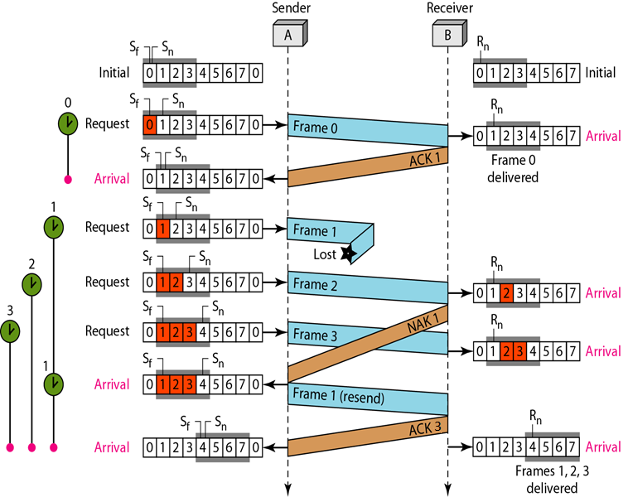
EXAMPLE (4)
This example is similar to Example (1) in which frame 1 is lost.
Here, each frame sent or resent needs a timer, which means that the timers need to be numbered (0, 1, 2 and 3).
The timer for frame starts at the first request, but stops when the ACK for this frame arrives.
The timer for frame 1 starts at the second request restarts when a NAK arrives, and finally stops when the last ACK arrives.
The other two timers start when the corresponding frames are sent and stop at the last arrival event.

Slide 7
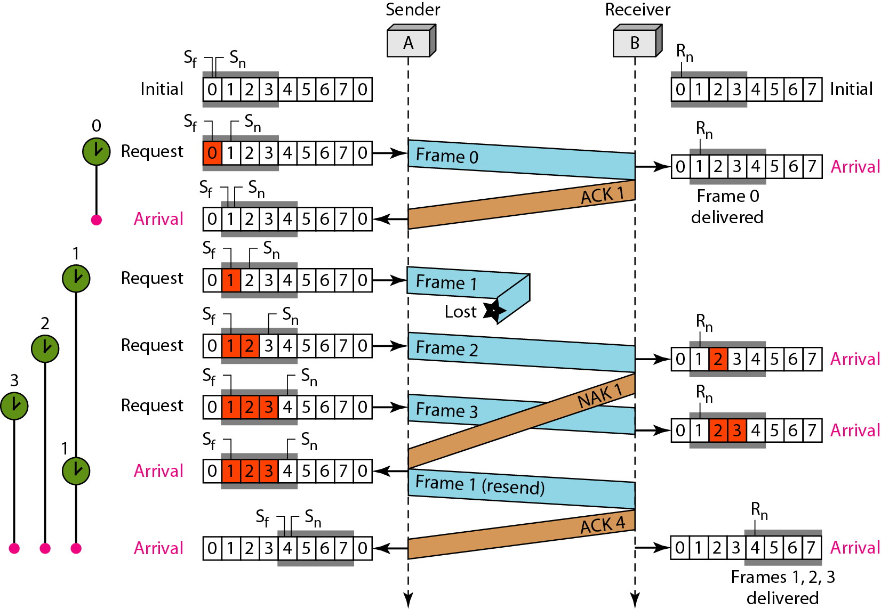
At the receiver site we need to distinguish between the acceptance of a frame and its delivery to the network layer.
At the second arrival, frame 2 arrives and is stored and marked (colored slot), but it cannot be delivered because frame 1 is missing.
At the next arrival, frame 3 arrives and is marked and stored, but still none of the frames can be delivered.
Only at the last arrival, when finally a copy of frame 1 arrives, can frames 1, 2, and 3 be delivered to the network layer.

Slide 8
Another important point is about the ACKs.
Notice that only two ACKs are sent here.
The first one acknowledges only the first frame; the second one acknowledges three frames.
In Selective Repeat, ACKs are sent when data are delivered to the network layer.
If the data belonging to n frames are delivered in one shot, only one ACK is sent for all of them.

Slide 10
Computer Networks
Chapter Seven
DATA LINK LAYER
Data Link Control and Protocols (Part II c)
Thanks
Asst. Prof. Dr. Mazin S. Al-Hakeem

