Slide 1
Computer Networks
Chapter Seven
DATA LINK LAYER
Data Link Control and Protocols
(Part II c)
Asst. Prof. Dr. Mazin S. Al-Hakeem

Slide 2
Data Link Control and Protocols (II c)
Protocols
Noiseless (error-free) Channels
Noisy (error-creating) Channels
Noisy (error-creating) Channels
Stop-and-Wait ARQ Protocol
Noiseless (error-free) Channels
Go-Back-N ARQ Protocol
Simplest Protocol
Selective Repeat ARQ Protocol
Stop-and-Wait Protocol

Slide 3
7.6- Protocols
7.6.2- Noisy (error-creating) Channels
B. Go-Back-N ARQ Protocol
To improve the efficiency of transmission, multiple frames must be in transition while waiting for acknowledgment.
In other words, we need to let more than one frame be outstanding to keep the channel busy while the sender is waiting for acknowledgment.
With Go-Back-N ARQ we can send several frames before receiving acknowledgments; we keep a copy of these frames until the acknowledgments arrive.

Slide 4
Sequence Numbers (seqNo & ackNo)
m
In the Go-Back-N Protocol, the sequence numbers are modulo-2 , where m is the size of the sequence number field in bits allocated in the frame header.
For example, if m is 4, the only sequence numbers are 0 through 15 inclusive.
However, we can repeat the sequence. So the sequence numbers are:
0, 1,2,3,4,5,6, 7,8,9, 10, 11, 12, 13, 14, 15,0, 1,2,3,4,5,6,7,8,9,10, 11, ...

Slide 5
Sender Sliding Window
At the sender side, to hold the outstanding frames until they are acknowledged, we use the concept of window.
We imagine that all frames are stored in a buffer. The outstanding frames are enclosed in a window. The maximum size of the window is (2 – 1).
The sliding window of size 15 i.e is (m =4), the size of the sliding window is 14.
m

Slide 6
Sender Sliding Window
The window at any time divides the possible sequence numbers into four regions.
The first region, from the left of the window, defines the sequence numbers belonging to frames that are already acknowledged. The sender does not worry about these frames and keeps no copies of them.
The second region, defines the range of sequence numbers belonging to the frames that are sent and have an unknown status. The sender needs to wait to find out if these frames have been received or were lost. We call these outstanding frames.
The third region, defines the range of sequence numbers for frames that can be sent; however, the corresponding data packets have not yet been received from the network layer.
Finally, the fourth region defines sequence numbers that cannot be used until the window slides.

Slide 7
Sender Sliding Window
m
The send window is an abstract concept defining an imaginary box of size 2 – 1 with three variables: Sf, Sn and Ssize.
The variable Sf defines the sequence number of the first (oldest) outstanding frame.
The variable Sn holds the sequence number that will be assigned to the next frame to be sent.
Finally, the variable Ssize defines the size of the window, which is fixed in our protocol.

Slide 8
Sender Sliding Window
This figure shows how a send window can slide one or more slots to the right when an acknowledgment arrives from the other end.
Frames 0, 1, and 2 are acknowledged, so the window has slid to the right three slots.
Note that the value of Sf is 3 because frame 3 is now the first outstanding frame.

Slide 9
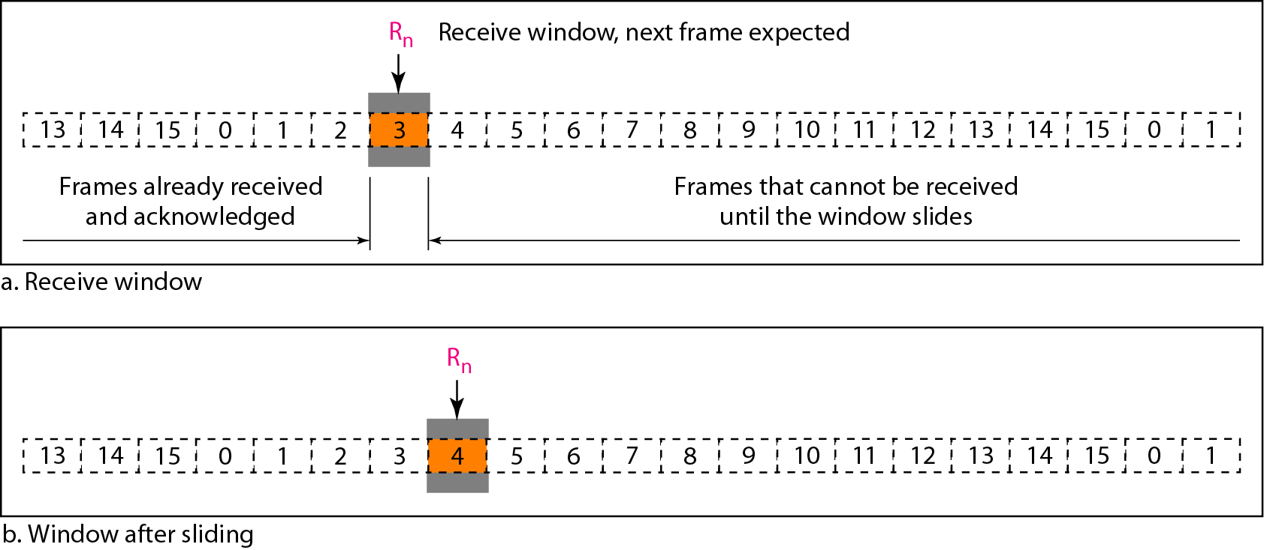
Receiver Sliding Window
The receive window makes sure that the correct data frames are received and that the correct acknowledgments are sent.
The size of the receive window is always 1.
The receiver is always looking for the arrival of a specific frame.
Any frame arriving out of order is discarded and needs to be resent.

Slide 10
Receiver Sliding Window
Note that we need only one variable Rn (receive window, next frame expected) to define this.
The sequence numbers to the left of the window belong to the frames already received and acknowledged; the sequence numbers to the right of this window define the frames that cannot be received.
Any received frame with a sequence number in these two regions is discarded; only a frame with a sequence number matching the value of Rn is accepted and acknowledged.
The receive window also slides, but only one slot at a time.
When a correct frame is received, the window slides.

Slide 11
Acknowledgment
Note The receiver sends a positive acknowledgment if a frame has arrived safe and sound and in order.
If a frame is damaged or is received out of order, the receiver is silent and will discard all subsequent frames until it receives the one it is expecting.
The silence of the receiver causes the timer of the unacknowledged frame at the sender site to expire.
This, in turn, causes the sender to go back and resend all frames, beginning with the one with the expired timer.
The receiver does not have to acknowledge each frame received. It can send one cumulative acknowledgment for several frames.

Slide 12
Resending a Frame
When the timer expires, the sender resends all outstanding frames.
For example, suppose the sender has already sent frame 6, but the timer for frame 3 expires.
This means that frame 3 has not been acknowledged; the sender goes back and sends frames 3, 4, 5, and 6 again.
That is why the protocol is called Go-Back-N ARQ.

Slide 13
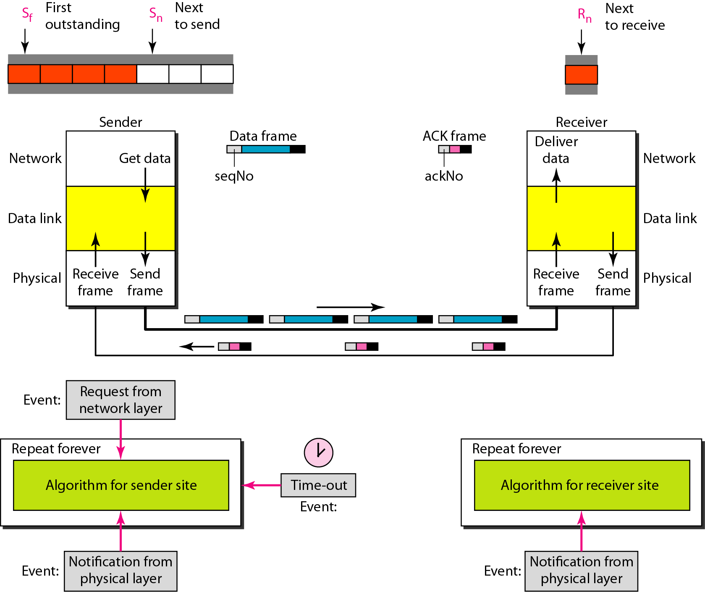
Resending a Frame
Operation
As we can see, multiple frames can be in transit in the forward direction, and multiple acknowledgments in the reverse direction.
The idea is similar to Stop-and-Wait ARQ; the difference is that the send window allows us to have as many frames in transition as there are slots in the send window.

Slide 14
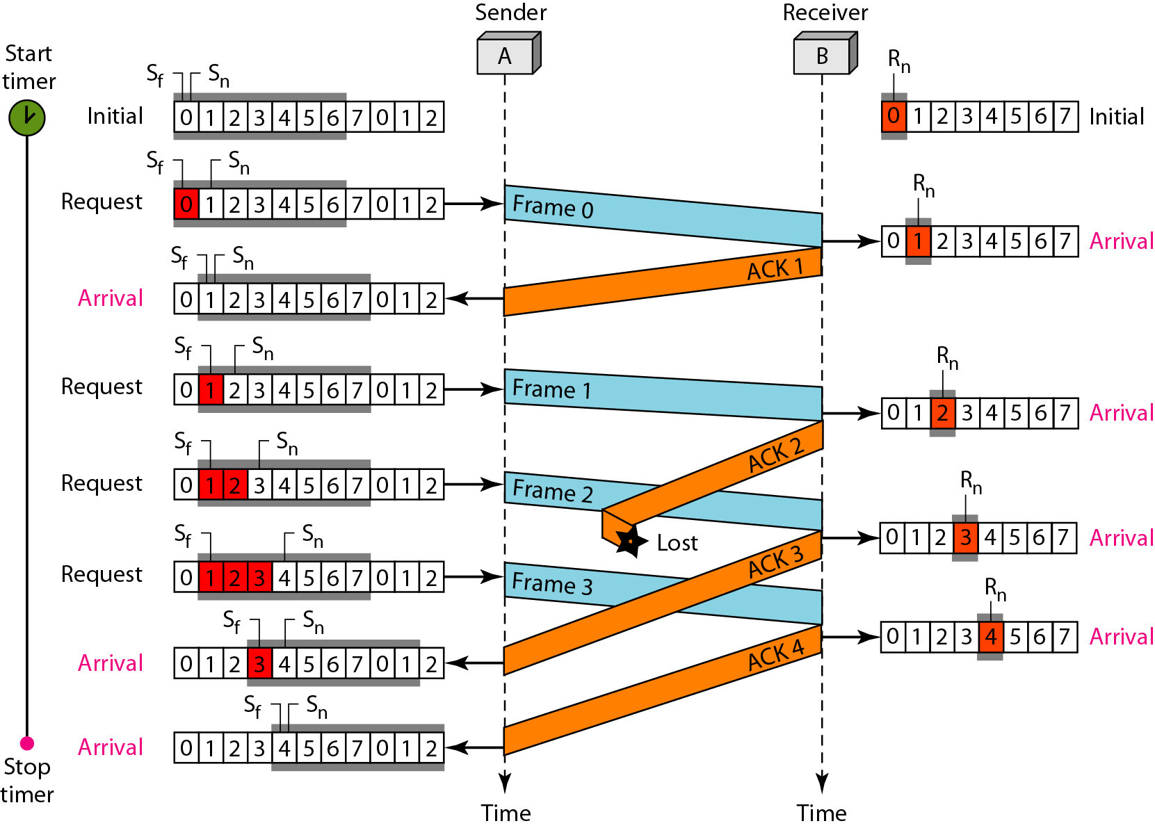
EXAMPLE (2)
This is an example of a case where the forward channel is reliable, but the reverse is not.
No data frames are lost, but some ACKs are delayed and one is lost.
m = 3
Ssize = 6
0, 1, 2, 3, 4, 5, 6, 7, 0, 1, 2, 3, 4, …
The example also shows how
cumulative acknowledgments
can help if acknowledgments are
delayed or lost.

Slide 15
EXAMPLE (2)
After initialization, there are seven sender events.
Request events are triggered by data from the network layer; arrival events are triggered by acknowledgments from the physical layer.
There is no time-out event here because all outstanding frames are acknowledged before the timer expires.
Note that although ACK2 is lost, ACK3 serves as both ACK2 and ACK3.
There are four receiver events, all triggered by the arrival of frames from the physical layer.

Slide 16
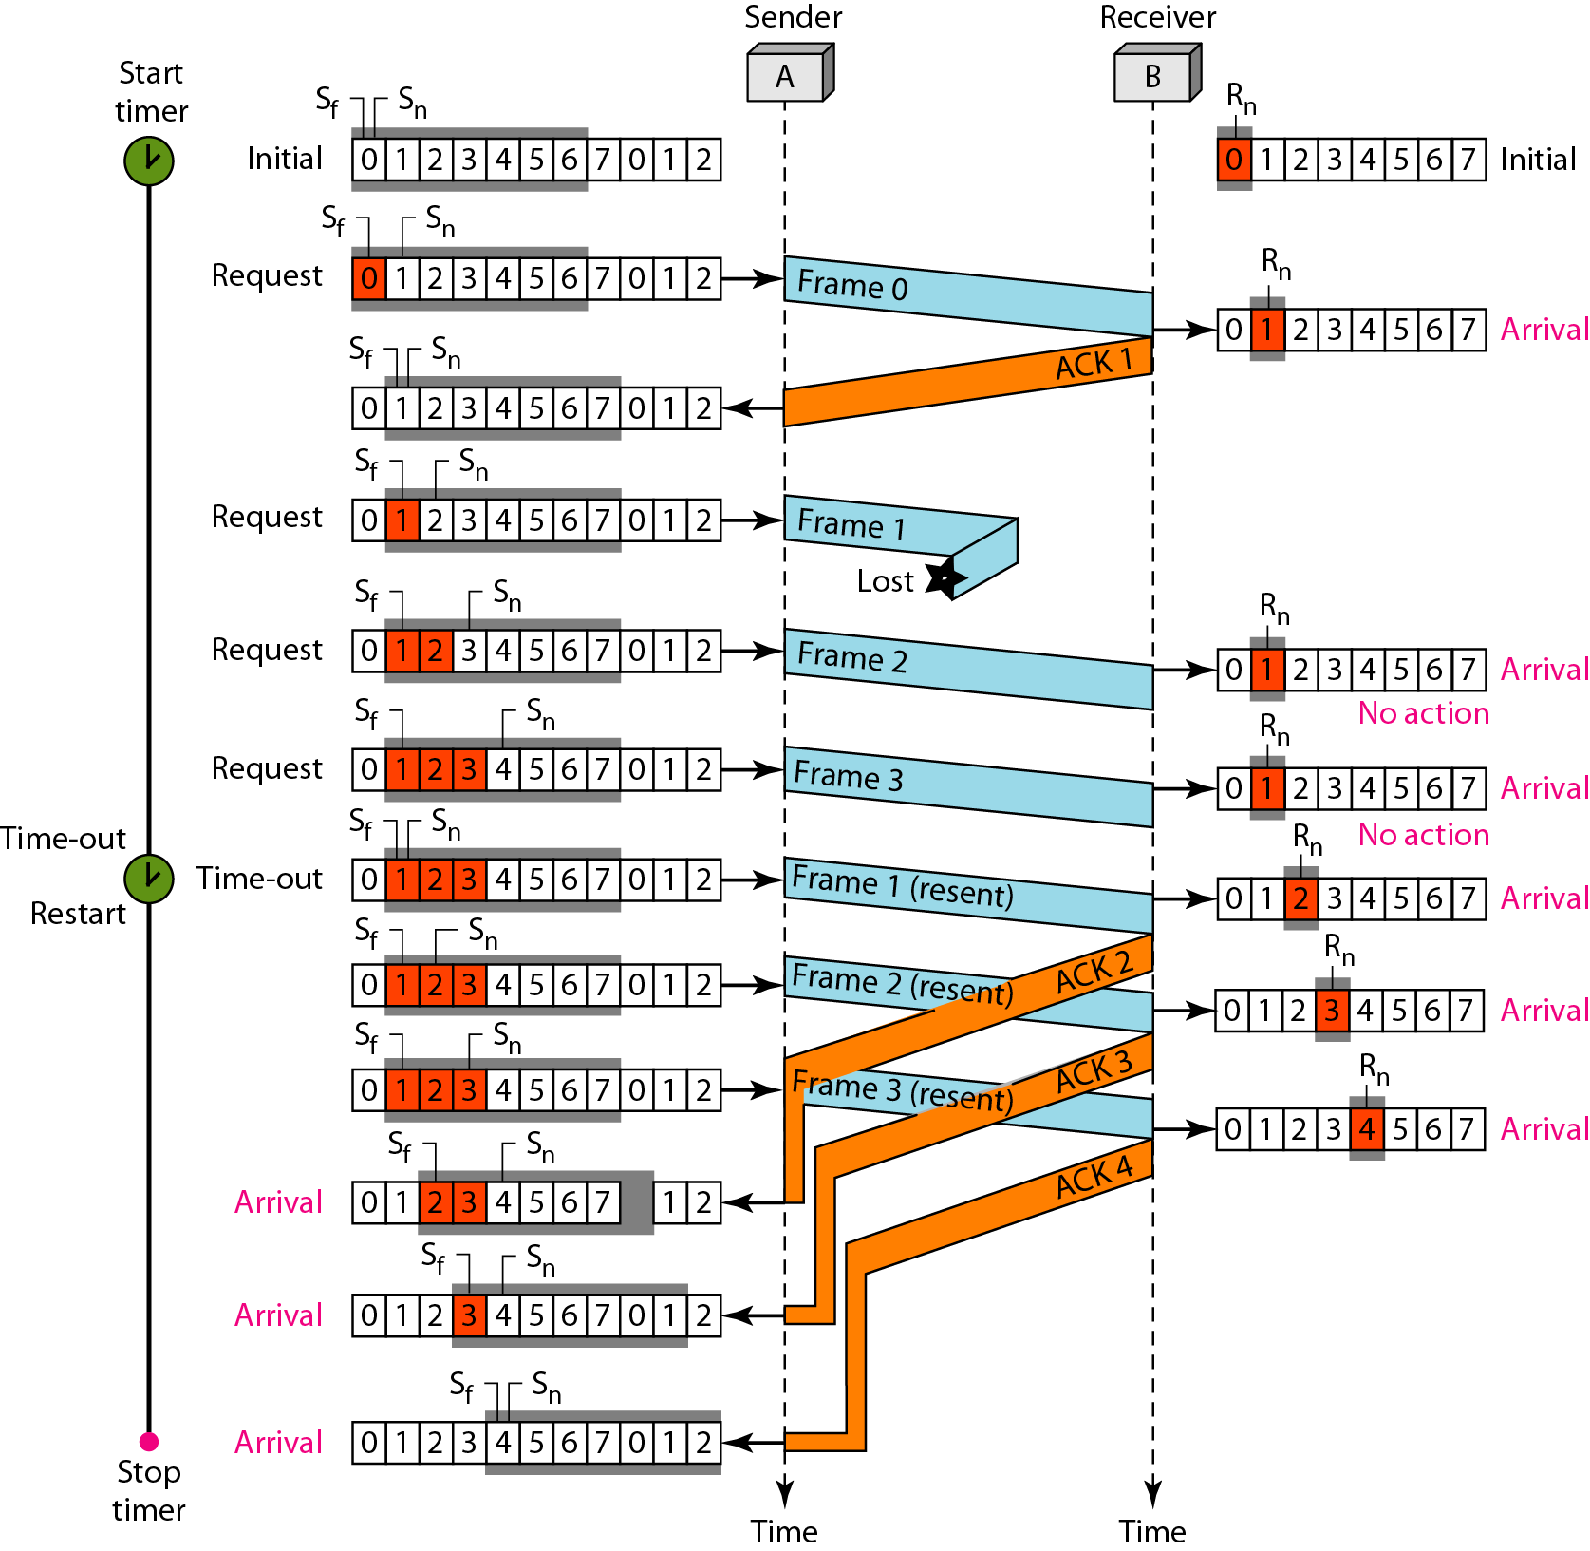
EXAMPLE (3)
This example shows what happens when a frame is lost.
Frames 0, 1, 2, and 3 are sent.
However, frame 1 is lost.

Slide 17
EXAMPLE (3)
The receiver receives frames 2 and 3, but they are discarded because they are received out of order (frame 1 is expected).
The sender receives no acknowledgment about frames 1, 2, or 3.
Its timer finally expires.

Slide 18
EXAMPLE (3)
The sender sends all outstanding frames (1, 2, and 3) because it does not know what is wrong.
Note that the resending of frames l, 2, and 3 is the response to one single event.
When the sender is responding to this event, it cannot accept the triggering of other events.
This means that when ACK 2 arrives, the sender is still busy with ending frame 3.

Slide 19
EXAMPLE (3)
The physica1layer must wait until this event is completed and the data link layer goes back to its sleeping state.
We have shown a vertical line to indicate the delay. I
t is the same story with ACK 3; but when ACK 3 arrives, the sender is busy responding to ACK 2.
It happens again when ACK 4 arrives.
Note that before the second timer expires, all outstanding frames have been sent and the timer is stopped.

Slide 21
Go-Back-N ARQ simplifies the process at the receiver site.
The receiver keeps track of only one variable, and there is no need to buffer out-of-order frames; they are simply discarded.
However, this protocol is very inefficient for a noisy link.
In a noisy link a frame has a higher probability of damage, which means the resending of multiple frames.
This resending uses up the bandwidth and slows down the transmission.
For noisy links, we need for another mechanism that does not resend N frames when just one frame is damaged; only the damaged frame is resent.

Slide 22
Computer Networks
Chapter Seven
DATA LINK LAYER
Data Link Control and Protocols (Part II c)
Thanks
Asst. Prof. Dr. Mazin S. Al-Hakeem

