Slide 1
3
Computer Networks
Chapter Seven
DATA LINK LAYER
Data Link Control and Protocols
(Part II b)
Asst. Prof. Dr. Mazin S. Al-Hakeem

Slide 2
Data Link Control and Protocols (II b)
Protocols
Noiseless (error-free) Channels
Noisy (error-creating) Channels
Noisy (error-creating) Channels
Stop-and-Wait ARQ Protocol
Noiseless (error-free) Channels
Go-Back-N ARQ Protocol
Simplest Protocol
Selective Repeat ARQ Protocol
Stop-and-Wait Protocol

Slide 3
7.6- Protocols
Noiseless (error-free) Channels
Noisy (error-creating) Channels
Noiseless channels are the ideal channel in which no frames are lost, duplicated, or corrupted.
We will introduce two protocols for this type of channel.
The first is a protocol that does not use flow control (Simplest Protocol); the second is the one that does (Stop-and-Wait Protocol).
Of course, neither has error control because we have assumed that the channel is a perfect noiseless channel.
Although the Stop-and-Wait Protocol gives us an idea of how to add flow control to its predecessor, noiseless channels are nonexistent (i.e. the error control are ignored).
We discuss three protocols in this section that use error control.
Stop-and-Wait ARQ
Go-Back-N ARQ
Selective Repeat ARQ

Slide 4
7.6- Protocols
7.6.2- Noisy (error-creating) Channels
A. Stop-and-Wait ARQ Protocol
7.5.2- Error Control
Error control in the data link layer is often implemented simply.
Any time an error is detected in an exchange, specified frames are retransmitted.
This process is called Automatic Repeat Request (ARQ).

Slide 5
7.6- Protocols
7.6.2- Noisy (error-creating) Channels
A. Stop-and-Wait ARQ Protocol
This protocol called the Stop-and-Wait Automatic Repeat Request, adds a simple error control mechanism to the Stop-and-Wait Protocol.
Error correction is done by keeping a copy of the sent frame and at the same time, it starts a timer.
If the timer expires and there is no ACK for the sent frame, the frame is resent, the copy is held, and the timer is restarted.

Slide 6
Sequence Numbers (seqNo & ackNo)
For identification purpose, both data frames and ACK frames are numbered by using sequence numbers.
A field is added to the data frame to hold the sequence number of that frame.
In Stop-and-Wait ARQ the sequence numbers are based on modulo-2 arithmetic.
So the sequence numbers are:
0, 1, 0, 1, 0, 1, 0, 1, 0, 1, 0, 1, 0, 1, 0, 1 ...
For example, if frame 0 has arrived safe and sound, the receiver sends an ACK frame with acknowledgment 1 (meaning frame 1 is expected next).
If frame 1 has arrived safe and sound, the receiver sends an ACK frame with acknowledgment 0 (meaning frame 0 is expected).

Slide 7
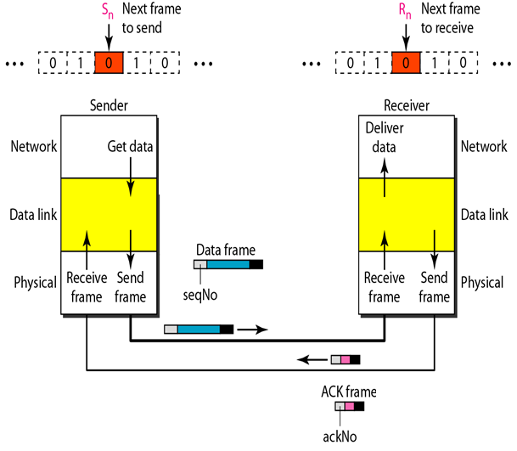
7.6- Protocols
Operation
7.6.2- Noisy (error-creating) Channels
A. Stop-and-Wait ARQ Protocol
The sending device keeps a copy of the last frame transmitted until it receives an acknowledgment for that frame.
A data frames uses a seqNo (sequence number); an ACK frame uses an ackNo (acknowledgment number).
The sender has a control variable, which we call Sn that holds the sequence number for the next frame to be sent (0 or 1). The receiver has a control variable, which we call Rn that holds the number of the next frame expected.
When a frame is sent, the value of Sn is incremented (modulo-2), which means if it is 0, it becomes 1 and vice versa. When a frame is received, the value of Rn is incremented (modulo-2), which means if it is 0, it becomes 1 and vice versa.

Slide 8
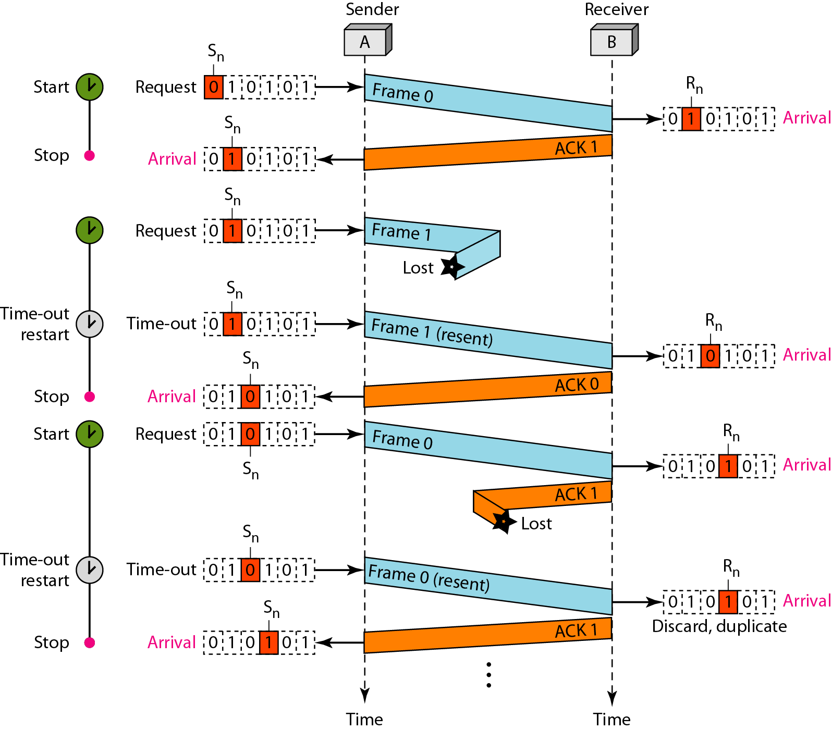
EXAMPLE (1)
Frame (0) is sent and acknowledged.
Frame 1 is lost and resent after the time-out.
The resent frame 1 is acknowledged and the timer stops.
Frame (0) is sent and acknowledged, but the acknowledgment is lost.
The sender has no idea if the frame or the acknowledgment is lost, so after the time-out, it resends frame (0), which is acknowledged.

Slide 9
Stop-and-Wait ARQ
modulo-2
0, 1, 0, 1, …

Slide 10
Stop-and-Wait ARQ
modulo-2
0, 1, 0, 1, …

Slide 11
Stop-and-Wait ARQ
modulo-2
0, 1, 0, 1, …

Slide 12
Computer Networks
Chapter Seven
DATA LINK LAYER
Data Link Control and Protocols (Part II b)
Thanks
Asst. Prof. Dr. Mazin S. Al-Hakeem

