Slide 1
1
Computer Networks
Chapter Seven
DATA LINK LAYER
Data Link Control and Protocols
(Part I)
Asst. Prof. Dr. Mazin S. Al-Hakeem

Slide 2
Data Link Control and Protocols (I)
Framing
Protocols
Fixed-Size Framing
Noiseless Channels Protocols
Variable-Size Framing
Noisy Channels Protocols
Flow and Error Control
Flow Control
Error Control

Slide 3
7.1- Introduction
The two main functions of the data link layer are data link control and media access control
The second function of the data link layer is media access control, or how to share the link.

Slide 4
7.1- Introduction
The two main functions of the data link layer are data link control and media access control
The first function, data link control, deals with the design and procedures for communication between two adjacent nodes: node-to-node communication.
Data link control functions include framing, flow and error control, and software implemented protocols that provide smooth and reliable transmission of frames between nodes.

Slide 5
7.1- Introduction
The two main functions of the data link layer are data link control and media access control
The first function, data link control, deals with the design and procedures for communication between two adjacent nodes: node-to-node communication.
To implement data link control, we need protocols
Each protocol is a set of rules that need to be implemented in software and run by the two nodes involved in data exchange at the data link layer.

Slide 6
7.2- Framing (The 1st Function)
The data link layer pack bits into frames, so that each frame is distinguishable from another.
Our postal system practices a type of framing.
The simple act of inserting a letter into an envelope separates one piece of information from another; the envelope serves as the delimiter.
Framing in the data link layer separates a message from one source to a destination, by adding a sender address and a destination address.
The destination address defines where the packet is to go; the sender address helps the recipient acknowledge the receipt.

Slide 7
Although the whole message could be packed in one frame; this is not normally done.
One reason is that a frame can be very large, making flow and error control very inefficient.
When a message is carried in one very large frame, even a single-bit error would require the retransmission of the whole message.
When a message is divided into smaller frames, a single-bit error affects only that small frame.

Slide 8
Framing
Variable-Size Framing
Fixed-Size Framing
In variable-size framing, we need a way to define the end of the frame and the beginning of the next.
Our main discussion in this chapter concerns variable-size framing, prevalent in local area networks (LAN).
In fixed-size framing, there is no need for defining the boundaries of the frames; the size itself can be used as a delimiter.
An example of this type of framing is the ATM wide-area network (WAN), which uses frames of fixed size called cells.
Historically, two approaches were used for this purpose:
a character-oriented approach and
a bit-oriented approach.

Slide 9
Framing
Fixed-Size Framing
Character-oriented framing was popular when only text was exchanged by the data link layers.
Variable-Size Framing
Character-Oriented Approach
In a character-oriented protocol,
Data to be carried are 8-bit characters from a coding system such as ASCII code.
The header, which normally carries the source and destination addresses and other control information, and
The trailer, which carries error detection or error correction redundant bits, are also multiples of 8 bits.

Slide 10
Framing
Fixed-Size Framing
Variable-Size Framing
Character-Oriented Approach
To separate one frame from the next, an 8-bit flag is added at the beginning and the end of a frame.
The flag, composed of protocol-dependent special characters, signals the start or end of a frame.

Slide 11
Framing
Fixed-Size Framing
The flag could be selected to be any character not used for text communication
Variable-Size Framing
Character-Oriented Approach
To separate one frame from the next, an 8-bit flag is added at the beginning and the end of a frame.
The flag, composed of protocol-dependent special characters, signals the start or end of a frame.

Slide 12
Framing
Fixed-Size Framing
Character-oriented framing framing was popular when text, graphic, audio, video, and so on was exchanged by the data link layers.
Variable-Size Framing
Bit-Oriented Approach
In a bit-oriented protocol,
The data section of a frame is a sequence of bits to be interpreted by the upper layer as text, graphic, audio, video, and so on.
However, in addition to headers (and possible trailers), we still need a delimiter to separate one frame from the other.

Slide 13
Framing
Fixed-Size Framing
The flag is a special 8-bit pattern
flag 01111110
Variable-Size Framing
Bit-Oriented Approach
Most protocols use a special 8-bit pattern flag 01111110 as the delimiter to define the beginning and the end of the frame

Slide 14
Bit Stuffing
flag 01111110
If the flag pattern appears in the data, we need to somehow inform the receiver that this is not the end of the frame.
We do this by stuffing 1 single bit (instead of 1 byte) to prevent the pattern from looking like a flag. The strategy is called bit stuffing.
In bit stuffing, if a 0 and five consecutive 1 bits are encountered, an extra 0 is added.
This extra stuffed bit is eventually removed from the data by the receiver. Note that the extra bit is added after one 0 followed by five 1s regardless of the value of the next bit. This guarantees that the flag field sequence does not inadvertently appear in the frame

Slide 15
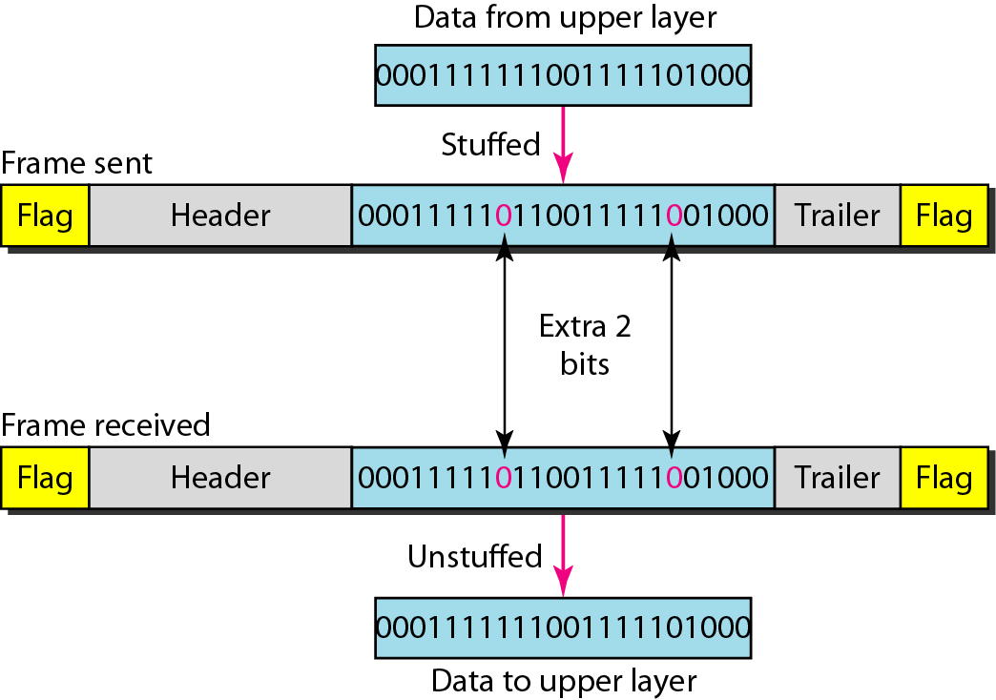
Bit Stuffing
Figure :Bit stuffing and unstuffing

Slide 16
Framing
Fixed-Size Framing
Variable-Size Framing
Character-Oriented Approach → special characters
Bit-Oriented Approach → 01111110
Bit Stuffing

Slide 17
7.5- Flow and Error Control (The 2nd Function)
The most important responsibilities of the data link layer are flow control and error control. Collectively, these functions are known as data link control.
Error control is both error detection and error correction. It allows the receiver to inform the sender of any frames lost or damaged in transmission and coordinates the retransmission of those frames by the sender.
Flow control refers to a set of procedures used to restrict the amount of data that the sender can send before receiving an acknowledgment ,
and is one of the most important duties of the data link layer.

Slide 18
7.5- Flow and Error Control (The 2nd Function)
7.5.1- Flow Control
Flow control refers to a set of procedures used to restrict the amount of data that the sender can send before receiving an acknowledgment ,
The flow of data must not be allowed to overwhelm the receiver

Slide 19
7.5- Flow and Error Control (The 2nd Function)
7.5.1- Flow Control
Any receiving device has a limited speed at which it can process incoming data and a limited amount of memory in which to store incoming data.
The receiving device must be able to inform the sending device before those limits are reached and to request that the transmitting device send fewer frames or stop temporarily.
Incoming data must be checked and processed before they can be used.

Slide 20
7.5- Flow and Error Control (The 2nd Function)
7.5.1- Flow Control
The rate of such processing is often slower than the rate of transmission.
For this reason, each receiving device has a block of memory, called a buffer, reserved for storing incoming data until they are processed.
If the buffer begins to fill up, the receiver must be able to tell the sender to halt transmission until it is once again able to receive.

Slide 21
7.5- Flow and Error Control (The 2nd Function)
7.5.2- Error Control
Error control is both error detection and error correction. It allows the receiver to inform the sender of any frames lost or damaged in transmission and coordinates the retransmission of those frames by the sender.
In the data link layer, the term error control refers primarily to methods of error detection and retransmission.

Slide 22
7.5- Flow and Error Control (The 2nd Function)
7.5.2- Error Control
Error control in the data link layer is often implemented simply.
Any time an error is detected in an exchange, specified frames are retransmitted.
This process is called Automatic Repeat Request (ARQ).

Slide 23
Flow and Error Control
The rate of such processing is often slower than the rate of transmission
set of procedures used to restrict the amount of data
Flow Control
Error Control
Automatic Repeat Request (ARQ)

Slide 24
7.6- Protocols
Now let us see how the data link layer can combine framing, flow control, and error control to achieve the delivery of data from one node to another.
The protocols are divided into those that can be used for noiseless (error-free) channels and those that can be used for noisy (error-creating) channels.

Slide 25
7.6- Protocols
Noiseless (error-free) Channels
Noisy (error-creating) Channels
Noiseless channels are the ideal channel in which no frames are lost, duplicated, or corrupted.
We will introduce two protocols for this type of channel.
The first is a protocol that does not use flow control (Simplest Protocol); the second is the one that does (Stop-and-Wait Protocol).
Of course, neither has error control because we have assumed that the channel is a perfect noiseless channel.
Although the Stop-and-Wait Protocol gives us an idea of how to add flow control to its predecessor, noiseless channels are nonexistent (i.e. the error control are ignored).
We discuss three protocols in this section that use error control.
Stop-and-Wait ARQ
Go-Back-N ARQ
Selective Repeat ARQ

Slide 26
Protocols
Noiseless Channels Protocols
Noisy Channels Protocols

Slide 27
Computer Networks
Chapter Seven
DATA LINK LAYER
Data Link Control and Protocols (Part I)
Thanks
Asst. Prof. Dr. Mazin S. Al-Hakeem

