Slide 1
Digital signal processing
Done By:
Issraa Jwad Kazim
Lec. 8

Slide 2
PROPERTIES OF THE Z TRANSFORM
Some of the important properties of the z transform are stated below :
1) Linearity property:

Slide 3
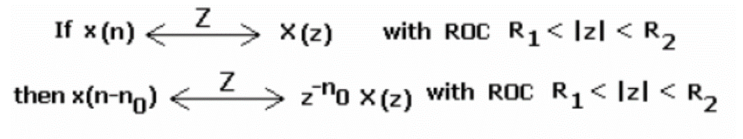
2) Time shifting property :

Slide 4
3) Multiplication by an exponential (an) :
4) Multiplication by a ramp (Differentiation in the z-domain) :
5) Time reversal property:

Slide 5
6)Convolution in Time domain:

Slide 6
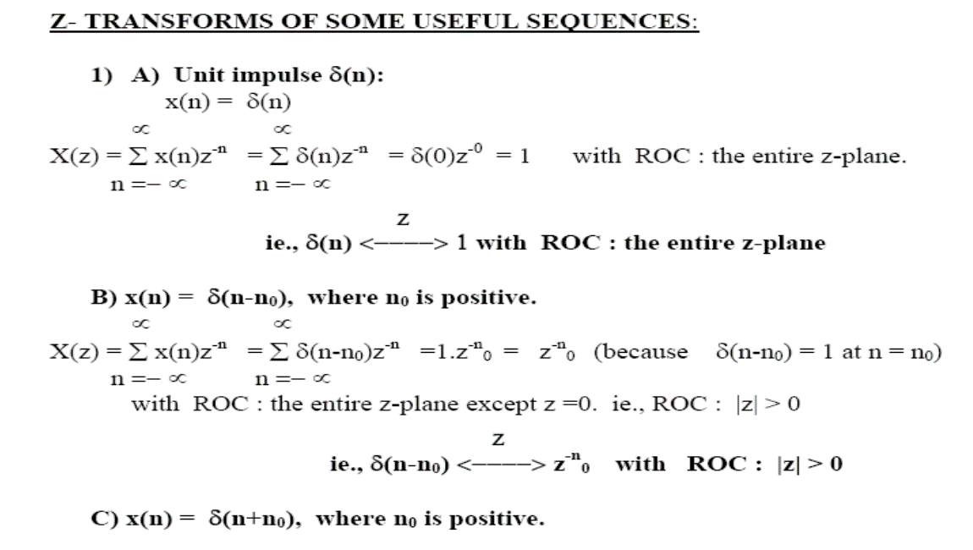

Slide 7
The z-transform of the above sequence has already been found as
X(z) = z/z-a, with ROC : |z|>|a| .
3) x(n) = -bn u(-n-1)
The z-transform of the above sequence has been found as ;
X(z) = z/z-b, with ROC : |z| <|b| .

Slide 8
4) x(n) = u(n) (Unit step sequence):

Slide 9
ie., X(z) = z / (z-1) , with |z| < 1 which defines the ROC of the z transform.
The ROC in this case, is the interior of a circle of radius ‘1.
6) Unit ramp sequence : x(n) = n u(n)
We use differentiation property of z transform to solve this problem:
The property states that

