Slide 1
Digital signal processing
Done By:
Issraa Jwad Kazim
Lec.6

Slide 9
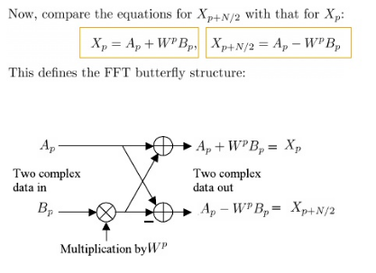

Slide 11
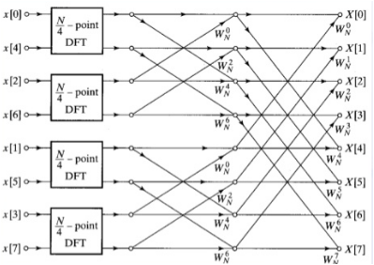

Slide 12
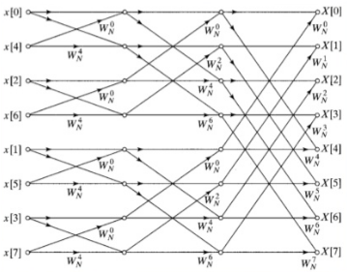

Slide 13
