Slide 1
Digital signal processing
Done By:
Issraa Jwad Kazim
Lec. 5

Slide 3
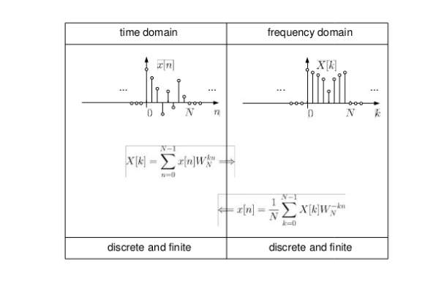

Slide 12
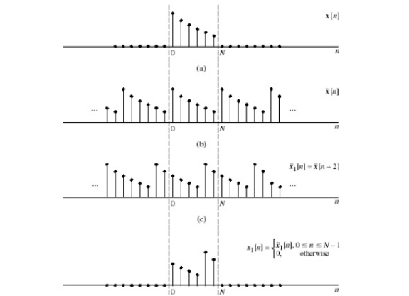

Slide 13
