Slide 1
Digital signal processing
Done By:
Issraa Jwad Kazim
Lec.3

Slide 6
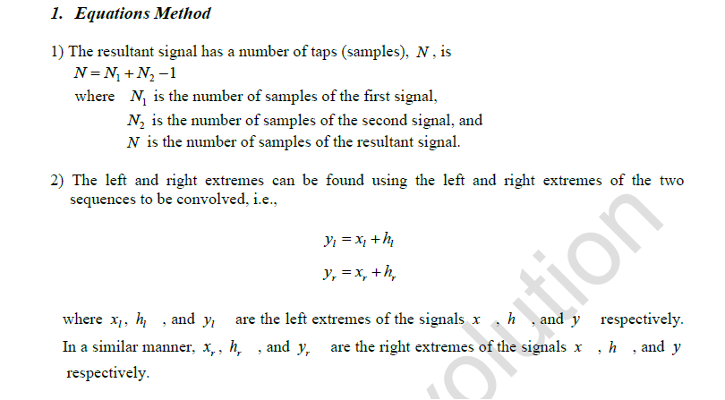

Slide 8
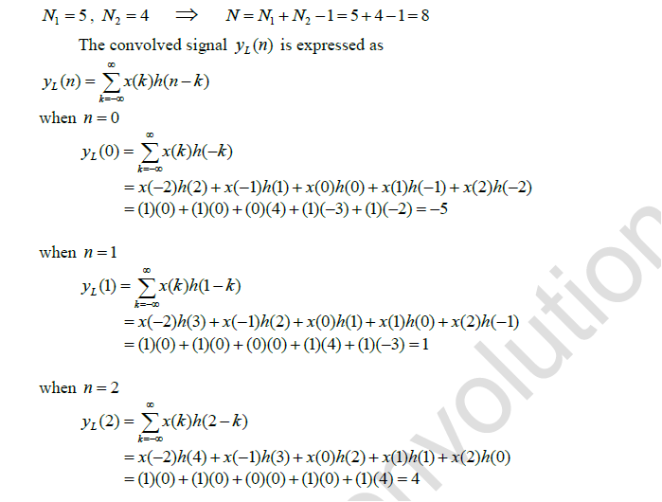

Slide 9
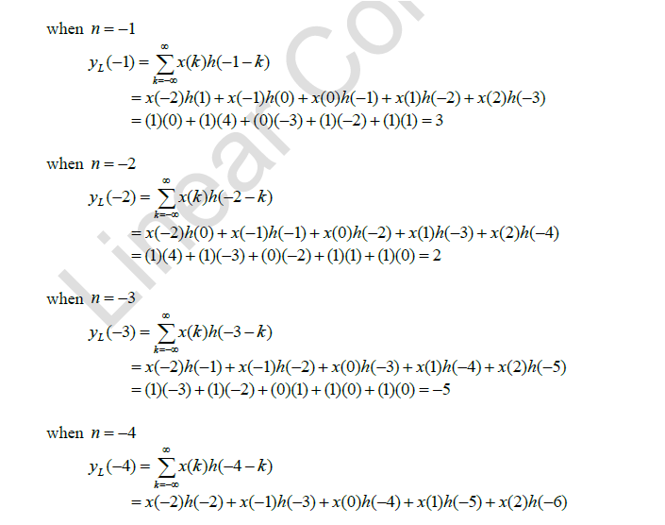

Slide 10
