Slide 1
Digital signal processing
Done By:
Issraa Jwad Kazim
Lec. 10

Slide 2
5-5 Z-Transform & System Difference Equation

Slide 3
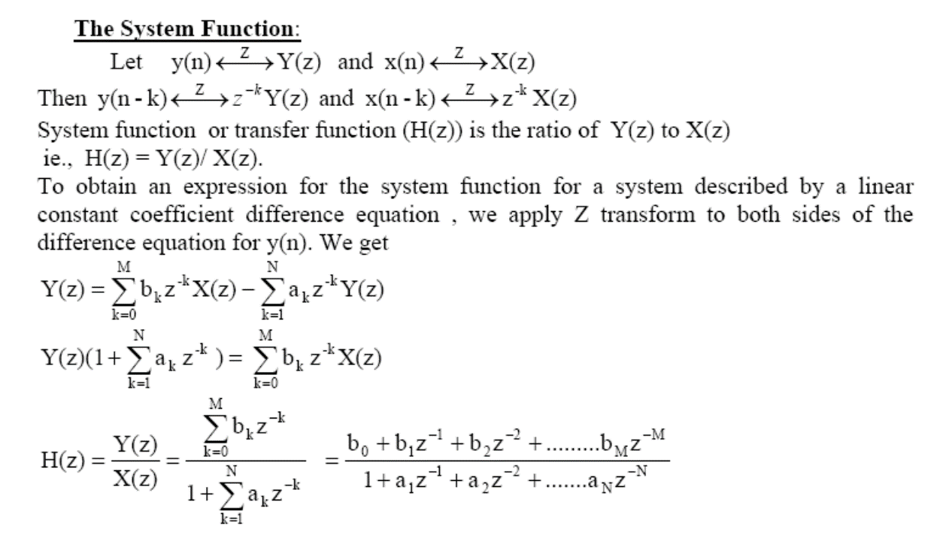

Slide 4
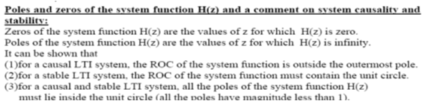

Slide 5
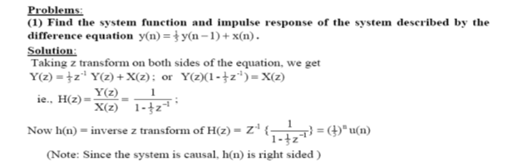

Slide 6
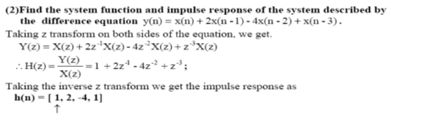

Slide 7
Problem:
Determine the pole – zero plot for the causal system described by the difference
equation and check its stability
Solution:
Find the system function H(z) by taking z transform on both sides of the equation.
We get
The system function has two zeros at z = 0, z = 1 and two poles at z = ½ and z = ¼ .
since the system is causal, its impulse response h(n) =0 for n<0. ie., it is a right sided sequence. Hence the ROC of H(z) is outside the largest pole ie., |z|> ½ .
Now since the ROC is outside the circle of radius ½ in the z plane, it contains the unit circle. Hence it is stable.
In other words, we see that all the poles of H(z) ( ½ and ¼) are inside the unit circle, since their magnitudes are less than 1.So
this system is both causal and stable.

Slide 8
Frequency Response & Z-Transform of LTI System
Frequency response of a LTI system is defined as the
Discrete Time Fourier Transform (DTFT) of its impulse
response h[n] and denoted as H(w) .
Now, DTFT of is a Z transform evaluated on the unit circle:
So the system function of the LTI system evaluated on the unit circle gives its frequency response.
The frequency response of an LTI system is ,in general, a complex number. So it has a magnitude part and a phase part as given previously.

Slide 9
Example:
Evaluate the frequency response, magnitude and phase responses of the

