Slide 1
Digital signal processing
Done By:
Issraa Jwad Kazim
Lec.1

Slide 2
What is Dsp?
processing

Slide 3
example

Slide 4
Analog signal
Type of signals
Digital signal

Slide 5
Classification of signal
1-continuous and discrete signal
2-perodic and non-perodic signal
3-odd and even signal
4-deterministic and random signal

Slide 6
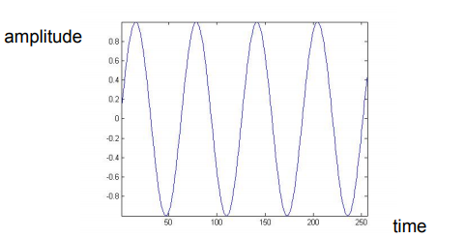
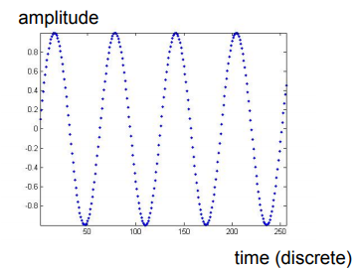
1-continuous and discrete signal

Slide 7
discrete signal

Slide 8
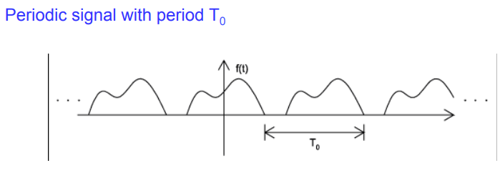
2-perodic and non-parodic signal

Slide 9
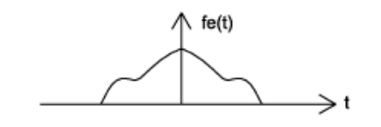
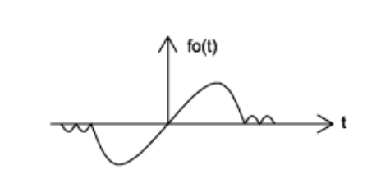
3-Even and Odd signal

Slide 10
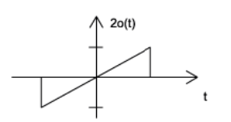
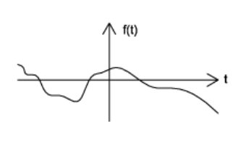
4-deterministic and random signal

Slide 11
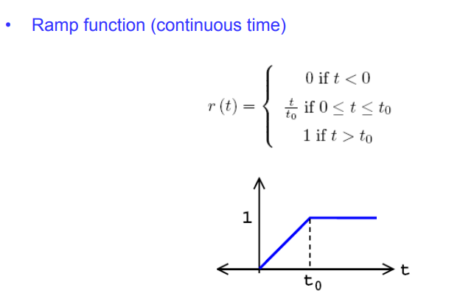

Slide 12
