Slide 1


Electronic branch
Fourth Class
Interface Circuits Design
Analog to Digital Converters
Asst. Lec. Lubna A. Alnabi

Slide 2
Analog to Digital Converters
What is Analog to Digital Converters (ADC)?
(ADC) are an electronic integrated circuit (IC) which transforms a signal from analog to digital form.

Slide 3
Analog to Digital Converters
All microprocessors works with digital signal so ADC Provides a link between the analog and the digital worlds of signal processing.
Why ADC is needed?

Slide 4
Analog to Digital Converters
What is ADC classification ?
1) The first group includes SAR, and flash-type converters.
2) The second group includes integrator and voltage to frequency converters.

Slide 5
Analog to Digital Converters
What is the tradeoff between ADC groups?
Accuracy
Speed

Slide 6
Analog to Digital Converters
What is the uses of ADC (successive- approximation and the Integrator)?
successive-approximation is used as data loggers
The integrator types are
used as digital meter

Slide 7
Analog to Digital Converters
Sampling and Holding
What is ADC process?
Quantizing and Encoding

Slide 8
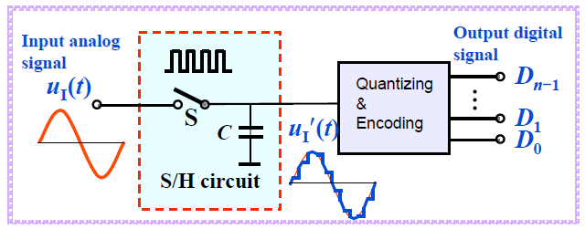
Analog to Digital Converters

Slide 9
Analog to Digital Converters
Sampling and Holding:-
It is a process of taking a sufficient number of discrete values at point on a waveform that will define the shape of waveform.

Slide 10
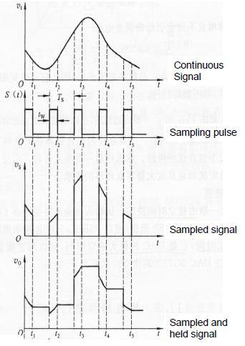

Slide 11
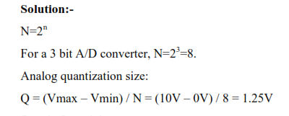
For a 3 bit A/D, with Vmin=0 V, V max=10 V, what is the code-word for Vin=5.7 Volts?

Slide 12
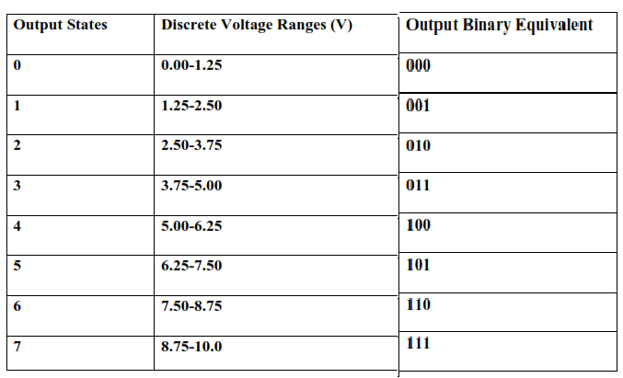

Slide 13
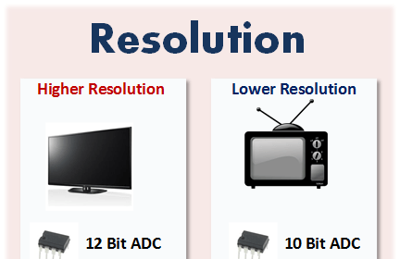
Analog to Digital Converters
Resolution:-
Resolution is the number of bits used for conversion (8 bits, 12 bits, …)

Slide 14
Analog to Digital Converters
How to increase Accuracy of A/D Conversion?
Increasing the resolution
Increasing the sampling

Slide 15
Flash A/D Converter
What is flash A/D Converter Components
Resistors use the resistors to form a ladder voltage divider
2) Comparators comparing input signal to reference voltage.
3) Priority encoder produces a binary output.

Slide 16
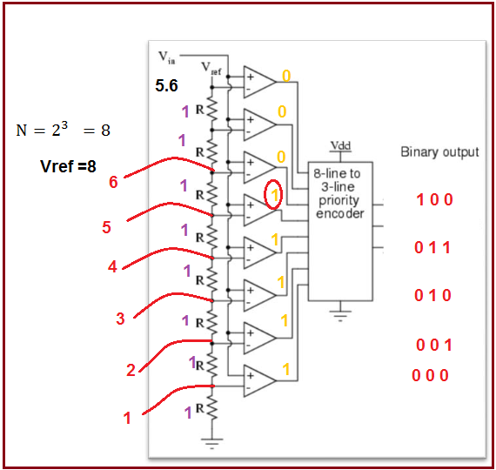
Find the code-word for a 3 bit, flash A/D with Vref=8V with Vin=5.6V.

Slide 17
How does Flash A/D work?
1- Vref is divided over the resistors
2- The voltage on the resistors is compared with Vin
3- The output of the comparator is fed to the priority encoder.

Slide 18
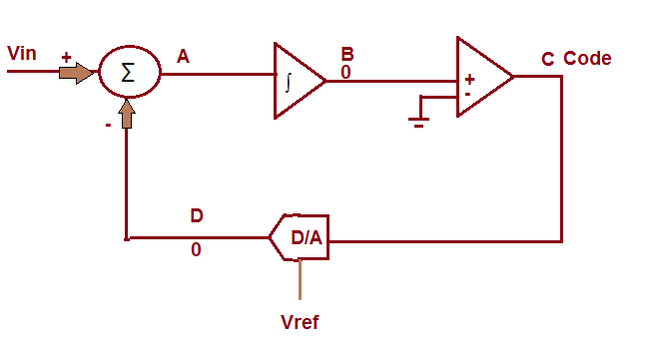
What is sigma delta A/D Converter Components draw the CCT
1- Adder
2- Integrator
3- Comparator
4- D/A

Slide 19
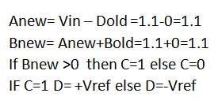
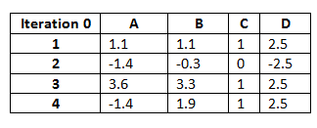
Find the code-word for a 4 bit, sigma-delta A/D with Vref=2.5V with Vin=1.1V.

Slide 20
How does dual slope work?
1- Control Logic switches to Vin and starts the counter.
2- Charging starts and lasts for Tch.
3- Control logic Switches to -Vref and restart the counter.
4- Discharge for Tdis until reaches the threshold and Enable output latch.

Slide 21
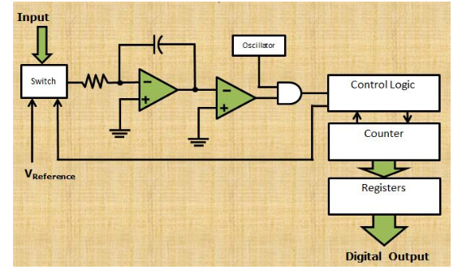
What is dual slope A/D Converter Components draw the CCT
Integrator
Electronically Cont
Counter
Clock
Control Logic
Comparator

Slide 22
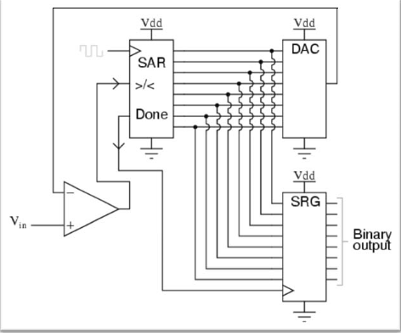
What is SAR A/D Converter Components draw the CCT
1Comparator
2- SAR unit
3- DAC
4- Output Register

Slide 23
Find the code-word for a 5 Bit SAR A/D with Vin=0.6V while Vref=1V.
MSB (bit 5)
Vref /2
If Vin > than Vref /2 , turn MSB on (1)
If Vin < Vref /2 , turn MSB off (0)
Vin =0.6V and V=0.5
Since Vin>V, MSB = 1 (on)
 |  |  |  | 1

Slide 24
Next Calculate (bit 4)
V=Vref/2 + Vref/4= 0.5+0.25 =0.75V
Since Vin < 0.75, bit 4= 0
(bit 3)
V=Vref/2(0.5) + Vref/8 =0.625
Since 0.6<0.625, MSB is turned off bit 3 = 0
(bit 2)
V=Vref/2(0.5) + Vref/16 =0.5625
Since 0.6>0.5625 MSB is turned off bit 2 = 1
(bit 2)
V=0.5625 + Vref/32 =0.59375
Since 0.6>0.59375 MSB is turned off bit 2 = 1
1 | 1 | 0 | 0 | 1

