Slide 1
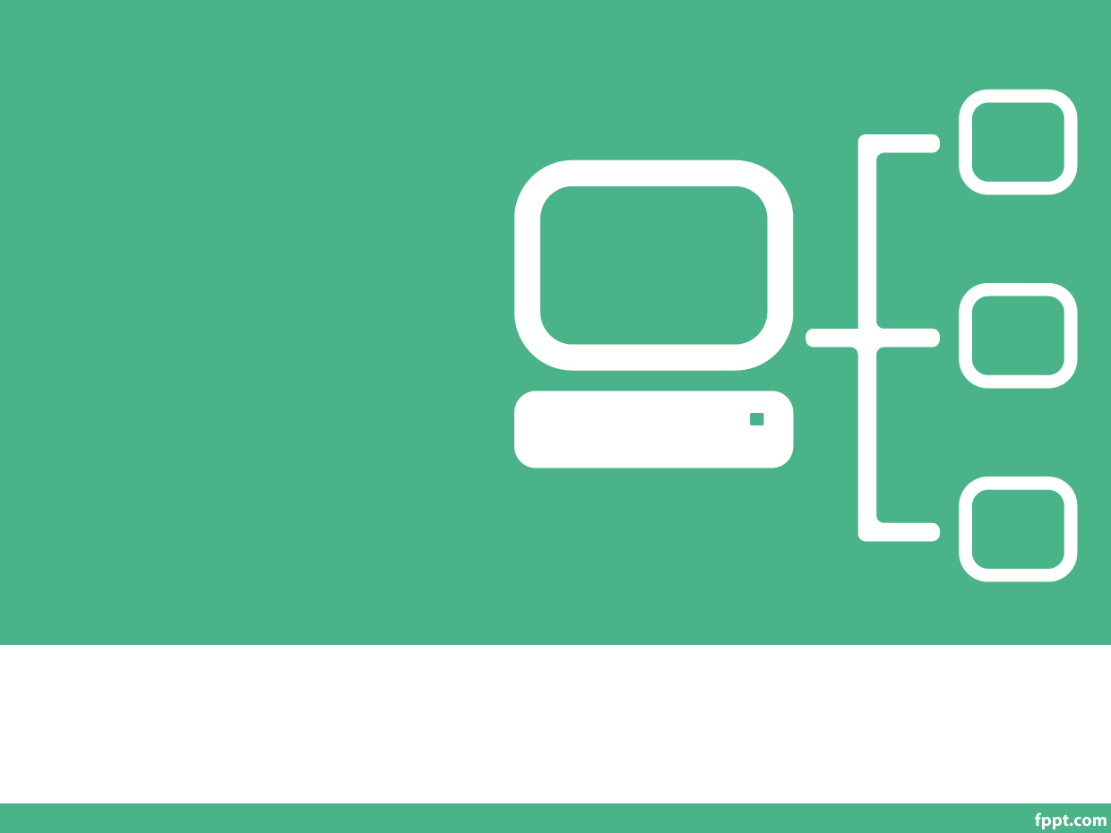
Al Mustafa University College
Computer Technology Eng. Dep.
Network Simulation
By
Asst. Lect. Omer W. Taha
Lecture 8

Slide 2
Subnet Mask
Determines which part of an IP address is the network field and which part
is the host field
Follow these steps to determine the subnet mask:
1. Express the sub network IP address in binary form.
2. Replace the network and subnet portion of the address with all 1s.
3. Replace the host portion of the address with all 0s.
4. Convert the binary expression back to dotted-decimal notation.

Slide 3
Subnet Mask
Subnet mask in decimal = 255.255.240.0

Slide 4
Subnetting
Host bits must are reassigned (or “borrowed”) as network bits.
The starting point is always the leftmost host bit.
3 bits borrowed allows 2³-2 or 6 subnets
5 bits borrowed allows 2⁵-2 or 30 subnets
12 bits borrowed allows 2¹²-2 or 4094 subnets

Slide 5
subnetmask: CIDR
CIDR: Classless Inter Domain Routing
subnet portion of address of arbitrary length
address format: a.b.c.d/x, where x is # of bits in subnet portion of address (1s) only
We will explain this in detail in later
subnet part
host part
11001000 00010111 00010000 00000000
200.23.16.0/23

Slide 6
Default Subnet Masks

Slide 7
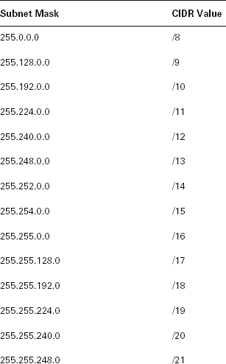
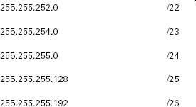
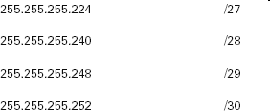
CIDR Values

Slide 8
Sub netting chart table
Mask | 128 | 64 | 32 | 16 | 8 | 4 | 2 | 1
Sub net mask value | 128 | 128+64 =192 | 128+64+ 32=224 | 224 | 240 | 248 | 252 | 254
Net Mask CA/8 | /9 | /10 | /11 | /12 | /13 | /14 | /15 | /16
Net Mask CA/16 | /17 | /18 | /19 | /20 | /21 | /22 | /23 | /24
Net Mask CA/24 | /25 | /26 | /27 | /28 | /29 | /30 | /31 | /32

Slide 9
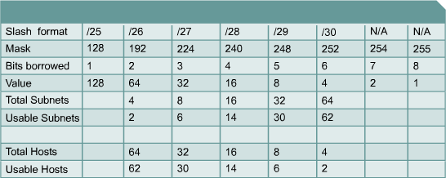
Establishing the Subnet Mask Address
To determine the number of bits to be used, the network designer needs to calculate how many hosts the largest subnetwork requires and the number of subnetworks needed.
The “slash format” is a shorter way of representing the subnet mask:
– /25 represents the 25 one bits in the subnet mask 255.255.255.128

Slide 10
Subnetting Examlpes
What is the subnet mask value for 255.255.255.0? its class C then for /25 =128, /26=192 …etc..
Read sub net mask value for /18,/22,/11?
For /18 its class B then due to table the mask is 255.255.192.0
For /22 its class B then due to table the mask is 255.255.252.0
For /11 its class A then due to table the mask is 255.244.0.0

Slide 11
Determining subnet
Example: network = 192.168.10.0/26 class c. then from table /26= 64 step i.e.
0-64-128. then | 192.168.10.0
1= | 192.168.10.64
2= | 192.168.10.128
2 subnet can be determined from this IP
Exercise: determine subnet from network 192.168.10.0/20?

Slide 12
Subnetting Class C Addresses
In a Class C address, only 8 bits are available for defining the hosts. Remember that subnet bits start at the left and go to the right, without skipping bits. This means that the only Class C subnet masks can be the following:
Binary Decimal CIDR
---------------------------------------------------------
10000000 = 128 | /25
11000000 = 192 | /26
11100000 = 224 | /27
11110000 = 240 | /28
11111000 = 248 | /29
11111100 = 252 | /30

Slide 13
Calculating the Subnetwork With ANDing
ANDing is a binary process by which the router calculates the subnetwork ID for an incoming packet.
– 1 AND 1 = 1; 1 AND 0 = 0; 0 AND 0 = 0
The router then uses that information to forward the packet across the correct interface.
Packet Address | 192.168.10.65 | 11000000.10101000.00001010.010 | 00001
Subnet Mask | 255.255.255.224 | 11111111.11111111.11111111.111 | 00000
Subnetwork Address | 192.168.10.64 | 11000000.10101000.00001010.010 | 00000

Slide 14
Understanding the Powers of 2

Slide 15
How Many Subnets?
2² = number of subnets.
X is the number of masked bits, or the 1s.
For example, in 11000000, the number of ones gives us 2² subnets. In this example there are 4 subnets.

Slide 16
How Many Hosts Per Subnet?
2^{y}-2 = number of hosts per subnet.
Y is the number of unmasked bits, or the 0s.
For example, in 11000000, the number of zeros gives us 2⁶-2 hosts. In this example, there are 62 hosts per subnet.

