Slide 1
Al Mustafa University College
Computer Technology Eng. Dep.
Network Simulation
By
Asst. Lect. Omer W. Taha
Lecture 7

Slide 2
Subnet Mask
Determines which part of an IP address is the network field and which part
is the host field
Follow these steps to determine the subnet mask:
1. Express the sub network IP address in binary form.
2. Replace the network and subnet portion of the address with all 1s.
3. Replace the host portion of the address with all 0s.
4. Convert the binary expression back to dotted-decimal notation.
60

Slide 3
Subnet Mask
Subnet mask in decimal = 255.255.240.0
61

Slide 4
IP addressing: CIDR
CIDR: Classless InterDomain Routing
subnet portion of address of arbitrary length
address format: a.b.c.d/x, where x is # of bits in subnet portion of address (1s) only
We will explain this in detail in Chapter 2
subnet part
host part
11001000 00010111 00010000 00000000
200.23.16.0/23
Network Layer
4-62

Slide 5
Subnet questions
Answer Five Simple Questions:

Slide 6
Q. What’s The Broadcast Address For Each Subnet?
The broadcast address is all host bits turned on, which is the number immediately preceding the next subnet.

Slide 7
Q. What Are The Valid Hosts?
Valid hosts are the number between the subnets, omitting all 0s and all 1s.

Slide 8
COMMUNICATION FROM HOST TO HOST
Layer 3, provides services to exchange the individual pieces of data over the network between identified end devices. To accomplish this end-to-end transport, Layer 3 uses four basic processes:
Addressing
Encapsulation
Routing
D-ecapsulation

Slide 9
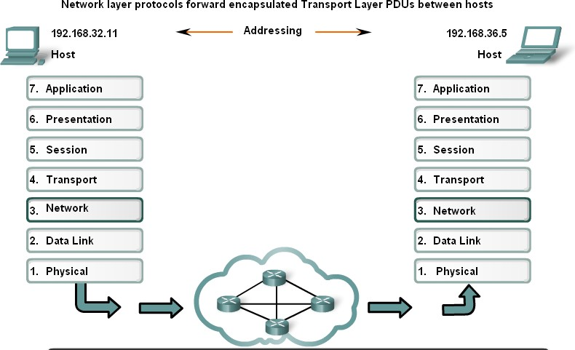

Slide 10
ROUTING
Within a network or a sub network, hosts communicate with each other without the need for any Network layer intermediary device. When a host needs to communicate with another network, an intermediary device, or router, acts as a gateway to the other network.

Slide 11
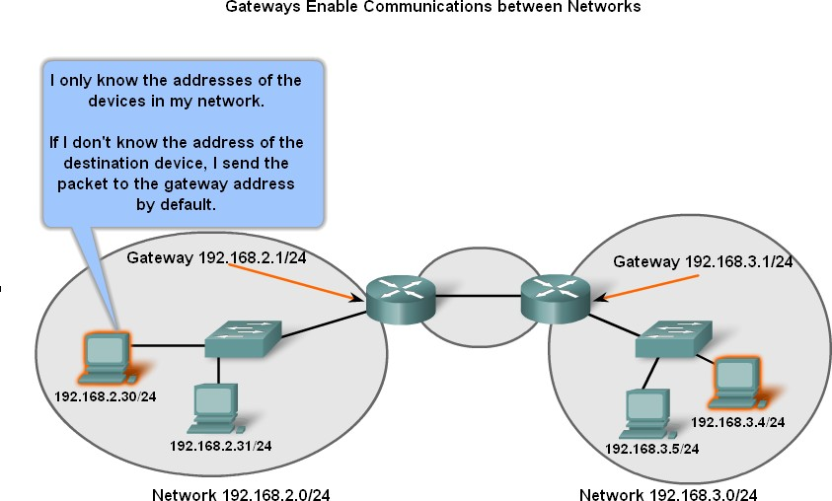

Slide 12
GATEWAY – THE WAY OUT OF OUR NETWORK
The gateway, also known as the default gateway, is needed to send a packet out of the local network. If the network portion of the destination address of the packet is different from the network of the originating host, the packet has to be routed outside the original network

Slide 13
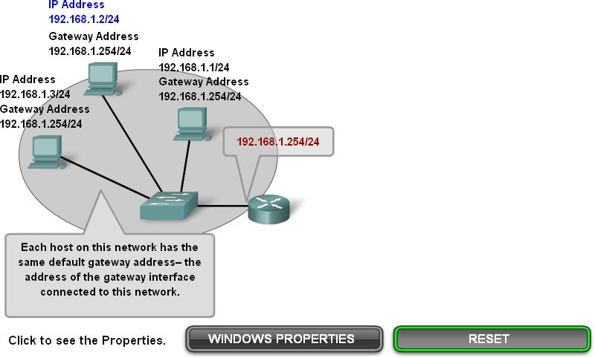
Confirming the Gateway and Route

Slide 14
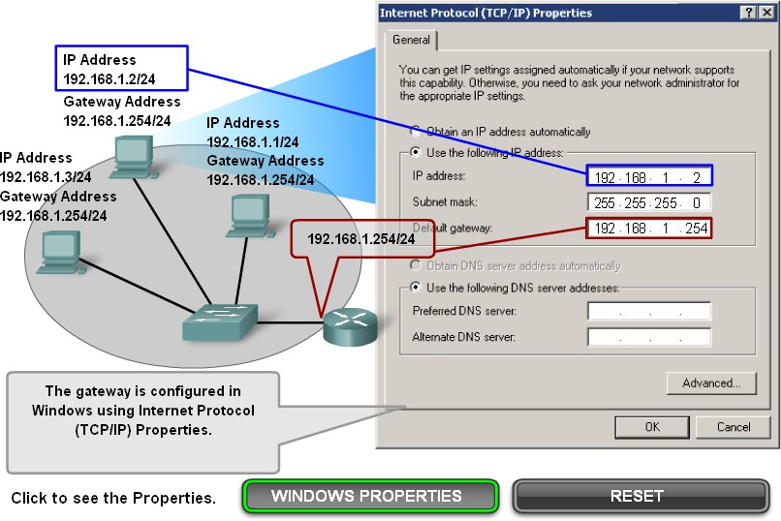

Slide 15
